Slide 1

Beware of Pridefulness
Proverbs 16:18
Richie Thetford www.thetfordcountry.com

Slide 2

Pride Destroys Humility
Pride is the opponent of humility
  Romans 12:16
By destroying humility, pride
destroys the servant heart
Richie Thetford www.thetfordcountry.com

Slide 3
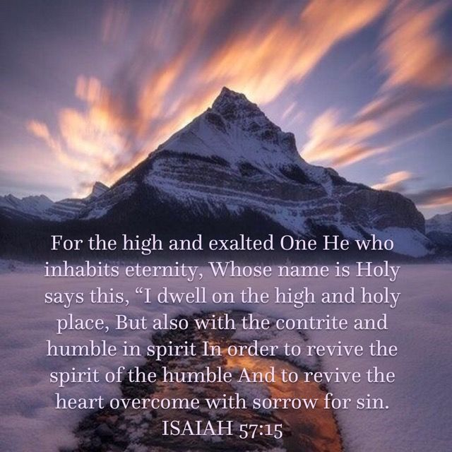
Pride Destroys Remorse for Sin
A contrite heart is crushed by its sin
  Isaiah 57:15
God resists the proud,
but gives grace to the humble
  James 4:6
Richie Thetford www.thetfordcountry.com

Slide 4
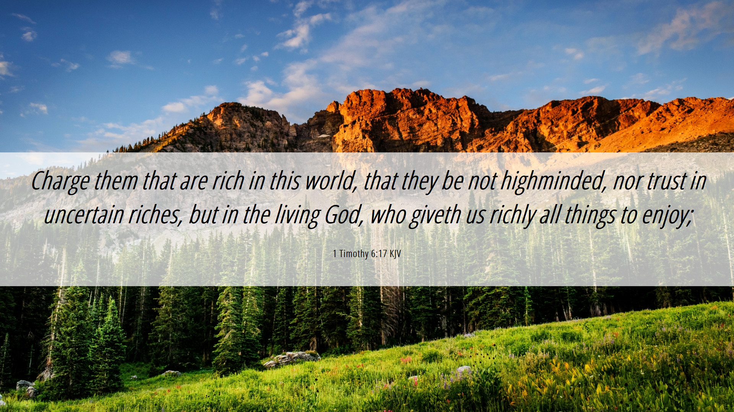
Pride Destroys Generosity
Pride is selfish arrogance
Generosity comes from a
humble, thankful heart
  1 Timothy 6:17
Richie Thetford www.thetfordcountry.com

Slide 5

Pride Hardens the Heart Against God
Pharaoh’s heart
  Exodus 9:18
Richie Thetford www.thetfordcountry.com

Slide 6
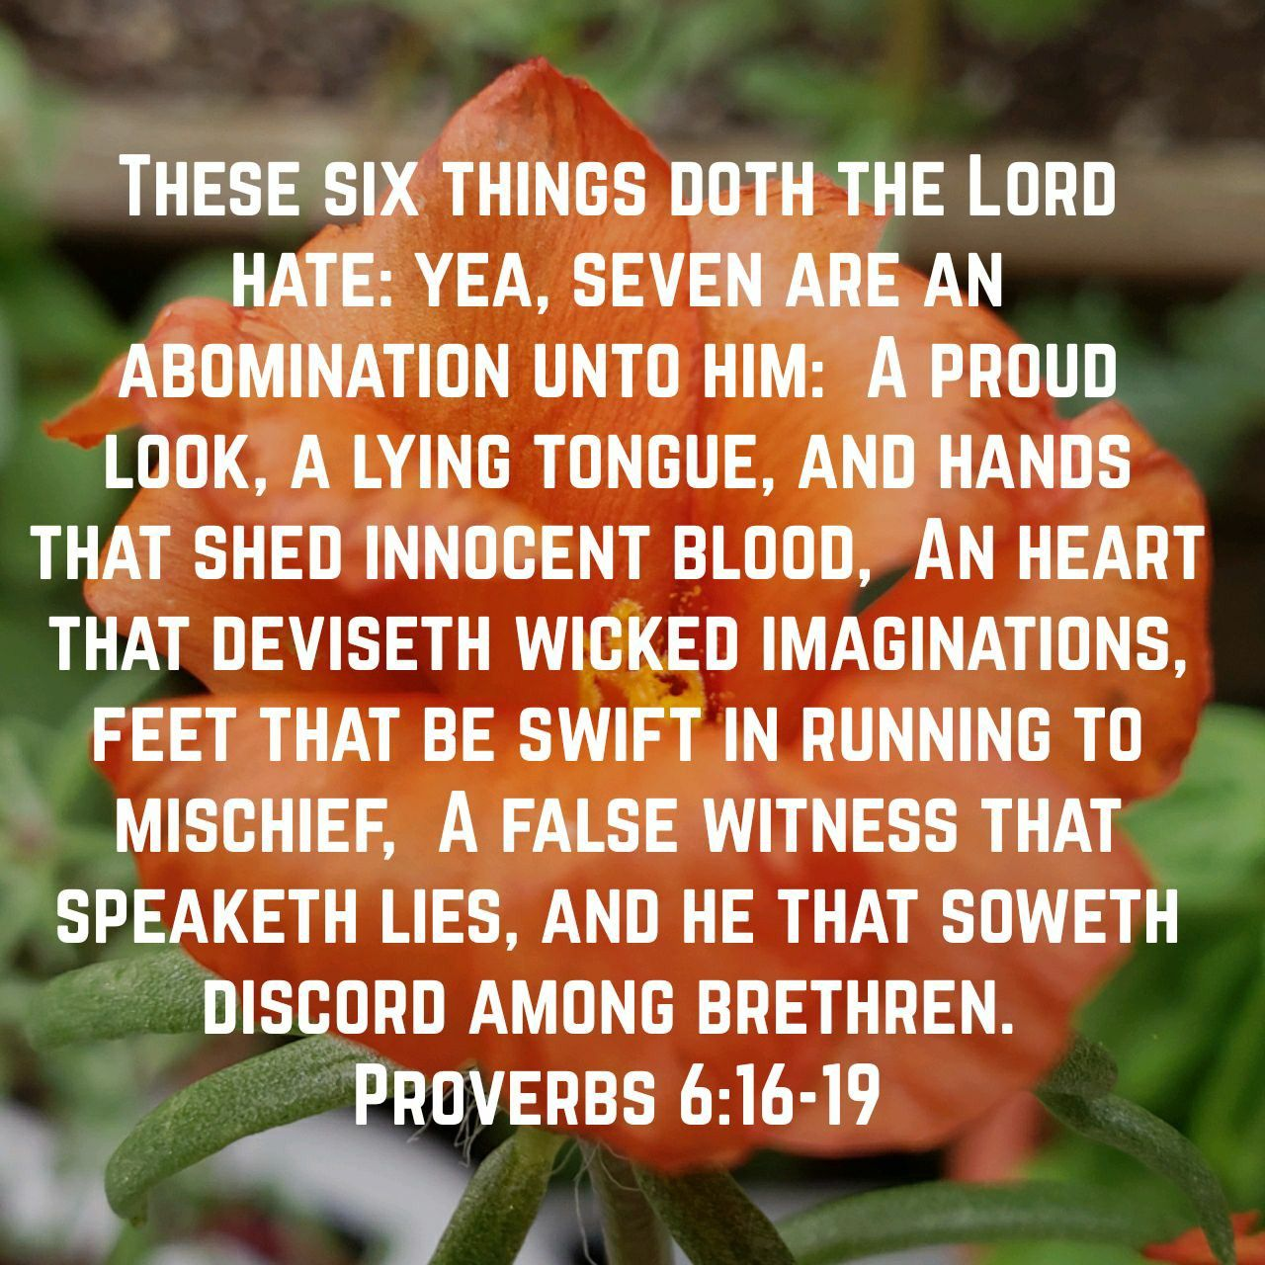
Pride Destroys the Soul
Pride is an abomination to God
  Proverbs 6:17-19
Those who elevate themselves
will be humbled by God
  Luke 18:14
Richie Thetford www.thetfordcountry.com

Slide 7

“When pride comes, then comes shame;
But with the humble is wisdom.”
Proverbs 11:2
Richie Thetford www.thetfordcountry.com

