Slide 1

Mark 1:17
Richie Thetford www.thetfordcountry.com

Slide 2
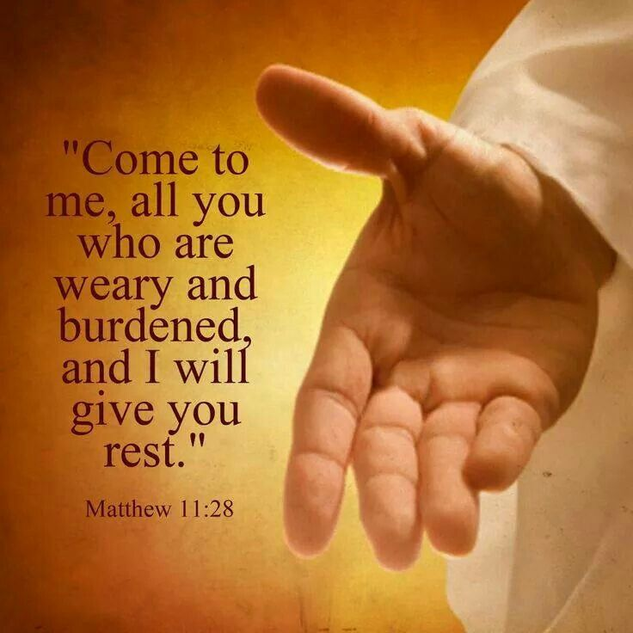
Come
No calling is greater!
Jesus calls, but man must come
Invitation is to all
Matthew 11:28-30
Must leave all and follow Christ
Luke 9:23
John 5:39-40
Richie Thetford www.thetfordcountry.com

Slide 3

After Me
Must follow Jesus
John 14:6
Some follow someone else
Must become a Christian
Romans 10:17
Hebrews 11:6
Acts 2:38
John 3:5
Richie Thetford www.thetfordcountry.com

Slide 4

And I Will Make You Fishers of Men
One must be a Christian first
John 6:45
One must continue to follow Him
The most Christ-like are the best fishers of men
1 Corinthians 15:58
Can’t put other things before the kingdom
Matthew 6:33; Colossians 3:1-3
Richie Thetford www.thetfordcountry.com

Slide 5

The Attitude of Fishers of Men
Attitude must be right
A genuine desire is needed
Romans 6:17-18
Realize the lost condition of others
Romans 3:23; 6:23
It takes hard work
Matthew 22:37-39
Richie Thetford www.thetfordcountry.com

Slide 6

The Need for Fishers of Men
Gospel needs to be preached
Mark 16:15-16
Matthew 28:19
The fields are white unto harvest
John 4:35-36
Luke 10:2
Richie Thetford www.thetfordcountry.com

Slide 7
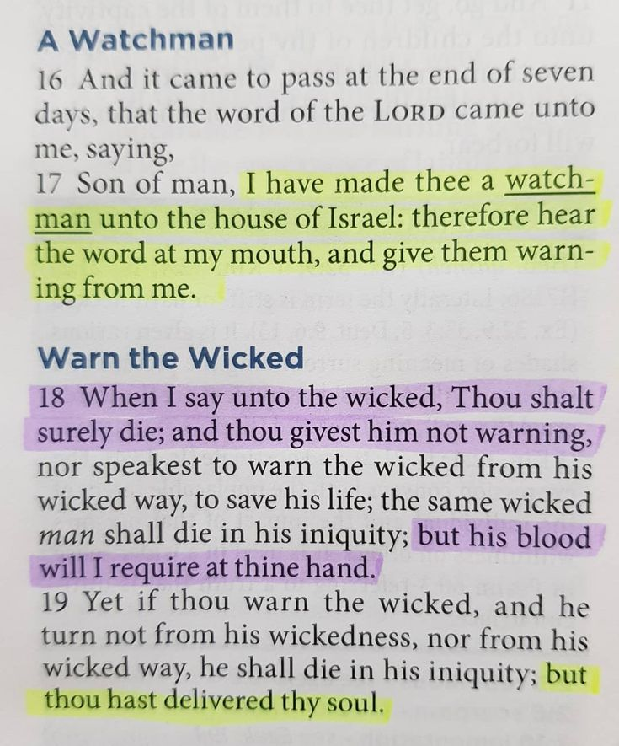

Conclusion
Commanded to teach others
Ezekiel 3:17-19
Gain enthusiasm for Christ!
We decide….
Richie Thetford www.thetfordcountry.com

