Slide 1
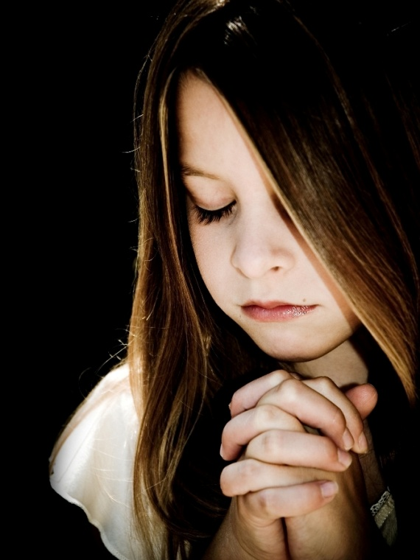
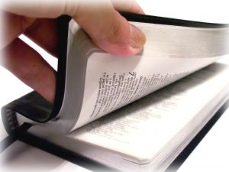
Giving thanks to our god
Romans 1:21
Luke 17:15-19
Richie Thetford www.thetfordcountry.com

Slide 2
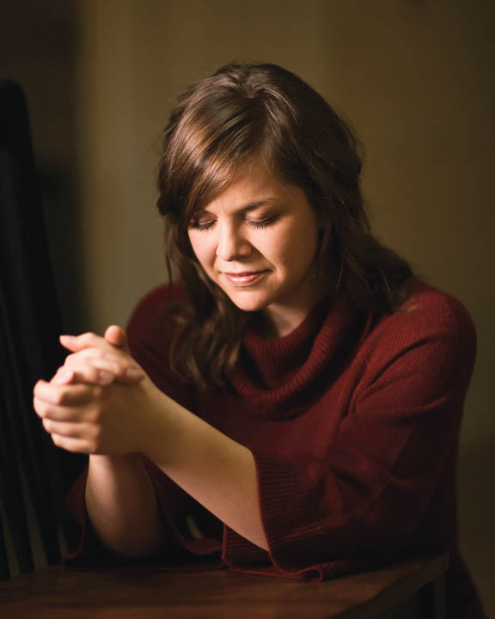
Giving thanks to our god
King David – a celebration of thanksgiving
1 Chronicles 15:26-28
We should give thanks
Psalms 96
1 Chronicles 16:23-33
Richie Thetford www.thetfordcountry.com

Slide 3
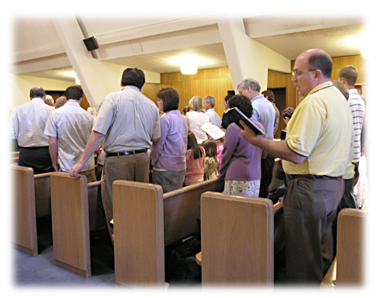
Giving thanks to GOD IN SONG
Expression of our thanks to Him
Ephesians 5:19-20
Colossians 3:16
Richie Thetford www.thetfordcountry.com

Slide 4
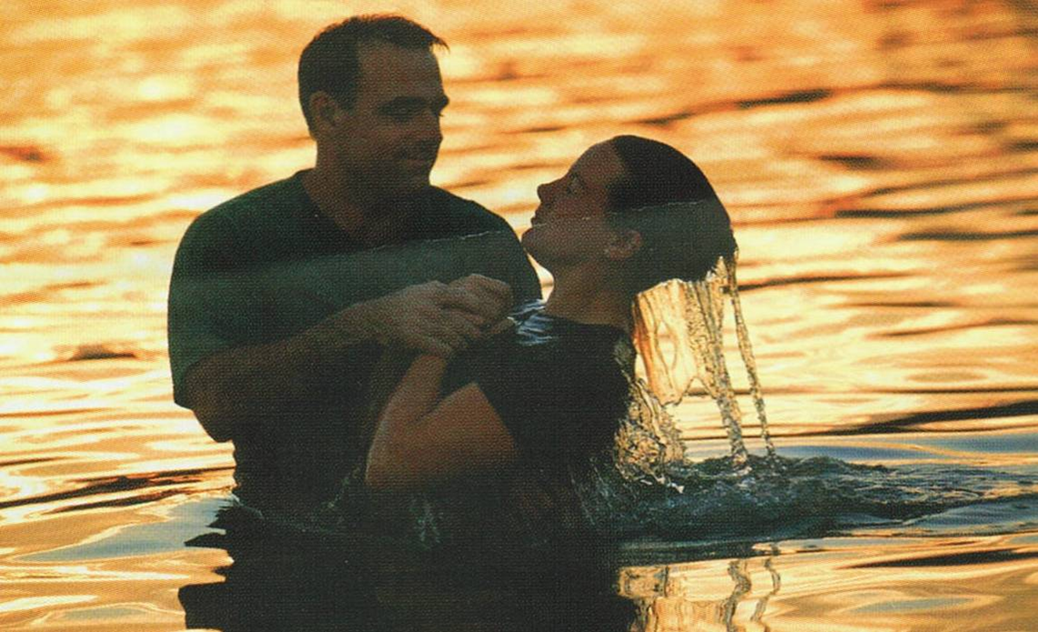
Giving thanks in worship
Thankful for the power of God
Psalms 96:2-9
Thank Him for salvation
Psalms 71:15
Exodus 15:1-2
Acts 4:12
Richie Thetford www.thetfordcountry.com

Slide 5
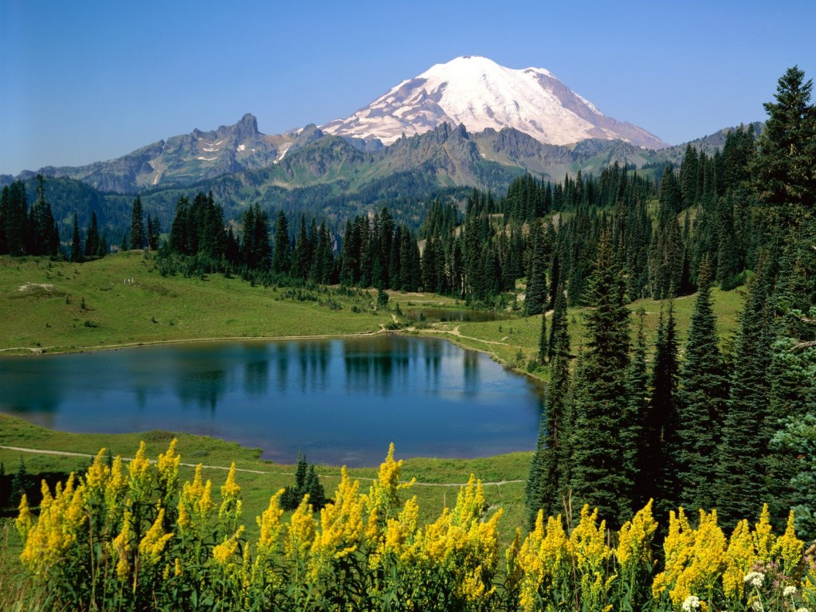
Giving thanks in worship
He is glorious and we honor Him
Psalms 96:3
Psalms 29:2
Psalms 72:19
Surrounded us with beauty
Psalms 40:5
Richie Thetford www.thetfordcountry.com

Slide 6
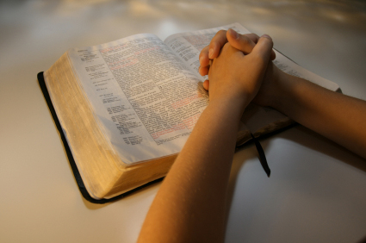
Giving thanks in worship
Our response to God
Psalms 96:4-5
Thankful for the dignity of God
Psalms 96:6-8
Richie Thetford www.thetfordcountry.com

Slide 7
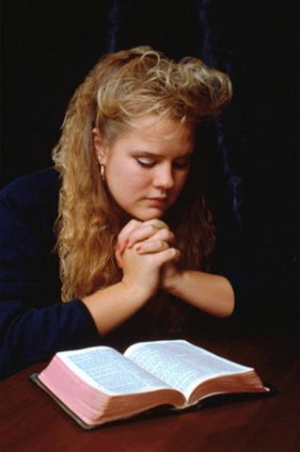
Thankful for His judgments
Are righteous
Romans 2:5
We judge based on God’s judgment
John 7:24
Romans 2:1-4
God’s judgments are according to truth
Psalms 96:13
Psalms 96:10-13
Richie Thetford www.thetfordcountry.com

Slide 8
conclusion
Remembering David’s thanksgiving during a moment of great blessing helps us be “thanksgivers” to God
“rooted and built up in Him and established in the faith, as you have been taught, abounding in it with thanksgiving.”
Colossians 2:7
Richie Thetford www.thetfordcountry.com

