Slide 1

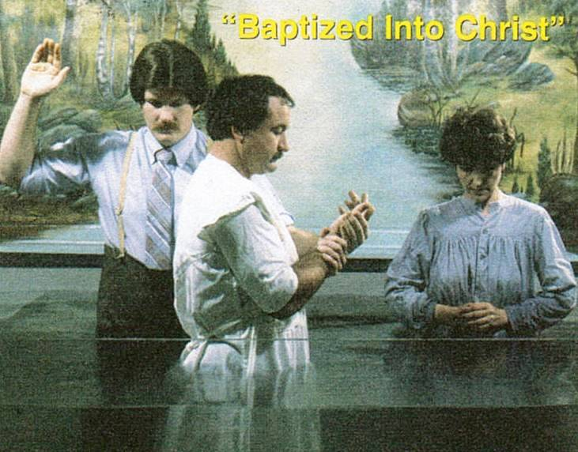

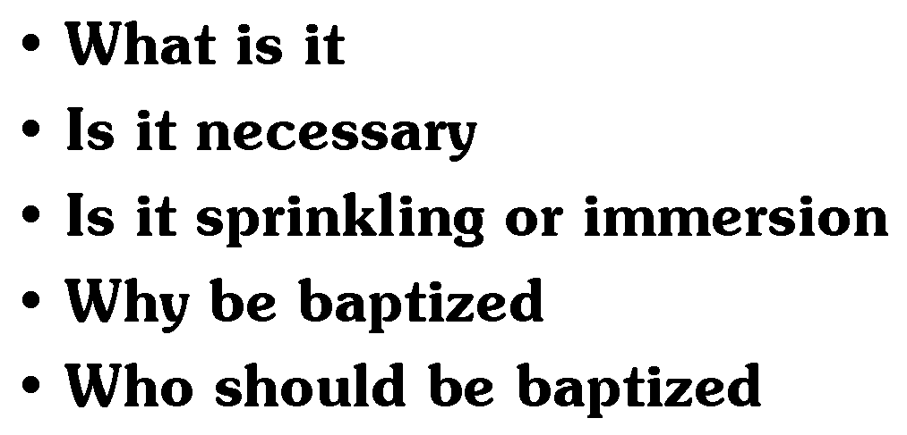
God’s Teaching on
?
Baptism
Richard Thetford www.thetfordcountry.com

Slide 2
What Is Baptism?
An immersion or burial in water
  Greek word baptizo means:
  “to dip, immerse, submerge, or plunge.”
    Context of God’s Word proves that baptism is immersion
Acts 8:36-38; Romans 6:4
Richard Thetford www.thetfordcountry.com

Slide 3
What Is Baptism?
“buried with Him in baptism, in which you also were raised with Him through faith in the working of God, who raised Him from the dead.”
Colossians 2:12
Richard Thetford www.thetfordcountry.com

Slide 4

What Is Baptism?
It is a death, burial and resurrection
  Romans 6:3-5
It is a new birth
  John 3:3-5
It is a washing away of all one’s past sins
  Acts 22:16
Richard Thetford www.thetfordcountry.com

Slide 5
What Is Baptism?
“And now why are you waiting? Arise and be baptized, and wash away your sins, calling on the name of the Lord.”
Acts 22:16
Richard Thetford www.thetfordcountry.com

Slide 6
Why Be Baptized?
Because God commanded it
  Matthew 28:18-20
Because one has faith in God (baptism is the result, or action,
of our faith)
  Hebrews 11:6
“And he commanded them to be baptized
in the name of the Lord….”
Acts 10:48
Richard Thetford www.thetfordcountry.com

Slide 7
Why Be Baptized?
Because we love God and want to keep His commandments
Because Jesus said it is necessary in order to receive salvation
  Mark 16:16
  1 Peter 3:21
"If you love Me, keep My commandments.”
John 14:15
Richard Thetford www.thetfordcountry.com

Slide 8
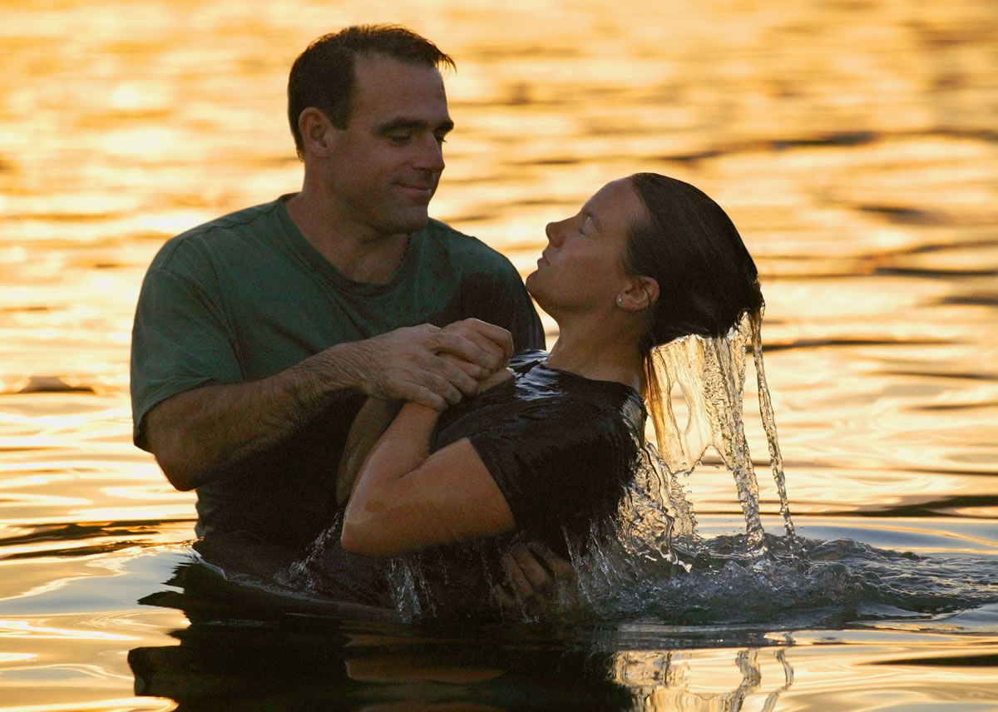
Why Be Baptized?
To have all past sins forgiven
  Acts 2:38; 22:16
To “put on Christ”
  Galatians 3:26-27
To be added to the church
  1 Corinthians 12:13; Acts 2:47
To be obedient to Christ
  Hebrews 5:9
Richard Thetford www.thetfordcountry.com

Slide 9
Who Should Be Baptized?
Those old enough to hear God’s word and to be taught it’s truths about sin and salvation
“It is written in the prophets, ‘And they shall all be taught by God.’ Therefore, everyone who has heard and learned from the Father comes to Me.”
John 6:45
Richard Thetford www.thetfordcountry.com

Slide 10
Who Should Be Baptized?
Those old enough to believe the gospel
  Acts 16:30-33
Those old enough to understand sin and repentance from it
  Acts 2:36-38
Those old enough to confess Jesus
  Romans 10:10; Acts 8:37
Richard Thetford www.thetfordcountry.com

Slide 11
Who Should Be Baptized?
Those ready to begin a new life in Christ
“Therefore, we were buried with Him through baptism into death, that just as Christ was raised from the dead by the glory of the Father, even so we also should walk in newness of life. For if we have been united together in the likeness of His death, certainly we also shall be
in the likeness of His resurrection”
Romans 6:4-5
Richard Thetford www.thetfordcountry.com

Slide 12
Conclusion
There is NO ROOM for opinions or traditions
One will either accept God’s way and live forever with Him OR accept man’s way and suffer an eternal death!
Why not become a Christian today?
Acts 22:16; 2 Corinthians 6:2
Richard Thetford www.thetfordcountry.com

