Slide 1
Luke 24
Richie Thetford www.thetfordcountry.com

Slide 2
Forgetting His Word
Luke 24:1-12
The stone was rolled away
Holy Spirit reminds us of His word
John 14:26
Yield to the Spirit
Richie Thetford www.thetfordcountry.com

Slide 3
Learning the Word
Luke 24:13-35
They could have talked for days
Do we allow the Holy Spirit to teach us?
John 16:13-15
Richie Thetford www.thetfordcountry.com

Slide 4
Receiving the Word
Luke 24:36-45
Their hearts were troubled
Strive to see Jesus in the Word
John 14:1-6
When faith grows weak
Romans 10:17
Richie Thetford www.thetfordcountry.com

Slide 5
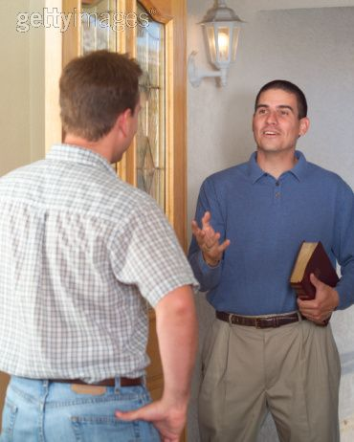
Sharing the Word
Luke 24:46-53
God opens our eyes
Luke 24:27, 32
Jesus gives us the commission
Romans 1:16
Experiencing joyful worship
Luke 24:52-53
Richie Thetford www.thetfordcountry.com

Slide 6
Richie Thetford www.thetfordcountry.com

