Slide 1

The Preacher’s Heart
Philippians 1:3-11
Richie Thetford www.thetfordcounty.com

Slide 2

Paul’s Unselfish Commitment to Serve God
Verses 3-8: Thankful for the privilege to preach the gospel
  Heart filled with prayer
    1 Thessalonians 5:17
  Strove to grow nearer
  Strove to have spiritual unity
    1 John 1:3
Richie Thetford www.thetfordcounty.com

Slide 3

Paul’s Unselfish Commitment to Serve God
Verses 9-11: Concern for Spiritual growth and maturity
  Grow in love, knowledge, and judgment
  Approved the things that are excellent
    2 Timothy 2:15
  Result of maturity
  – bears fruit of righteousness
Richie Thetford www.thetfordcounty.com

Slide 4
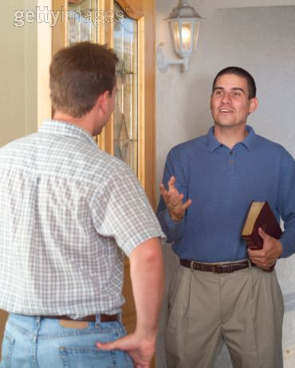
Paul’s Unselfish Commitment to Serve God
Verses 12-18: Focus on the spreading of the gospel
  A spirit of joy
  Trials caused by unbelievers
  Trials when betrayed by brethren
Richie Thetford www.thetfordcounty.com

Slide 5

Paul’s Unselfish Commitment to Serve God
Verses 19-26: Sought to magnify Christ
  By serving Him
  When one dies in faithful service to Him
  By unselfish behavior
Richie Thetford www.thetfordcounty.com

Slide 6

Paul’s Unselfish Commitment to Serve God
Verses 27-30: Urged the saints to stand fast
  To live godly lives
  Fight together for the truth
Do not be discouraged by persecution
  When living godly – will suffer persecution
    2 Timothy 3:12
Richie Thetford www.thetfordcounty.com

Slide 7

Christ suffered
Paul suffered
The Saints at Philippi suffered
Saints today suffer
Be steadfast in our suffering
Richie Thetford www.thetfordcounty.com

Slide 8

Conclusion
Let God fill and mold your heart:
  Be thankful to serve God and the Brethren
  Make it your aim to be concerned for spiritual growth
  Focus on the spreading of the Gospel to others
  Magnify Christ in life and in death
  Stand fast and stand united
Richie Thetford www.thetfordcounty.com

