Slide 1
Spiritual Arithmetic
Richie Thetford www.thetfordcountry.com

Slide 2
Addition
Can’t add to the word of God
Revelation 22:18
2 John 9
Added to the church when we obey
Acts 2:47; 2:38
Add to our faith
2 Peter 1:5-8
Richie Thetford www.thetfordcountry.com

Slide 3
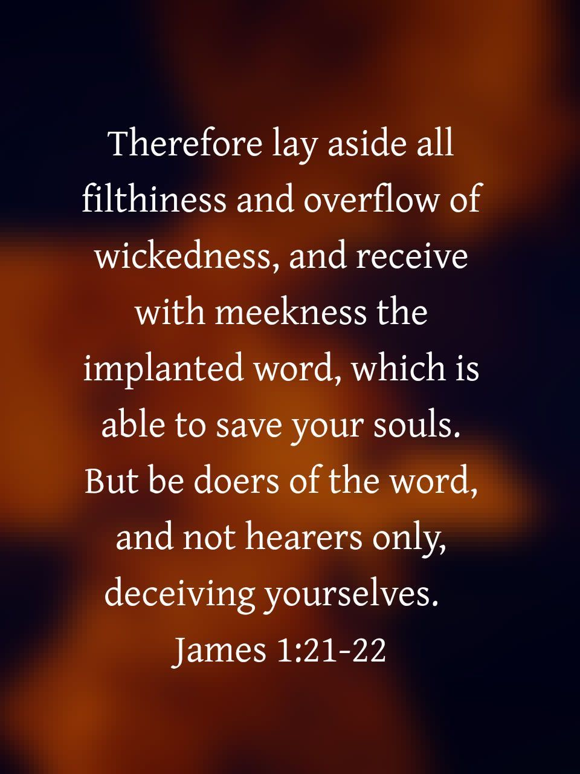
Subtraction
Can’t subtract from God’s word
Revelation 22:19
Subtract wickedness
James 1:21
Subtract fleshly defilements
2 Corinthians 7:1
Subtract bitterness
Ephesians 4:31
Richie Thetford www.thetfordcountry.com

Slide 4
Multiplication
Many things should be multiplied
Jude 2
2 Corinthians 9:10
The Jerusalem church grew rapidly
Acts 6:7
Richie Thetford www.thetfordcountry.com

Slide 5
Division
Takes study to learn how to properly divide
2 Timothy 2:15
It takes work to keep from dividing the church
1 Corinthians 1:10
Those causing division should be dealt with
Romans 16:17-18
Richie Thetford www.thetfordcountry.com

Slide 6
Spiritual Arithmetic
Learn Our
Richie Thetford www.thetfordcountry.com

