Slide 1
Things Seen When Blind
Acts 9:1-9
Richie Thetford www.thetfordcountry.com

Slide 2
Conscience is Not Always a Safe Guide
One can live in all good conscience and still be in error
Saul was guided by his conscience
Acts 8:3
Acts 23:1
Many today are living in all good conscience in regard to religious matters
Richie Thetford www.thetfordcountry.com

Slide 3
Zealousness in Religion Can Be Wrong
Zealousness does not mean one is right
Saul was a religious man
Galatians 1:14
Saul was “zealous toward God”
Zeal is essential if one is to please God
Titus 2:14
Philippians 3:6
Zealous: Showing great energy or enthusiasm in pursuit of a cause or objective
Richie Thetford www.thetfordcountry.com

Slide 4
What One Must Do to Wash Away Sin
Saul learned what was needed to wash away sin
Acts 9:6
He asked “Lord what do you want me to do?”
Saul had to do what he was told to do!
Saul was told “arise and be baptized…”
Acts 22:16
While blind – Saul saw that in order to have his sins washed away – he NEEDED TO be baptized
Richie Thetford www.thetfordcountry.com

Slide 5
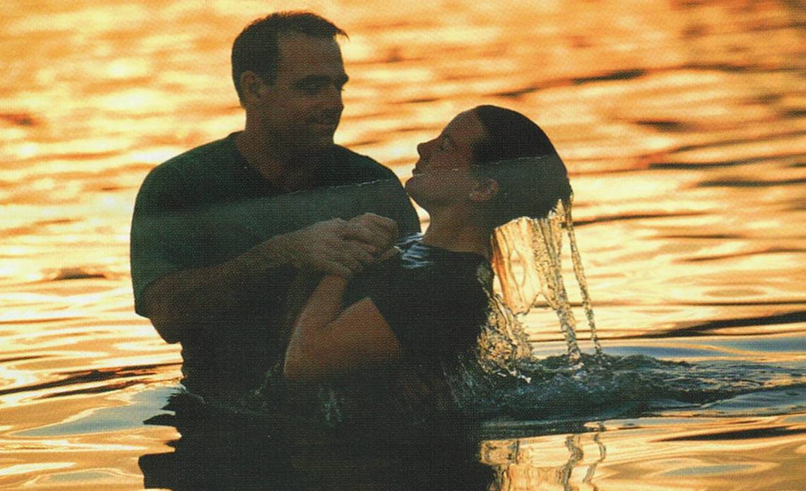
Conclusion
Can we see the things that Saul saw – while blind?
Saul had an honest heart
Saul was asked “why are you waiting?”
Jesus invites you to come to Him now
Matthew 11:28-30
Richie Thetford www.thetfordcountry.com

