Slide 1
UNDERSTANDING THE GODHEAD
The Father, The Son, The Holy Spirit
Father
Son
God
Holy
Spirit
“God is Spirit, and those who worship Him
must worship in spirit and truth.”
John 4:24
Richie Thetford www.thetfordcountry.com

Slide 2
Different Beliefs:
Theism – belief in the existence of a god or gods
Natural Theism – a study of existence and character and God in light of nature and reason
Deism – belief that God created the world, but denies His supernatural intervention (will not allow God to perform miracles)
Richie Thetford www.thetfordcountry.com

Slide 3
Different Beliefs:
Pantheism – belief that the universe and God are the same (laws of nature and universe = God)
Atheism – a disbelief of the existence of deity – there is no deity
Agnosticism – belief that the existence of God is unknown and probably unknowable
Humanism – philosophy that usually rejects supernaturalism and elevates man
Richie Thetford www.thetfordcountry.com

Slide 4
Different Beliefs:
Naturalism – the view which ascribes everything to natural causes (often called evolution, rationalism). It is always anti-supernatural
Polytheism – belief in or worship of more than one God
Monotheism – belief that there is but one God (no trinity)
Richie Thetford www.thetfordcountry.com

Slide 5

It is no wonder that the world is so confused in the realm of religion!
“God is Spirit, and those who worship Him must worship in spirit and truth.”
John 4:24
Richie Thetford www.thetfordcountry.com

Slide 6
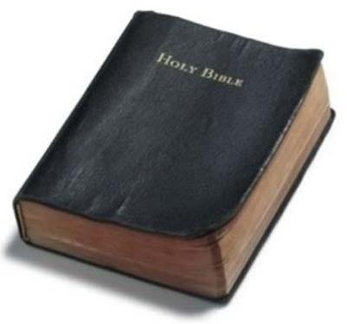
The Bible Christian:
.…believes in an all-present, all knowing, all powerful God!
….believes that the Bible is divine revelation!
Divine: “from God”
Revelation: “an uncovering by God; not something that man could discover for himself”
2 Tim 3:16-17
Richie Thetford www.thetfordcountry.com

Slide 7
UNDERSTANDING THE GODHEAD
Plurality
Then God said, “Let Us make man in Our image, according to Our likeness; let them have dominion over the fish of the sea, over the birds of the air, and over the cattle, over all the earth and over every creeping thing that creeps on the earth.”
Genesis 1:26
“There is one body and one Spirit, just as you were called in one hope of your calling; one Lord, one faith, one baptism; one God and Father of all, who is above all, and through all, and in you all.”
Ephesians 4:4-6
Richie Thetford www.thetfordcountry.com

Slide 8
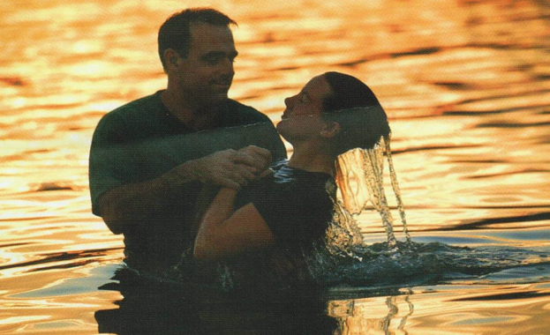
UNDERSTANDING THE GODHEAD
The Father, The Son, The Holy Spirit
All were present at Jesus’ baptism
“When He had been baptized, Jesus came up immediately from the water; and behold, the heavens were opened to Him, and He saw the Spirit of God descending like a dove and alighting upon Him. And suddenly a voice came from heaven, saying, "This is My beloved Son, in whom I am well pleased.” Matthew 3:16
Matthew 28:19
Richie Thetford www.thetfordcountry.com

Slide 9
Father
IS NOT
Son
IS
IS
God
IS NOT
IS NOT
IS
Holy
Spirit

Slide 10
Tom
IS NOT
Sam
IS
IS
Man
IS NOT
IS NOT
IS
Bill

Slide 11
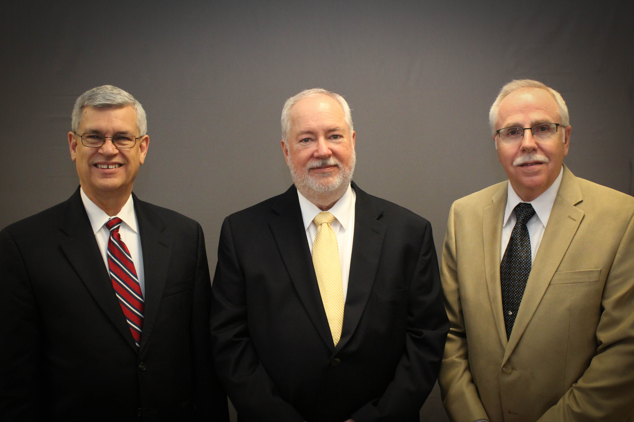
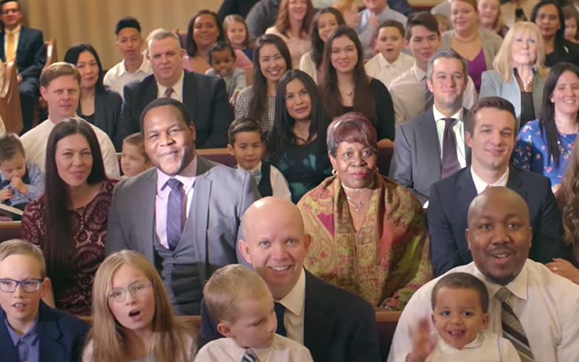
How Can THREE Be ONE?
ONE
Board
ONE
Eldership
ONE
Body
Plurality
Of Elders
Many Members
1 Cor 12:12-20
8 Members
X
X
X
X
X
X
X
X
Richie Thetford www.thetfordcountry.com

Slide 12
How Can THREE Persons Be ONE God?
Humanity
(Human Attributes)
One Manhood
Angels
(Angelic Attributes)
One Angelhood
Deity
(Divine Attributes)
One Godhood
Many Individuals
Many
Angels
Three Persons
One in Purpose, One in all things….Except Person – THREE PERSONS
Never Disagree
Richie Thetford www.thetfordcountry.com

Slide 13
John 20:17; 1 Peter 1:3; 2 John 3; 1 John 1:3
Father
IS NOT
Son
Jn 1:1,14; Heb 1:8
Tit 2:13; Jn 8:58;
Matt 16:16
Jn 3:16; 8:42
Matt 6:9
IS
IS
God
Jn 14:16-17,26
Rom 8:16,26
IS NOT
IS NOT
Jn 15:26;
Acts 10:38
Acts
5:1-4
IS
Holy
Spirit

Slide 14
The Heathen Concept
Many deities or gods
The Bible Teaching
ONE God (Isaiah 43:10; 45:6,18)
god
god
Father
god
god
god
god
Holy
Spirit
Son
god
god
god
No two the same sun god, rain god, etc.
rain god not interested in sun god
sun god not interested in rain god
Imperfect gods
Various attributes and powers
(Acts 17:22ff; Galatians 4:8; 1 Corinthians 8:4-7;
Acts 19:26; 14:11; Exodus 20:3)
Never Disagree
One in Purpose/Interest
Perfect God
One in Attributes, One in all things….
Except Person
THREE Persons
Richie Thetford www.thetfordcountry.com

Slide 15
UNDERSTANDING THE GODHEAD
The Father, The Son, The Holy Spirit
“and to make all see what is the fellowship of the mystery,
which from the beginning of the ages has been hidden in
God who created all things through Jesus Christ;”
Ephesians 3:9
“For by Him all things were created that are in heaven and that are on earth, visible and invisible, whether thrones or dominions or principalities or powers. All things were created through Him and for Him.”
Colossians 1:16
Richie Thetford www.thetfordcountry.com

Slide 16

A proper understanding of the Godhead will make it easier for us to have the right attitude when we worship our God in spirit and truth
“He who rejects Me, and does not receive my words, has that which judges him – the word that I have spoken will judge him in the last day.” John 12:48
Richie Thetford www.thetfordcountry.com

