Slide 1

Realized Eschatology
The
Second Coming
of Christ

Slide 2
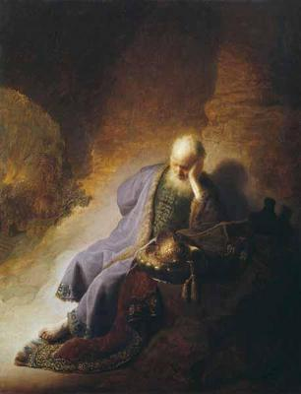
Introduction
Advocates of Realized Eschatology teach:
  The second coming of Christ
  The resurrection of the dead
  The day of judgment
  The end of the world
Occurred in 70 A.D. at the destruction of Jerusalem
  To look beyond that date is without Biblical authority

Slide 3
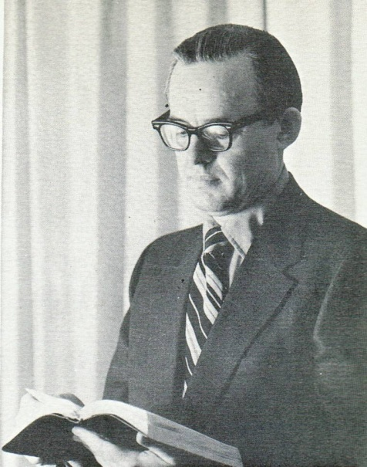

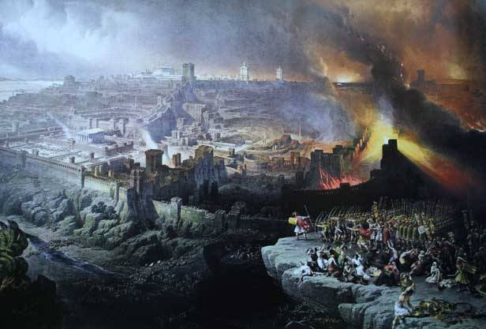
Introduction
Max King (1971)
“It is the second coming, and it is His coming in the fall of Jerusalem, for these are not two separate comings but one”
(SOP, P. 70)
70 A. D. Doctrine
Coming of Christ
30
AD
“Last Days”
70
AD
ETERNAL DAYS
(Transitional Period)
The Cross
Destruction of Jerusalem

Slide 4
Introduction
Max King (1971)
“There is no scriptural basis for
extending the second coming of Christ beyond the fall of Judaism”
(SOP, P. 105)
70 A. D. Doctrine
Coming of Christ
30
AD
“Last Days”
70
AD
ETERNAL DAYS
(Transitional Period)
The Cross
Destruction of Jerusalem

Slide 5
Introduction
Max King (1971)
“…the end of the Jewish world was the second coming of Christ”
(SOP, P. 81)
70 A. D. Doctrine
Coming of Christ
30
AD
“Last Days”
70
AD
ETERNAL DAYS
(Transitional Period)
The Cross
Destruction of Jerusalem

Slide 6
Introduction
Max King (1971)
“Prophecy found its complete fulfillment in the second coming of Christ, and now may be regarded as closed and consummated”
(SOP, P. 65)
70 A. D. Doctrine
Coming of Christ
30
AD
“Last Days”
70
AD
ETERNAL DAYS
(Transitional Period)
The Cross
Destruction of Jerusalem

Slide 7

Did Jesus Come in the First Century?
Jesus did come in some sense in the first century
  He came in His kingdom
    Matthew 16:28
  He came with power
“Assuredly, I say to you that there are some standing here who will not taste death till they see the kingdom of God present with power.”
Mark 9:1

Slide 8
Did Jesus Come in the First Century?
  He came on the day of Pentecost
    Acts 1:4-5, 8; 2:1-4, 33
  Jesus described the sending of the promised Comforter (the Holy Spirit)
    Not a bodily coming of Jesus!
    He came representatively (John 15:26)
“I will not leave you orphans; I will come to you.”
John 14:18

Slide 9
Did Jesus Come in the First Century?
  Jesus taught during “that” generation (24:34):
“Immediately after the tribulation of those days the sun will be darkened, and the moon will not give its light; the stars will fall from heaven, and the powers of the heavens will be shaken. Then the sign of the Son of Man will appear in heaven, and then all the tribes of the earth will mourn, and they will see the Son of Man coming on the clouds of heaven with power and great glory.” Matthew 24:29-30
Jesus did come in judgment in 70 A.D., but it was not His bodily return!

Slide 10

Same Phrase,
Different Meanings
70 AD doctrine makes every mention of the “coming of the Lord” or “Day of the Lord” mean the same event, regardless of its usage in context
Biblical interpretation can have
different meanings

Slide 11
Same Phrase,
Different Meanings
“Laid hands on them” (Acts 4:3)
to arrest
“Laid hands on them” (Acts 13:3)
to commend
“Laid hands on her” (Luke 13:13)
to heal
“Laid hands on them” (Acts 8:17; 19:6)
to impart spiritual gifts
We can’t arbitrarily assign one meaning to this phrase!

Slide 12
Same Phrase,
Different Meanings
The problem with limiting the “coming of the Lord” to 70 A.D. is demonstrated by the following passages of scripture:
“Now when He had spoken these things, while they watched, He was taken up, and a cloud received Him out of their sight. And while they looked steadfastly toward heaven as He went up, behold, two men stood by them in white apparel, who also said, "Men of Galilee, why do you stand gazing up into heaven? This same Jesus, who was taken up from you into heaven, will so come in like manner as you saw Him go into heaven.”
Acts 1:9-11

Slide 13

Same Phrase,
Different Meanings
  The apostles actually saw Jesus’ bodily ascension
  This IS the manner in which He will return
  Jesus did NOT come in bodily form – nor was He personally seen in the events of:
    The coming of the kingdom (Matthew 16:28)
    The destruction of Jerusalem – 70 A.D (Matthew 24:30)
1 Thessalonians 4:16-17
Christ’s personal, bodily return is yet future!

Slide 14
Same Phrase,
Different Meanings
2 Peter 3:5-11
  God created and then destroyed the world with water
    By that same word of God – the heavens and earth are stored up for fire
  70 A.D. advocates try to make the heavens and earth (v.7,10) the Jewish economy
    Was the world of Noah’s day destroyed by water?
    Today’s world will be destroyed by fire

Slide 15
Same Phrase,
Different Meanings
The abuse of 2 Peter 3:5-11 illustrates the error in Biblical interpretation which is present in this system of error
“Many seem disposed to regard themselves as at liberty to make anything out of the Bible which their theology may demand or their whims require. And if, at any time, they find a passage that will not harmonize with that view, then the next thing is to find one or more words in the text used elsewhere in a figurative sense, and then demand that such be the Biblical dictionary on the meaning of that word, and hence that it must be the meaning in that place.” (Hermeneutics, Dungan, p. 217)

Slide 16
Jesus Christ is Coming Again!
To say that those living in the first century were taught that Jesus would return within their lifetime is:
  Without scriptural proof
  Contradictory of Biblical passages that say the time of the Lord’s return could be discerned neither by the times nor by signs
Christ’s coming will be sudden, unexpected, and unannounced
  1 Thessalonians 5:2; 2 Peter 3:10

Slide 17

Jesus Christ is Coming Again!
The second coming of Christ is yet future
  Max King’s contention of a spiritual second coming is destroyed by Hebrews 9:28
    Was Christ literally offered up to die on the cross? YES
    Did Christ literally bear the sins of many? YES
    Since this is so – He will literally return a second time!
“so Christ was offered once to bear the sins of many. To those who eagerly wait for Him He will appear a second time, apart from sin, for salvation.”
Hebrews 9:28

Slide 18

Jesus Christ is Coming Again!
Jesus said He would come again – and take believers to be with Him
  This would be heaven according to
  Psalms 33:13-14
    Believers are not yet with Christ in heaven
    Supporters of the 70 A.D. say that John 14:1-3
    only applies to the apostles – not you and me
“Let not your heart be troubled; you believe in God, believe also in Me. In My Father's house are many mansions; if it were not so, I would have told you. I go to prepare a place for you. And if I go and prepare a place for you, I will come again and receive you to Myself; that where I am, there you may be also.”
John 14:1-3

Slide 19

Jesus Christ is Coming Again!
Words from the Apostle Paul:
Words from the Apostle Peter:
“Finally, there is laid up for me the crown of righteousness, which the Lord, the righteous Judge, will give to me on that Day, and not to me only but also to all who have loved His appearing.” 2 Timothy 4:8
“and when the Chief Shepherd appears, you will receive the
crown of glory that does not fade away.” 1 Peter 5:4
We have not received the “crown of righteousness,”
nor the “crown of glory”
– Jesus has NOT yet returned

Slide 20

Conclusion
The consequences of the 70 A.D. doctrine means that all that are in the graves will never hear the voice of Jesus
  It means there will not be a future resurrection
  It means that all who die in the Lord have no hope of seeing the Lord and being with Him
Comforting Words from Paul:
1 Thessalonians 4:13-18

