Slide 1
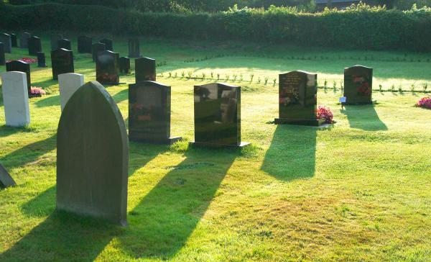
Realized Eschatology
The Resurrection of the Dead

Slide 2
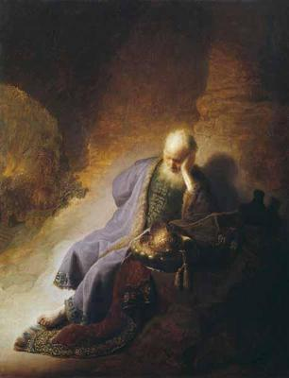
Introduction
Realized Eschatology teaches that ALL Bible prophecy has been fulfilled:
  The second coming of Christ
  The resurrection of the dead
  The day of judgment
  The end of the world
All these things were fulfilled in 70 A.D. at the destruction of Jerusalem

Slide 3
Realized Eschatology
View of the Resurrection
Believe and teach that the resurrection has already occurred in 70 A.D.
  Deny that there will be a future resurrection of the dead from the graves
  Believe that the resurrection was a spiritual resurrection, not a bodily resurrection
    The suppressed spiritual body of Christ, the church, released from Jewish suppression

Slide 4
The natural body that was sown answers to the fleshly or carnal system of Judaism in which existed prophecies, types, and patterns from which came the spiritual body designed of God. Judaism answers to the field or the world in which the good seed was sown (Matthew 13:37-38). This natural body, receiving its death blow at the cross and beginning then to wax old and decay (Hebrews 8:13), became a nursery or seed-body for the germination, growth, and development of the spiritual body by means of the gospel. Thus, out of the decay of Judaism arose the spiritual body of Christianity that became fully developed or resurrected by the end-time. Hence, this is the primary meaning of Paul’s statement, “It is sown a natural body; it is raised a spiritual body. There is a natural body and there is a spiritual body.” (SOP, P. 200).

Slide 5
Realized Eschatology
View of the Resurrection
This doctrine (theory) is not a series of misunderstandings
  This doctrine is a systematic effort to rewrite the scriptures
“as also in all his epistles, speaking in them of these things,
in which are some things hard to understand, which untaught and unstable people twist to their own destruction,
as they do also the rest of the Scriptures.”
2 Peter 3:16

Slide 6
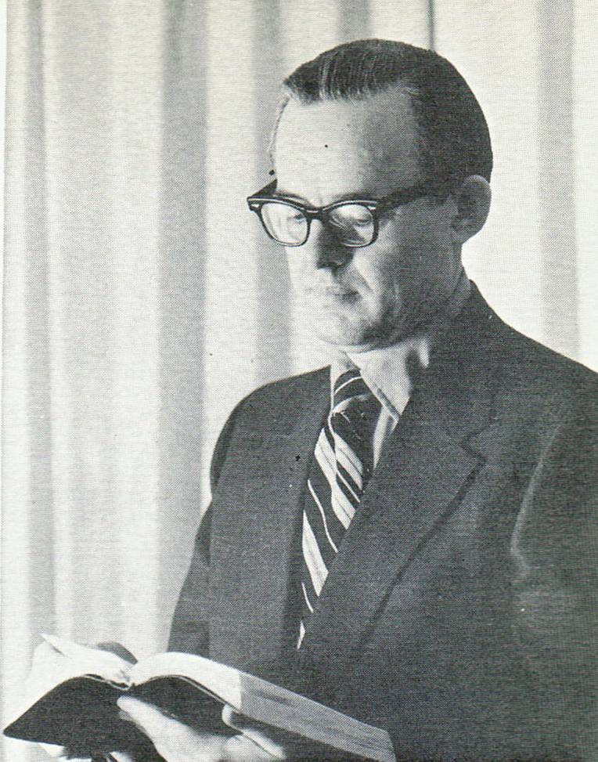
Who Will Come Forth
From the Graves?
In his debate with Gus Nichols in July 1973, Max King said the church:
Max King (1971)
“was in the grave or the casket of Judaism until the Roman army destroyed Jerusalem”

Slide 7
Who Will Come Forth
From the Graves?
If the church was born on the day of Pentecost in Acts 2 and was raised from the grave of Judaism in 70 A.D…..
  WHEN DID THE CHURCH DIE?
The church was not raised from the casket of Judaism in 70 A.D. or at any other time

Slide 8
Who Will Come Forth
From the Graves?
When the New Testament discusses a resurrection…
  It is discussing a resurrection from the grave
“Do not marvel at this; for the hour is coming in which all who are in the graves will hear His voice and come forth — those who have done good, to the resurrection of life, and those who have done evil, to the resurrection of condemnation.” (John 5:28-29)

Slide 9
Who Will Come Forth
From the Graves?
Jesus is talking about a resurrection from the grave
  The Realized Eschatologist says Jesus is speaking of the grave of Judaism
Max King (1971)
“I deny John 5:28 is a literal grave in the cemetery somewhere.”

Slide 10
Who Will Come Forth
From the Graves?
Jesus IS NOT discussing a resurrection of the church from the grave of Judaism
  He is talking about a literal death and a literal resurrection from literal graves
The apostle Paul said:
“I have hope in God, which they themselves also accept,
that there will be a resurrection of the dead,
both of the just and the unjust.” (Acts 24:15)

Slide 11
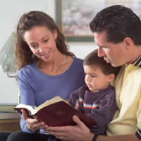
Paul’s Teaching of
A Bodily Resurrection
Examining the text of 1 Corinthians 15
Verses 1-8
  Facts of the gospel are critical
    Consist of the death, burial, and
    resurrection of Christ – must be believed
Verses 17-18
  Without a bodily resurrection of Christ there is no hope for those who have died in Christ

Slide 12
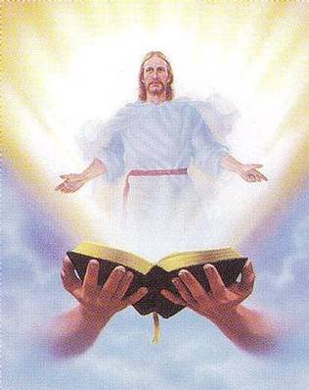
Paul’s Teaching of
A Bodily Resurrection
Examining the text of 1 Corinthians 15
Verse 20
  First fruits guaranteed a harvest
    Resurrection of Jesus guarantees a future
    resurrection
Verses 21-23
  When Jesus returns, the dead will be raised from the grave

Slide 13

Paul’s Teaching of
A Bodily Resurrection
Examining the text of 1 Corinthians 15
Verses 29-34
  Paul presents the consequences of denying the resurrection
  of the dead
Verses 35-50
  He anticipates objections to the bodily resurrection

Slide 14
Paul’s Teaching of
A Bodily Resurrection
Examining the text of 1 Corinthians 15
Verses 51-58
  Paul praises the victory over death God gives us in Christ through the resurrection
    False doctrine of Realized Eschatology denies that this
    will happen
    They do not believe that there will be a future resurrection
    of the dead

Slide 15
Paul’s Teaching of
A Bodily Resurrection
Those who believe that the resurrection is past, which the Realized Eschatologist believes…
  In the same company as two men in the Bible
“But shun profane and idle babblings, for they will increase to more ungodliness. And their message will spread like cancer. Hymenaeus and Philetus are of this sort, who have strayed concerning the truth, saying that the resurrection is already past; and they overthrow the faith of some.”
2 Timothy 2:16-18

Slide 16

The Gospel of Christ Teaches That We Will Be Raised!
“And this is the will of Him who sent Me, that everyone who sees the Son and believes in Him may have everlasting life; and I will raise him up at the last day
John 6:40
Jesus said:

Slide 17
The Gospel of Christ Teaches That We Will Be Raised!
The resurrection will take place at the last day
  John 6:44
    Realized Eschatology doctrine says Jesus is discussing the resurrection of the dead church from the grave of Judaism – and the last day is September 70 A.D.
    They teach no literal graves opened and no physical bodies were raised at that time

Slide 18
The Gospel of Christ Teaches That We Will Be Raised!
“Whoever eats My flesh and drinks My blood has eternal life,
and I will raise him up at the last day.” John 6:54
Jesus is speaking of individuals literally being raised from the dead
  Not discussing a resurrection of a cause
This resurrection will occur at the last day – at His second coming

Slide 19
The Gospel of Christ Teaches That We Will Be Raised!
The last day – the day the dead will be raised, is the
day of judgment
How did those who lived during the lifetime of Jesus understand these words?
“He who rejects Me, and does not receive My words, has that which judges him — the word that I have spoken
will judge him in the last day.” (John 12:48)

Slide 20
The Gospel of Christ Teaches That We Will Be Raised!
John 11: Martha understood what the resurrection was
  Jesus returned to Bethany upon the death of Lazarus
  – He says:
    “Your brother will rise again” (11:23)
  Was she affected by a future type of resurrection in 70 A.D. that is now taught by the Realized Eschatologists?

Slide 21
The Gospel of Christ Teaches That We Will Be Raised!
Martha said to Him, “I know that he will rise again in the
resurrection at the last day.” John 11:24
Martha understood that Lazarus would be raised in the resurrection at the last day
  She had NO knowledge of a resurrected dead church from the grave of Judaism
  Martha got it right – understood Jesus’ words
    John 11:25 “though he may die, he shall live”

Slide 22

Conclusion
Faithful Christians have so much to
look forward to!
  The resurrection in the last day to be with our Lord and Savior Jesus Christ eternally
Apostle Paul assures us of our hope of immortal glory
2 Corinthians 5:1-8

