Slide 1

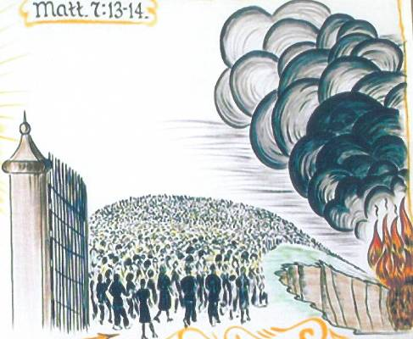
Choosing the Right Road
Matthew 7:13-14
“Enter by the narrow gate; for wide is the gate and broad is the way that leads to destruction, and there are many who go in by it. Because narrow is the gate and difficult is the way which leads to life, and there are few who find it.”
Richard Thetford www.thetfordcountry.com

Slide 2
Choosing the Right Road
Matthew 7:13-14
Surrendered will
  Hebrews 5:8-9; Matthew 7:21
Pride
  Proverbs 16:18; Isaiah 28:1; Acts 12:20-23
Richard Thetford www.thetfordcountry.com

Slide 3
Choosing the Right Road
Matthew 7:13-14
Glorify God
  1 Corinthians 6:18-20
Self-Indulgence
  James 1:13-15; 1 John 2:15-17;
  Daniel 5:20 (Belshazzar)
Richard Thetford www.thetfordcountry.com

Slide 4
Choosing the Right Road
Matthew 7:13-14
Obedience
  1 Samuel 3:10; Acts 22:10
Rebellion
  Proverbs 1:24-33; Joshua 1:18;
  2 Thessalonians 1:7-9
Richard Thetford www.thetfordcountry.com

Slide 5
Choosing the Right Road
Matthew 7:13-14
Doing God’s Will
  Matthew 7:21; James 4:17
Omission
  James 4:7
Richard Thetford www.thetfordcountry.com

Slide 6
Choosing the Right Road
Matthew 7:13-14
Make Ready
  Acts 2:40-41
Heedlessness
  Luke 17:26-29
Richard Thetford www.thetfordcountry.com

Slide 7
Choosing the Right Road
Matthew 7:13-14
Way of Truth
  Matthew 7:21; John 8:32
  John 17:17; Revelation 22:14
Religious Error
  Proverbs 14:12; Acts 23:1
Richard Thetford www.thetfordcountry.com

Slide 8
Which Road Will You Choose?
The Life you live reflects your choice!
Matthew 7:13-14
Richard Thetford www.thetfordcountry.com

