Slide 1
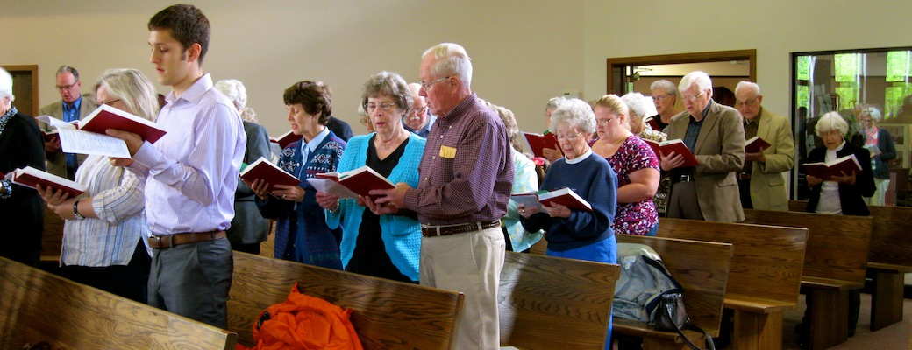
The Edification of the Church
Luke 19:10; Matthew 28:18-20; Ephesians 4:15-16; 1 Corinthians 16:1-3
Richard Thetford www.thetfordcountry.com

Slide 2

Some Realms in Which We Are to Grow
Grace and knowledge of the truth
  2 Peter 3:18
In the likeness of Jesus
  Ephesians 4:15
In Christian characteristics
  2 Peter 1:4-11
In our ability to serve and resist
  Romans 12:1-2; James 4:7
In love, knowledge, and judgment
  Philippians 1:9-10
Richard Thetford www.thetfordcountry.com

Slide 3

What This Growth Requires
Desire for the truth
  1 Peter 2:2
Spiritual exercise
  Hebrews 5:12-14
Action instead of neglect
  Hebrews 2:1-3
Study, meditation, faithfulness
  2 Timothy 2:15
Purity of mind and in prayer
  Titus 2:11-14; Philippians 4:8; 1 Thessalonians 5:17-18
Richard Thetford www.thetfordcountry.com

Slide 4

Things That Hinder This Growth
Wickedness, hypocrisy, etc.
  1 Peter 2:1-2
Lack of hearing
  Romans 10:17
A love of the world
  1 John 2:15-17
Foolish disputes
  2 Timothy 2:23
Love of money (materialism)
  1 Timothy 6:10, 17
Richard Thetford www.thetfordcountry.com

Slide 5

Some Avenues Through Which We Can Edify
Having a greater concern for others
  Philippians 2:1-4
Exhorting those who need it
  Hebrews 10:23-29
Encouraging the weak
  1 Thessalonians 5:14
Worshiping God
  Colossians 3:16; Ephesians 5:19
Teaching and setting a good example
  Titus 2:1-8; 2 Timothy 2:2
Richard Thetford www.thetfordcountry.com

