Slide 1

“From Childhood”
2 Timothy 3:14-15
Richard Thetford www.thetfordcountry.com

Slide 2

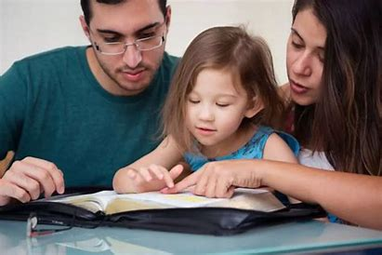
Must Continue
“Must” – no other way
“Continue” – be strong; endure
Richard Thetford www.thetfordcountry.com

Slide 3


“Continue” in the Things
You’ve Learned
“Learned” – to increase in knowledge
  Install morals
  Protect against false doctrine
  Teach about Christ’s true church
“Morals”
  See the difference between what the
  Bible teaches and what others often do
Richard Thetford www.thetfordcountry.com

Slide 4
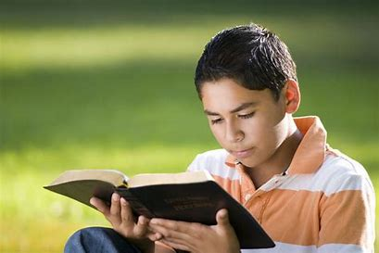
“Continue” in the Things
You’ve Been Assured of
“Assured” – to trust
Things that helped Timothy:
  God’s Word
    2 Timothy 3:16-17
    2 Timothy 2:15
  His family
    Acts 16:1-3
Richard Thetford www.thetfordcountry.com

Slide 5
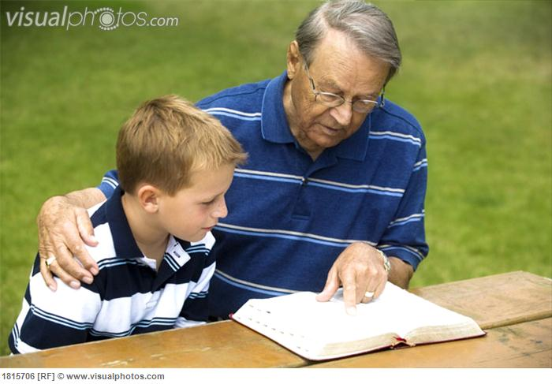
“Continue” in the Things
You’ve Been Assured of
Things that helped Timothy:
  The church
  The apostle Paul
    2 Timothy 1:8
  Looking back to his childhood
    2 Timothy 1:13
    2 Timothy 3:10-11
Richard Thetford www.thetfordcountry.com

Slide 6

Knowing from Whom
You Learned Them
Lois and Eunice
  2 Timothy 1:5
  A “Genuine” faith
Richard Thetford www.thetfordcountry.com

Slide 7

From Childhood You Have
Known the Scriptures
One can learn them as a child
  About God
  About the world
  About Christ
  About the Bible
  About morals
  About the church
Richard Thetford www.thetfordcountry.com

Slide 8

Which Are Able to Make
You Wise for Salvation
“Wise” – knowing the correct path
  Psalms 19:7
  Psalms 119:98
Richard Thetford www.thetfordcountry.com

Slide 9

Through Faith Which is in Christ Jesus
Timothy was a Christian
Things necessary to know
the scriptures
  That which is needed to
  “DO” and “NOT DO”
    2 Timothy 2:15
    1 Timothy 4:13
    Ephesians 3:3-4
Richard Thetford www.thetfordcountry.com

Slide 10

Through Faith Which is in Christ Jesus
Things necessary to know the scriptures
  That which is needed to “DO” and “NOT DO”
    Learn the Bible class lesson (Acts 17:11)
    Come equipped
      “attendance” versus “attentive”
    Do Not – leave your class book at home
    Do the lesson a few days in advance
Richard Thetford www.thetfordcountry.com

Slide 11

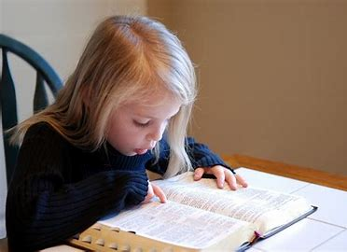
Conclusion
Paul told Timothy “You must continue…”
Be “strong” and “zealous”
Richard Thetford www.thetfordcountry.com

