Slide 1

Titus 2:11-14
Richard Thetford www.thetfordcountry.com

Slide 2


What is Grace?
Grace = “Receiving Unmerited Favor” Grace – “leads to reconciliation”
Grace is a state or condition in which one enjoys God’s favor
Romans 5:1-2
1 Peter 5:12
An expression of gratitude for favor bestowed
Richard Thetford www.thetfordcountry.com

Slide 3

and the Christian
We are saved by Grace
Ephesians 2:5-8
Titus 3:3-7
We are still “unworthy servants”
Always remember: Only by God’s grace is salvation possible for us
Richard Thetford www.thetfordcountry.com

Slide 4

and the Christian
God’s Grace requires Holy living
Titus 2:11-13
Deny ungodliness
Live soberly, righteously and godly
Look for the blessed hope and glorious appearing of Jesus Christ
The unmerited favor of God is no excuse to go on sinning!
Richard Thetford www.thetfordcountry.com

Slide 5

and the Christian
Holy living requires God’s Grace
To live soberly, righteously, and godly
Philippians 2:12-13
Philippians 4:13
Richard Thetford www.thetfordcountry.com

Slide 6

and the Christian
We must grow in Grace
2 Peter 3:18
Acts 20:32
Hebrews 4:16
MERCY: “withholding deserved punishment”
Mercy takes us to the path of forgiveness
Richard Thetford www.thetfordcountry.com

Slide 7
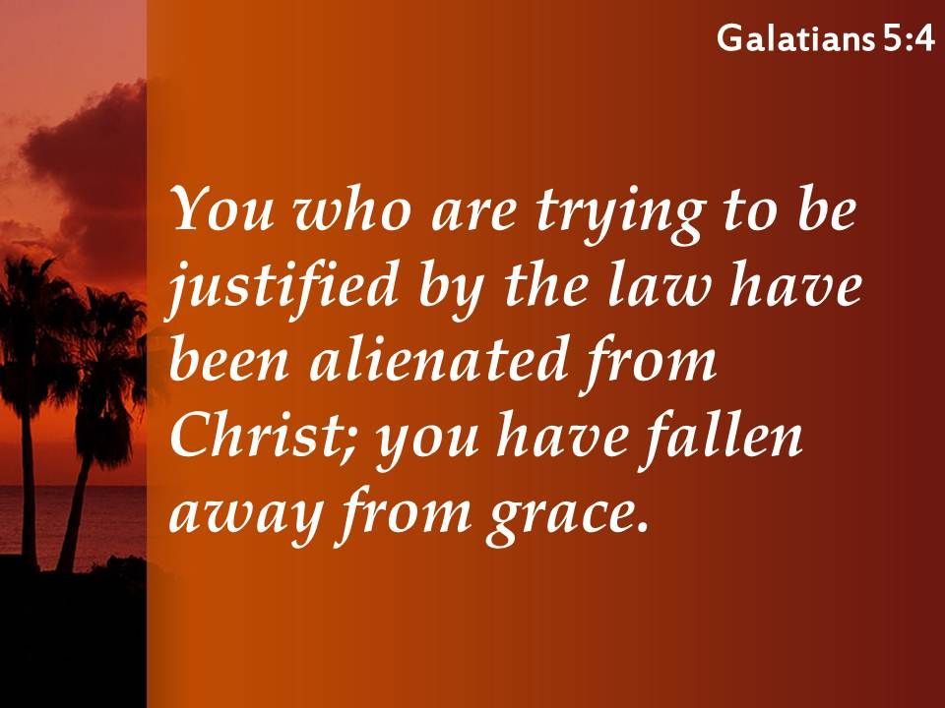
and the Christian
We can receive God’s Grace in vain
2 Corinthians 6:1
Galatians 5:4
Hebrews 10:26-31
Tramples the Son of God underfoot
Counts the blood of the covenant a common thing
Insults the Spirit of grace
Richard Thetford www.thetfordcountry.com

Slide 8

Conclusion
A terrible thing to have received God’s Grace in vain
Just as terrible….
Not to receive it at all
Or, not growing in it
All are encouraged:
Hebrews 12:15
Hebrews 12:28
Hebrews 13:9
Hebrews 13:25
Have you received the wonderful grace of God in your life, by….
being saved,
living a holy life,
growing in grace, and striving to never fall from it?
Richard Thetford www.thetfordcountry.com

