Slide 1

No Repentance, No Fellowship
Luke 13:1-5
Richard Thetford www.thetfordcountry.com

Slide 2
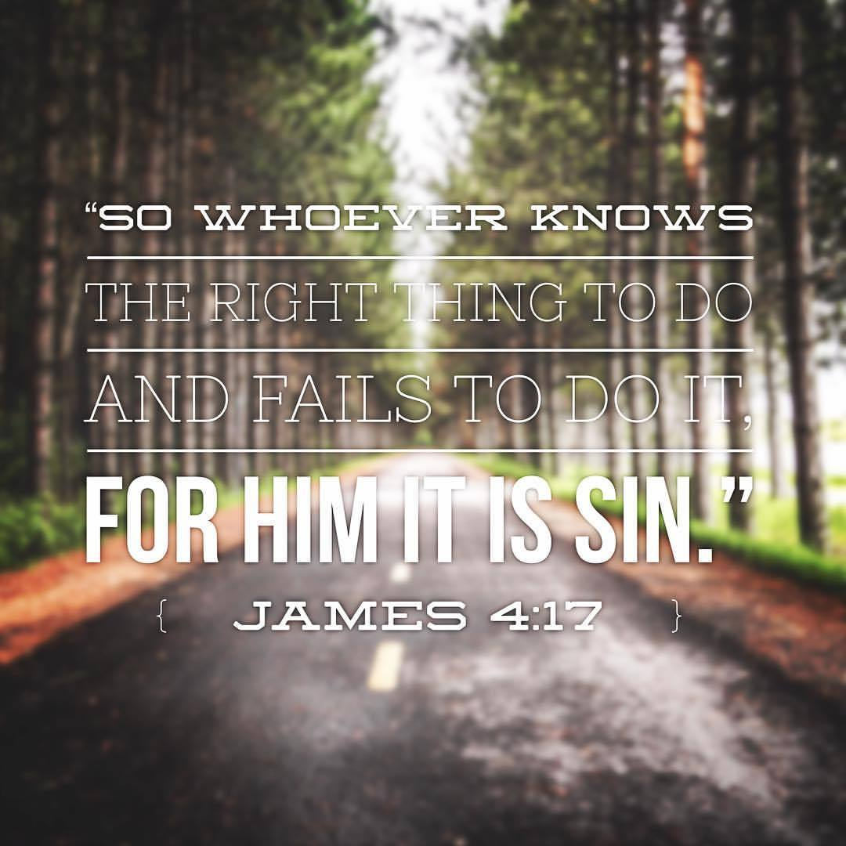
The Need for Repentance
All responsible people are guilty of sin and deserve punishment
Romans 3:23
Romans 6:23
Why are the unrepentant condemned?
1 John 3:4
1 John 5:17
James 4:17
Richard Thetford www.thetfordcountry.com

Slide 3
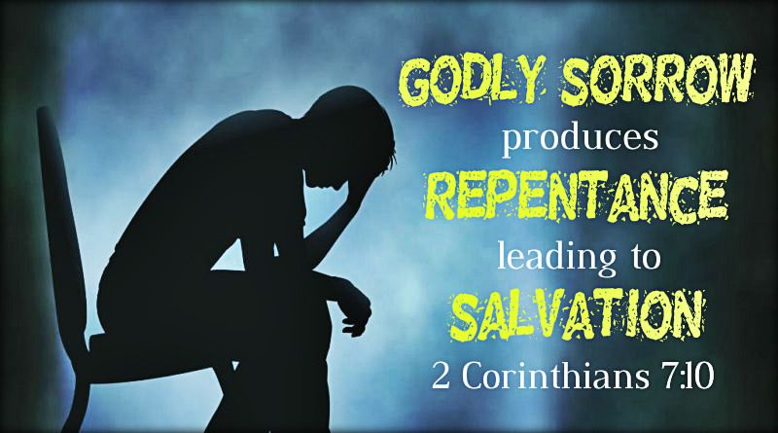
Hindrances to Repentance
Stubbornness
Acts 7:51-58
A lack of sorrow for sin
2 Corinthians 7:10-11
Ignorance
1 Timothy 1:12-13
Richard Thetford www.thetfordcountry.com

Slide 4
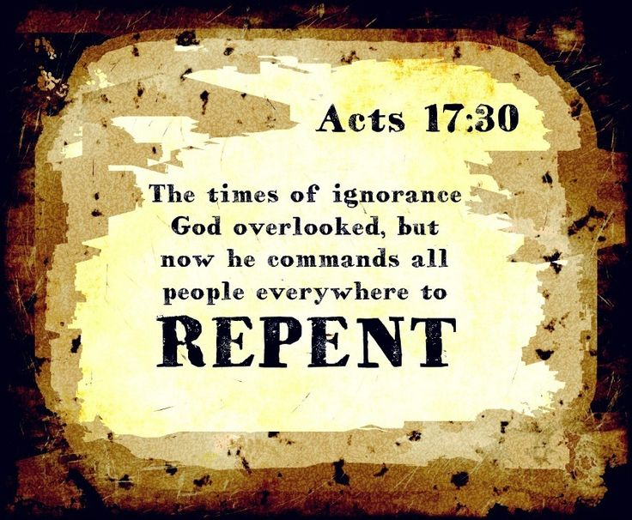
The Urgency of Repentance
Jesus’ statement “unless you repent, you will likewise perish”
Acts 17:30-31
Those lost in sin
Acts 2:36-38
Those who have left the faith
Acts 8:20-22
Richard Thetford www.thetfordcountry.com

Slide 5
Conclusion
Then He said to them, “Thus it is written, and thus it was necessary for the Christ to suffer and to rise from the dead the third day, and that repentance and remission of sins should be preached in His name to all nations, beginning at Jerusalem.”
Luke 24:46-47
Richard Thetford www.thetfordcountry.com

