Slide 1
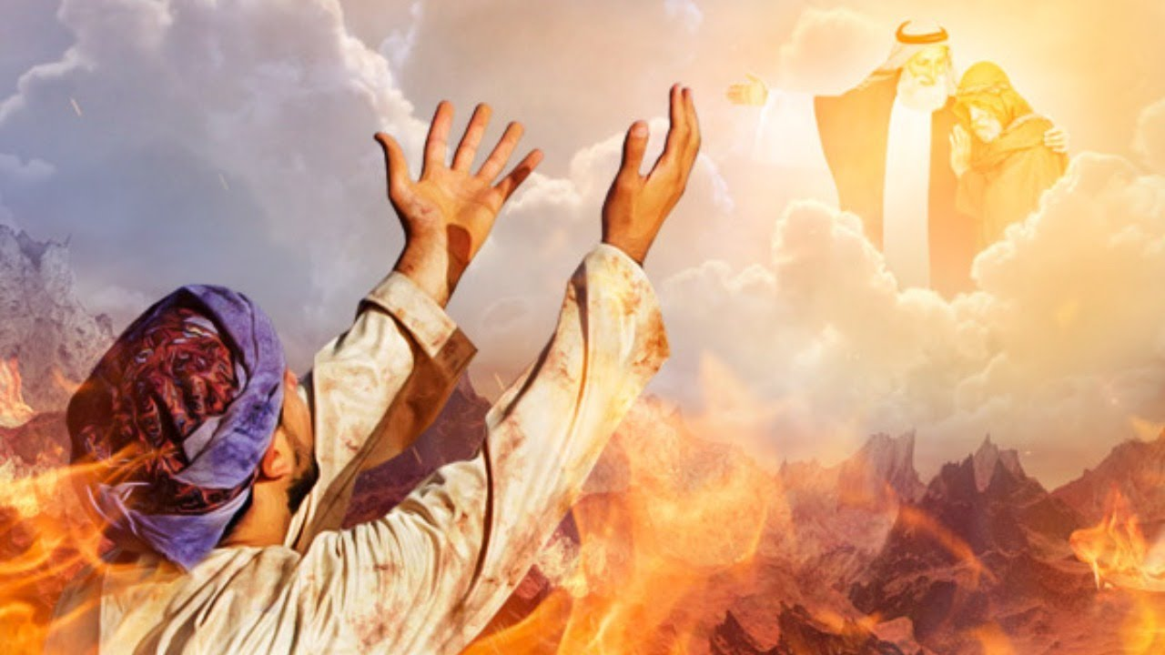
The Rich Man’s Lesson Learned Late
Luke 16:19-31
Richard Thetford www.thetfordcountry.com

Slide 2
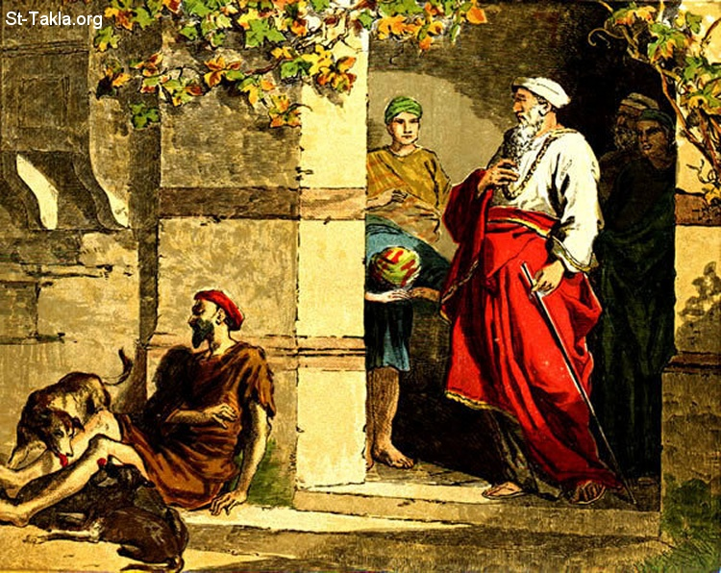
The Story
A rich man and Lazarus
  Luke 16:19-20
Both men died
  Luke 16:22-23
Richard Thetford www.thetfordcountry.com

Slide 3
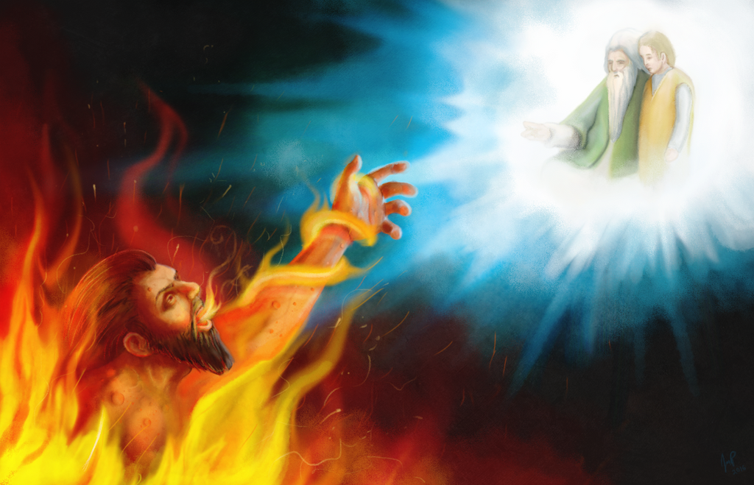
After Death - Hades
Paradise
  Luke 16:22, 25
  Acts 2:25-31
  Luke 23:42-43
Torment
  Luke 16:23-26
Richard Thetford www.thetfordcountry.com

Slide 4
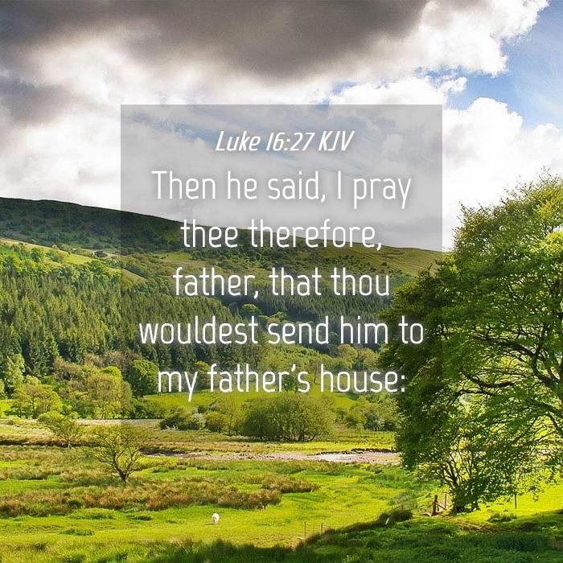
The Need to Listen to God NOW
Rich man wanting to warn others
  Luke 16:27-31
Richard Thetford www.thetfordcountry.com

Slide 5

Important Lessons
Riches or “things”
  Matthew 16:26
Death is coming to everyone
  Ecclesiastes 9:2-3
Everyone will give account
  2 Corinthians 5:10-11
Every knee will bow
  Romans 14:11-12
Richard Thetford www.thetfordcountry.com

