Slide 1

Sad Words Found in the Bible
Richard Thetford www.thetfordcountry.com

Slide 2


“Some Mocked”
The Resurrection of Jesus
  Acts 17:32-34
  Romans 1:4
  1 Peter 3:21
  1 Peter 1:3
  1 Corinthians 15:19
Richard Thetford www.thetfordcountry.com

Slide 3
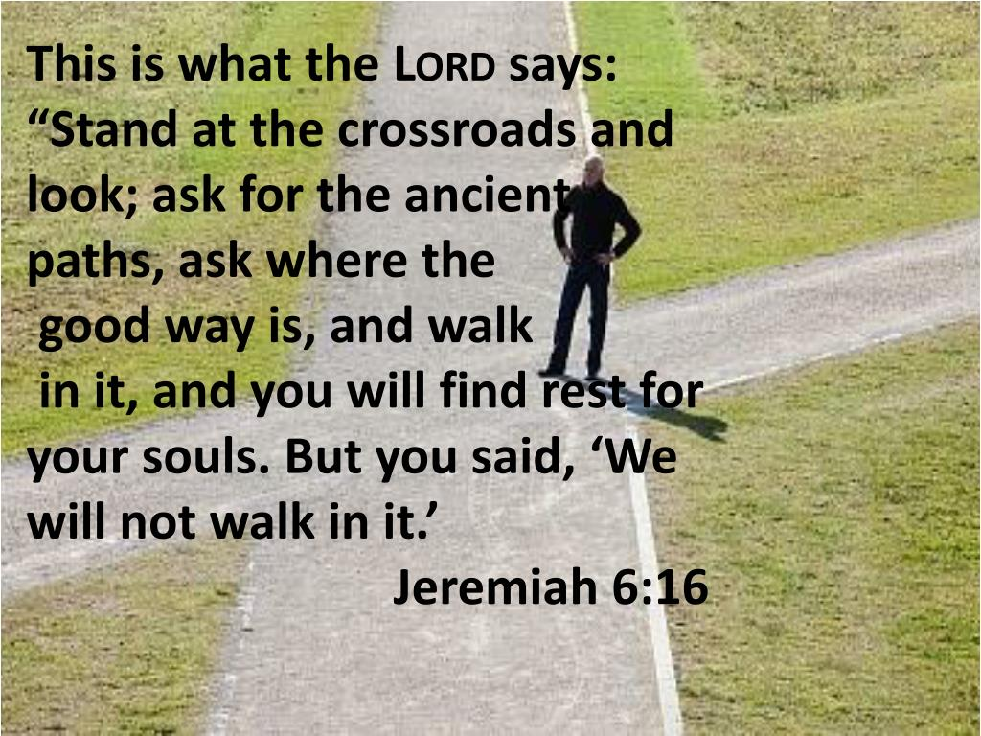
“We Will Not Walk In It”
Walk in the ways of God
  Jeremiah 6:15-19
  Romans 6:4
  1 John 1:7
  Ephesians 4:1; 5:1-2
  1 Thessalonians 4:12
Richard Thetford www.thetfordcountry.com

Slide 4
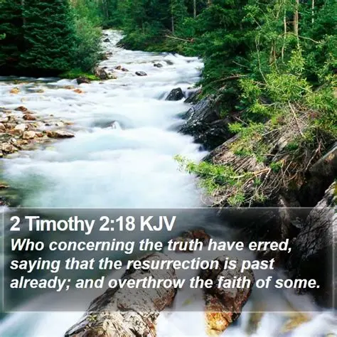
“Who Concerning the
Truth Have Erred”
Turning from God’s truth
  2 Timothy 2:17-18
  John 8:32
  Romans 6:17-18
Richard Thetford www.thetfordcountry.com

Slide 5
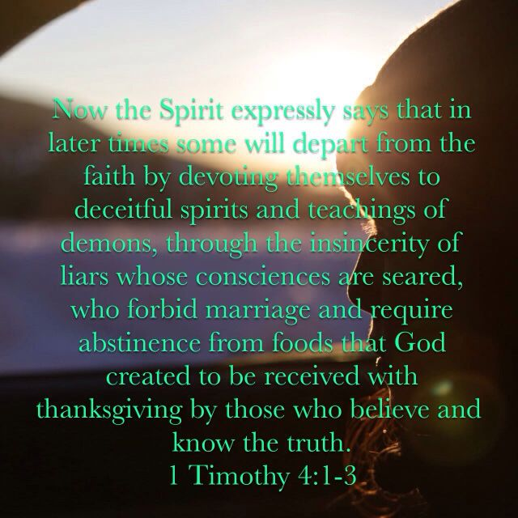
“Some Shall Depart from the Faith”
Departing or denying the faith
  1 Timothy 4:1-3
  1 Timothy 5:8, 12
  1 Timothy 6:10, 20-21
Richard Thetford www.thetfordcountry.com

Slide 6
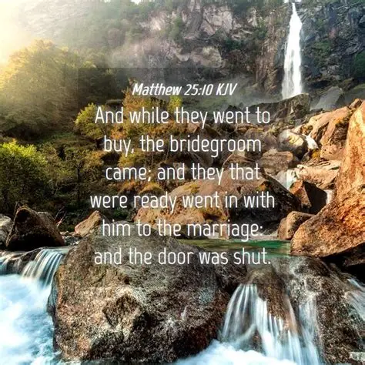
“And the Door Was Shut”
Not ready and/or lost
  Matthew 25:10
  Amos 4:12
Richard Thetford www.thetfordcountry.com

Slide 7
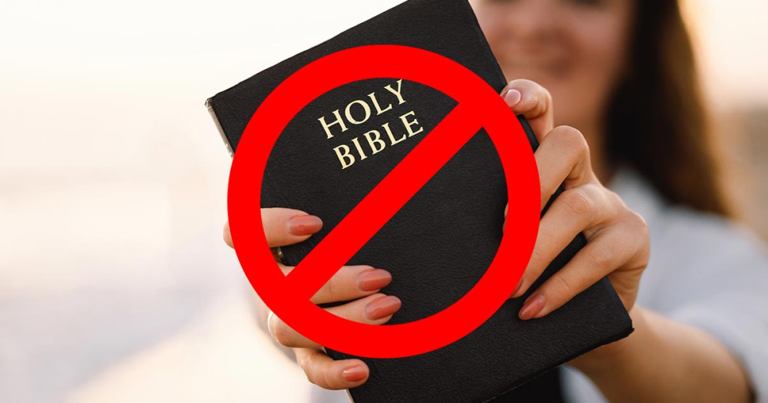
“Go Away for Now”
Refusing salvation
  Acts 24:24-25
Richard Thetford www.thetfordcountry.com

Slide 8
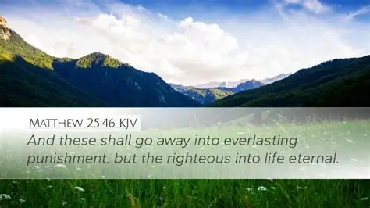
“Depart from Me”
Cast into eternal hell
  Matthew 25:41
  Matthew 25:30
  Matthew 7:21-23
  Matthew 25:46
Richard Thetford www.thetfordcountry.com

Slide 9

“Almost”
So near, yet so far!
  Acts 26:28
  2 Corinthians 5:11
Richard Thetford www.thetfordcountry.com

Slide 10
Sad Words Found in the Bible
What keeps you from being saved?
Richard Thetford www.thetfordcountry.com

