Slide 1

Consequences Both Positive and Negative
SOCIAL MEDIA:
John 15:14
Philippians 4:8
1 John 3:3
1 Peter 2:9
1 Peter 2:21
Richard Thetford www.thetfordcountry.com

Slide 2



Social Media: A Positive Tool
An effective way to share the gospel
  Posting daily scripture readings
  Posting spiritual songs with comments
  Posting regular Bible study articles
  Posting links about gospel meetings
  Posting and hosting Bible study groups
Richard Thetford www.thetfordcountry.com

Slide 3

Social Media: A Positive Tool
Other ways that it can be positive
  Making new friends
  Comforting others
  Speedy communication
  Making distance seem “not so far”
  Building relationships
  Keeping us informed
Richard Thetford www.thetfordcountry.com

Slide 4

Social Media: A Negative Tool
Hides who we claim to be – shows the sin
  Arrogance
  Anger
  Hate
  Gossip
  Backbiting
  Immodesty
  Profanity/Euphemisms
  Promoting filthy things
Richard Thetford www.thetfordcountry.com

Slide 5
Social Media: A Negative Tool
Other negative consequences
  Depression/Anxiety
  Cyberbullying
  Fear of missing out
  Unrealistic expectations
  General addiction
Can diminish our time, loyalty, faithfulness, and love for God
“And you shall love the Lord your God with all your heart, with all your soul, with all your mind, and with all your strength….”
Mark 12:30
Richard Thetford www.thetfordcountry.com

Slide 6

Be Mindful of the Consequences
But Jesus said to him, “No one, having put his hand to the plow,
and looking back, is fit for the kingdom of God.”
Luke 9:62
Positive: Keeping our hand to the plow
Negative: Looking back
  James 1:8
  James 4:4
  1 Corinthians 15:33
Richard Thetford www.thetfordcountry.com

Slide 7
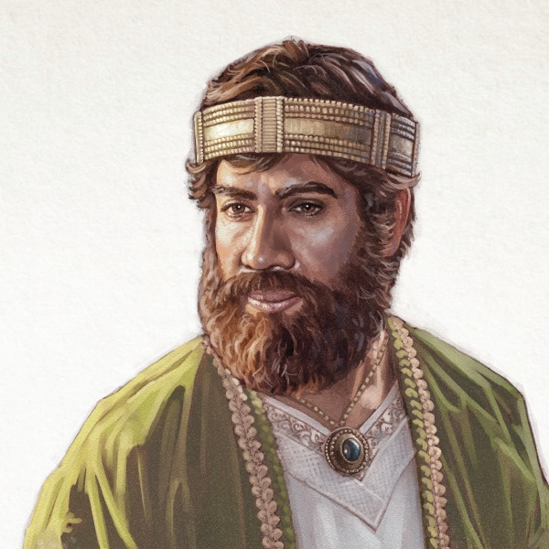
Be Mindful of the Consequences
But Jesus said to him, “No one, having put his hand to the plow,
and looking back, is fit for the kingdom of God.”
Luke 9:62
The reality of the consequences
  Paul taught: Philippians 3:13-14
  The Hebrew writer: Hebrews 12:1-2
  Peter warned: 2 Peter 2:20-21
Beware of the consequences
  Rehoboam’s example:
    1 Kings 12:3-11
Rehoboam rejects wise counsel
Richard Thetford www.thetfordcountry.com

Slide 8
Stay Focused on Our Reward
The faithful:
  Consequences of refusing to confess Christ
    Matthew 10:32-33
    2 Timothy 1:8, 12
    Luke 9:26
Moses:
  Hebrews 11:24-26
“And truly if they had called to mind that country from which they had come out, they would have had opportunity to return. But now they desire a better, that is, a heavenly country. Therefore, God is not ashamed to be called their God, for He has prepared a city for them.”
Hebrews 11:15-16
Richard Thetford www.thetfordcountry.com

Slide 9
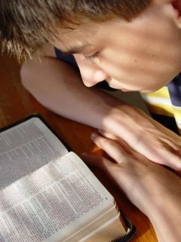
Conclusion
Social Media – A tool for positive or negative
  1 Corinthians 3:16-17
We are to imitate Christ
  1 Corinthians 11:1
Others should see our progress
  1 Timothy 4:12-16
Each soul must choose between:
  Life and death, holiness and sin, Christ and the world, fellowship with the children of God and friendship with the world
Richard Thetford www.thetfordcountry.com

Slide 10
Consequences Both Positive and Negative
Glorifying God Through Social Media
SOCIAL MEDIA:
Your Talk Talks
and your Walk Talks,
but your Walk Talks
more than your Talk Talks
Richard Thetford www.thetfordcountry.com

