Slide 1

The Source and Object of Man’s Love
This is My commandment, that you love one another as I have loved you. Greater love has no one than this, than to lay down one's life for his friends. John 15:12-13
Richard Thetford www.thetfordcounty.com

Slide 2
The Source of Man’s Love
Recognize the source of our love
1 John 4:7,19
Our love is the offspring of God’s love
1 John 4:21
We see man’s intrinsic worth and possibility in Christ
2 Corinthians 5:14-17
Richard Thetford www.thetfordcounty.com

Slide 3

The Object of Man’s Love
God must be the first object of man’s love
Must be loved with our all
Mark 12:29-34
Love shown in the keeping of His commandments
1 John 5:3
2 John 6
Deuteronomy 10:12
Richard Thetford www.thetfordcounty.com

Slide 4

The Object of Man’s Love
God must be the first object of man’s love
Will hate evil and all forms of worldliness
1 John 2:15-17
Must be chosen above all others
Matthew 10:35-38
1 Peter 1:8
Richard Thetford www.thetfordcounty.com

Slide 5

The Object of Man’s Love
Love of man must also be the object of man’s love
Natural consequence of the love of the fatherhood
1 John 3:10
Can’t love God and hate man
1 John 4:20-21
John 13:34
Romans 13:10
1 Corinthians 13:1-8
Richard Thetford www.thetfordcounty.com

Slide 6

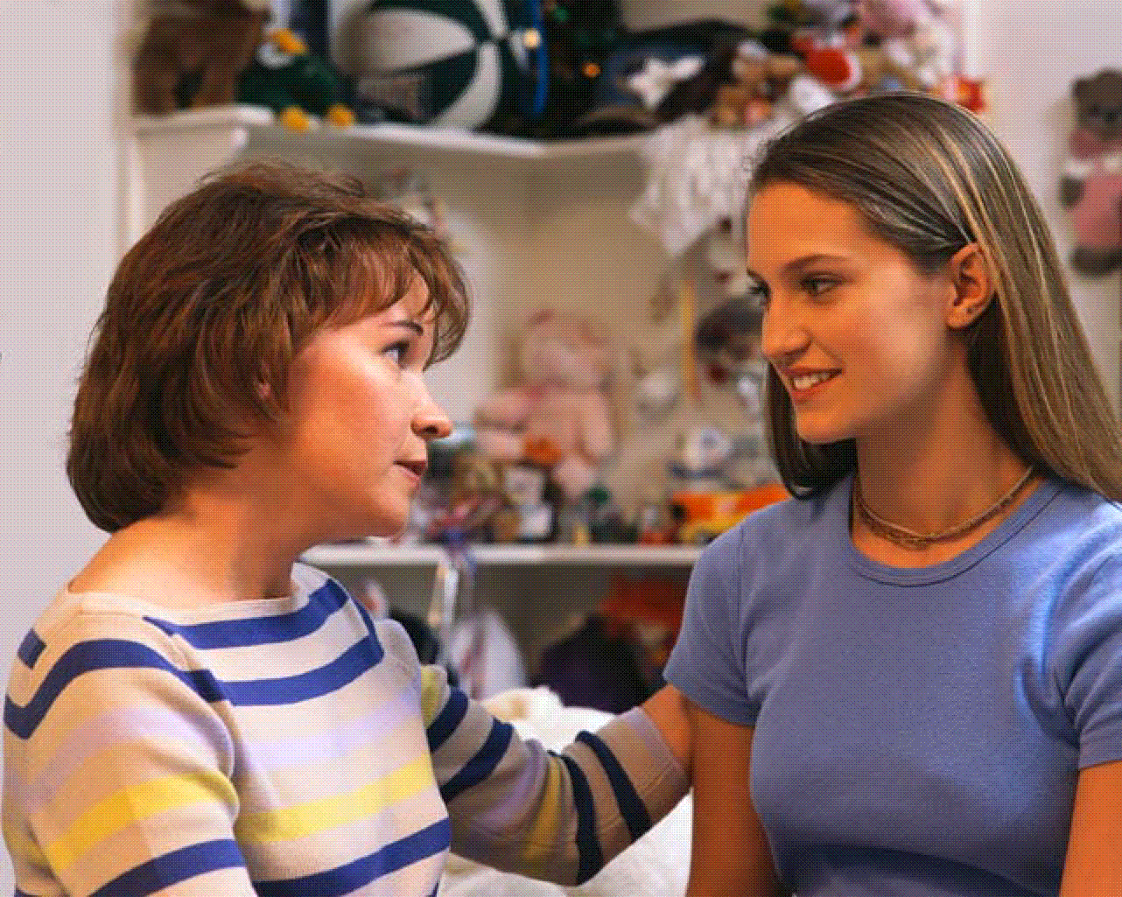
The Object of Man’s Love
Love of man must also be the object of man’s love
Love should be without hypocrisy
1 John 3:18
Galatians 5:13
Love seeks the welfare of others
Romans 15:1-2
Philippians 2:3-4
Ephesians 4:32
Romans 12:10
Richard Thetford www.thetfordcounty.com

Slide 7
Conclusion
What is more vital than to possess such love?
Fulfillment of the royal law
James 2:8
Put above everything else
Colossians 3:14
Know we have passed from death to life
1 John 3:14
Richard Thetford www.thetfordcounty.com

Slide 8
Conclusion
Supreme test of abiding in God and God in us
No one has seen God at any time. If we love one another, God abides in us, and His love has been perfected in us. By this we know that we abide in Him, and He in us, because He has given us of His Spirit. And we have seen and testify that the Father has sent the Son as Savior of the world. Whoever confesses that Jesus is the Son of God, God abides in him, and he in God. And we have known and believed the love that God has for us. God is love, and he who abides in love abides in God, and God in him.
1 John 4:12-16
Richard Thetford www.thetfordcounty.com

