Slide 1

Matthew 25:14-30
Richard Thetford www.thetfordcountry.com

Slide 2
Key Passage of Scripture Matthew 6:19-21
What really matters is storing up treasures in heaven
Whatever our treasure is – there we will find our heart
Richard Thetford www.thetfordcountry.com

Slide 3
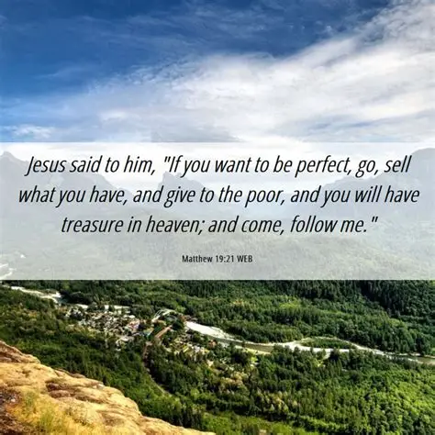
Understanding Heavenly Treasures
The nature of heavenly treasures
Eternal and imperishable
Spiritual rather than material
Jesus calls on us to invest in heavenly riches
Matthew 19:21
The importance of generosity
Luke 12:33-34
Richard Thetford www.thetfordcountry.com

Slide 4

Types of Treasures in Heaven
Benefits:
Salvation and eternal life
Rewards for our faithfulness on earth
2 Timothy 4:8
Invest wisely with what we have been given
Matthew 25:14-30
Richard Thetford www.thetfordcountry.com

Slide 5

Types of Treasures in Heaven
Things that generate “laying up treasures in heaven”
Acts of kindness
Generosity and giving
Building relationships
Living with integrity
Prayer and spiritual growth
These everyday actions reflect a heart focused on eternal values and contribute to storing up treasures in heaven!
Richard Thetford www.thetfordcountry.com

Slide 6
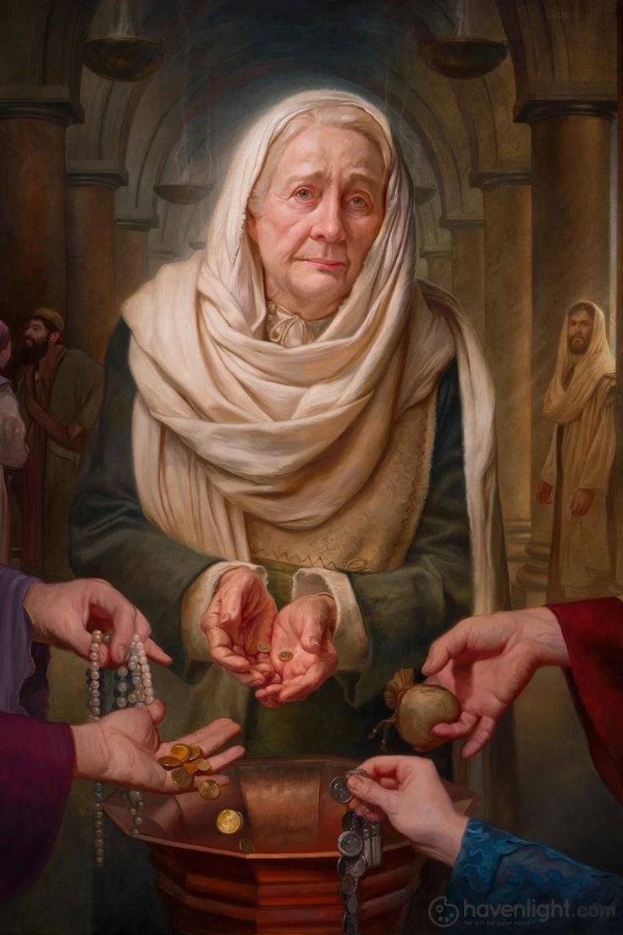
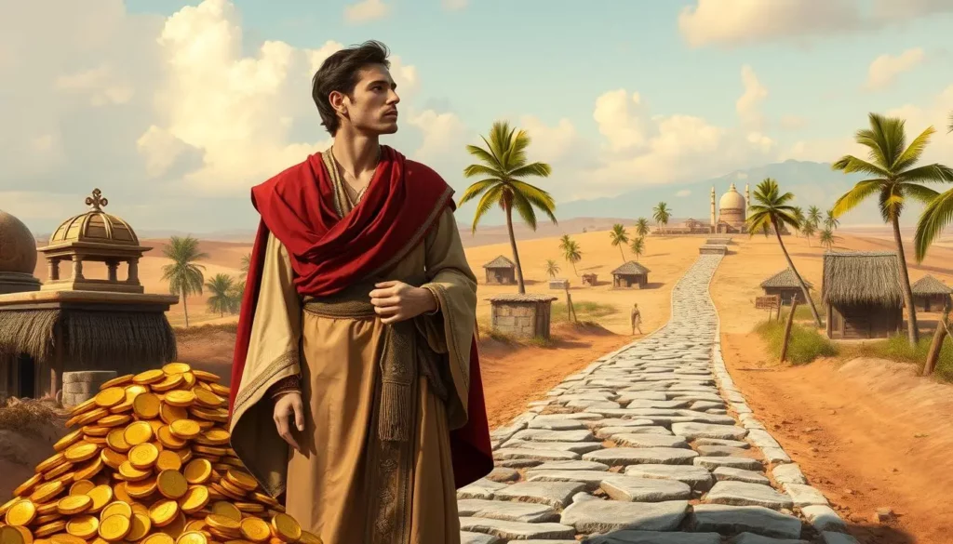
Illustrative Stories to Learn By
The rich young ruler
Matthew 19:16-22
The widow’s mites
Mark 12:41-44
Richard Thetford www.thetfordcountry.com

Slide 7

Conclusion
Prioritize the eternal over the temporal
Look within to reflect on personal priorities
We cannot afford to miss heaven!
Richard Thetford www.thetfordcountry.com

