Slide 1

2 Corinthians 5:7-8
Philippians 1:21-23
Psalms 90:10-12
James 2:26
Richard Thetford www.thetfordcountry.com

Slide 2

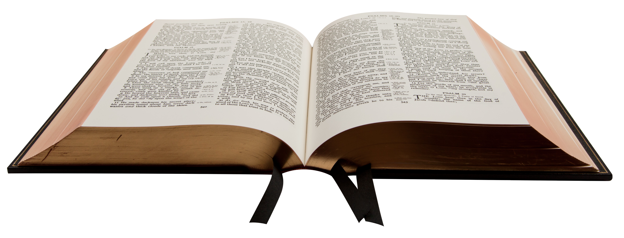
Righteousness versus Unrighteousness
Righteous and Unrighteous final destination
  Matthew 13:41-43
  1 John 3:1-2
  Philippians 3:21
  Romans 8:18
  Revelation 14:11
Richard Thetford www.thetfordcountry.com

Slide 3
At Death – Where Does the Spirit Go?
Unrighteous – to torment
  2 Peter 2:4
Righteous – to paradise
  Luke 16:19-31
Must listen to Jesus now
  John 14:6
  Matthew 17:5
Richard Thetford www.thetfordcountry.com

Slide 4
The Judgment
All must appear before Jesus
  2 Corinthians 5:10
We’ll be changed
  1 Corinthians 15:51-52
  1 Thessalonians 4:13-18
Richard Thetford www.thetfordcountry.com

Slide 5
The Judgment
Future recognition
  2 Corinthians 4:14
  Matthew 7:22
  Matthew 25:39-40
  Genesis 25:8
  Deuteronomy 32:50
We’ll be raised incorruptible
  1 Corinthians 15:42-44
Richard Thetford www.thetfordcountry.com

Slide 6
Conclusion
What kind of book is your life story writing?
Do we have the same confidence as Paul?
“For I am already being poured out as a drink offering, and the time of my departure is at hand. I have fought the good fight, I have finished the race, I have kept the faith. Finally, there is laid up for me the crown of righteousness, which the Lord, the righteous Judge, will give to me on that Day, and not to me only but also to all who have loved His appearing.”
2 Timothy 4:6-8
Richard Thetford www.thetfordcountry.com

