Slide 1
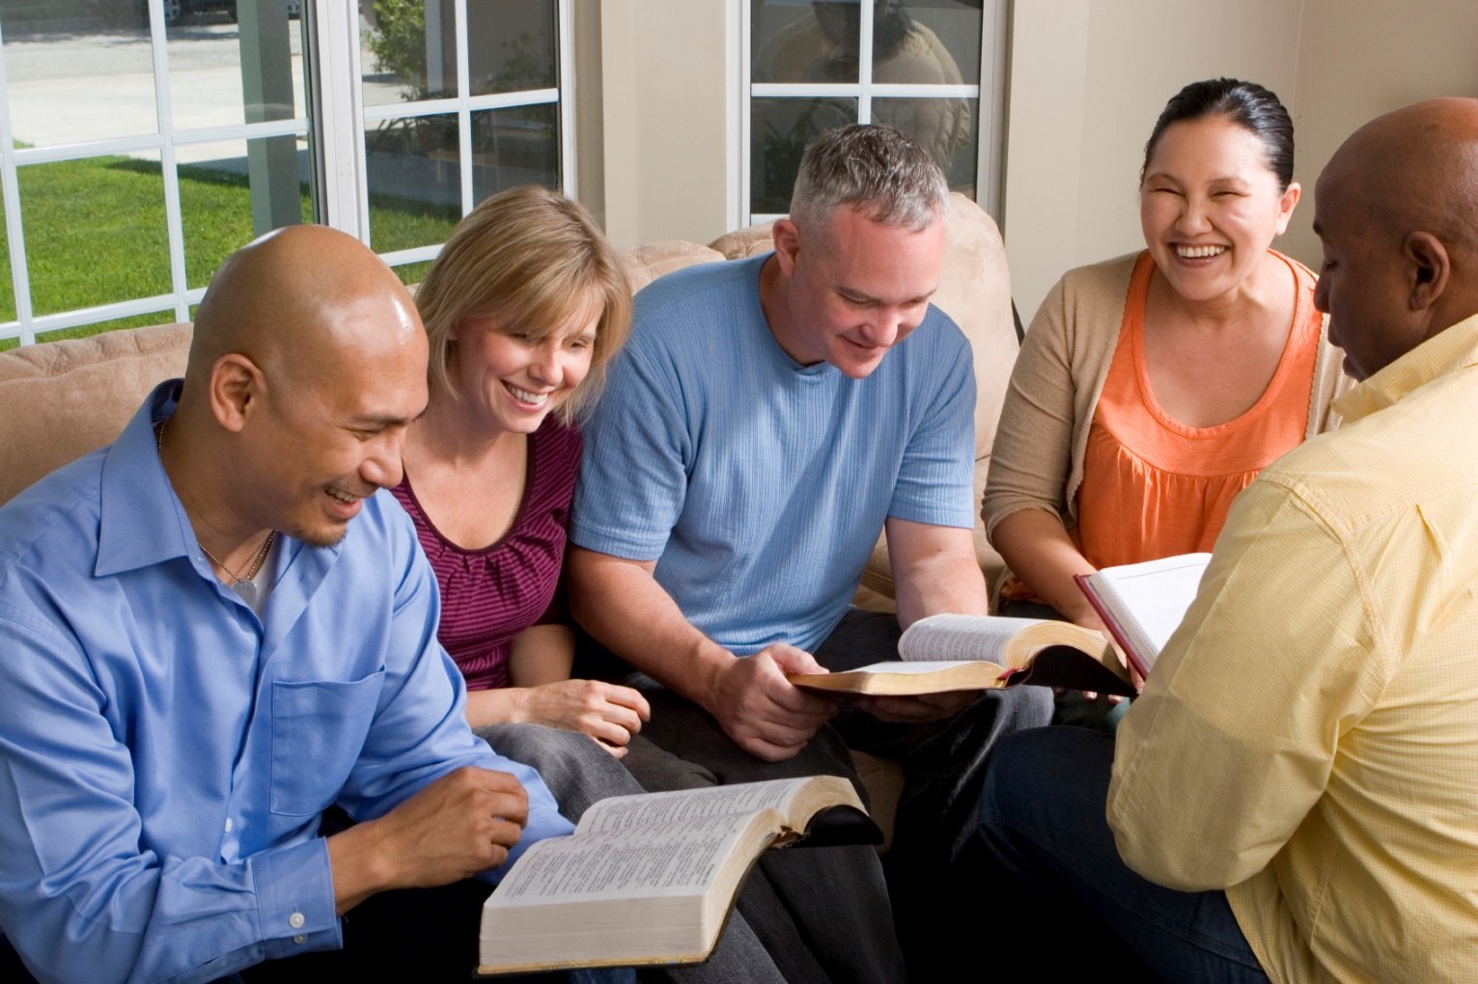
Building Our Faith….

Slide 2
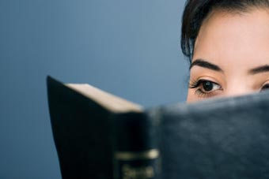
Building Our Faith…. ….By the Example of Abraham
Hebrews
11:8-10, 17-19
Abraham’s calling
11:8-10
Abraham’s trial
11:17-19

Slide 3
Abraham
“by faith Abraham obeyed
when he was called…”
Abraham was willing to believe God
Deep and abiding trust
Scripture monuments to his faith:
Romans 4, Hebrews 11, James 2
Used often as an example of faith!

Slide 4
Abraham
Obedience to the Divine Call
Begins a lifelong journey
Genesis 12:1-9
Left a large city to go to the unknown
Listened to God’s instruction
Put God above all others
Matthew 10:32-39

Slide 5
Abraham
Personal Trial of Faith
Hebrews 11:17-19
Offering his son Isaac
Genesis 22:1-13
His faith exemplified:
Prompt action
Thorough preparation
Complete confidence
Complete obedience (v12)

Slide 6
Abraham
Personal Trial of Faith
Hebrews 11:17-19
Faith said “I believe in God”
Works said “I’ll show you how much.”
Had a perfect faith – grew to maturity
“Was not Abraham our father justified by works when he offered Isaac his son on the altar? Do you see that faith was working together with his works, and by works faith was made perfect? And the Scripture was fulfilled which says, "ABRAHAM BELIEVED GOD, AND IT WAS ACCOUNTED TO HIM FOR RIGHTEOUSNESS." And he was called the friend of God. You see then that a man is justified by works, and not by faith only.” James 2:21-24

Slide 7
Abraham
Summary
Key verse – Hebrews 11:8
“by faith Abraham obeyed when he was called…”
Key thought
Knew where the source of life was
Faith is simply the willingness to trust God,
to take Him at His word, to do it “His way.”

