Slide 1
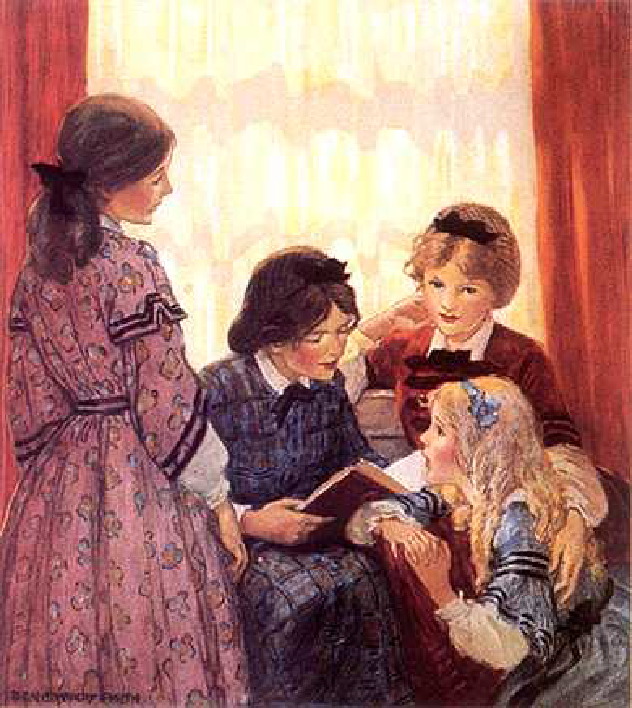
A Caring People
“Let your light so shine before men, that they may see your good works and glorify your Father in heaven.”
Matthew 5:16
Richie Thetford www.thetfordcountry.com

Slide 2
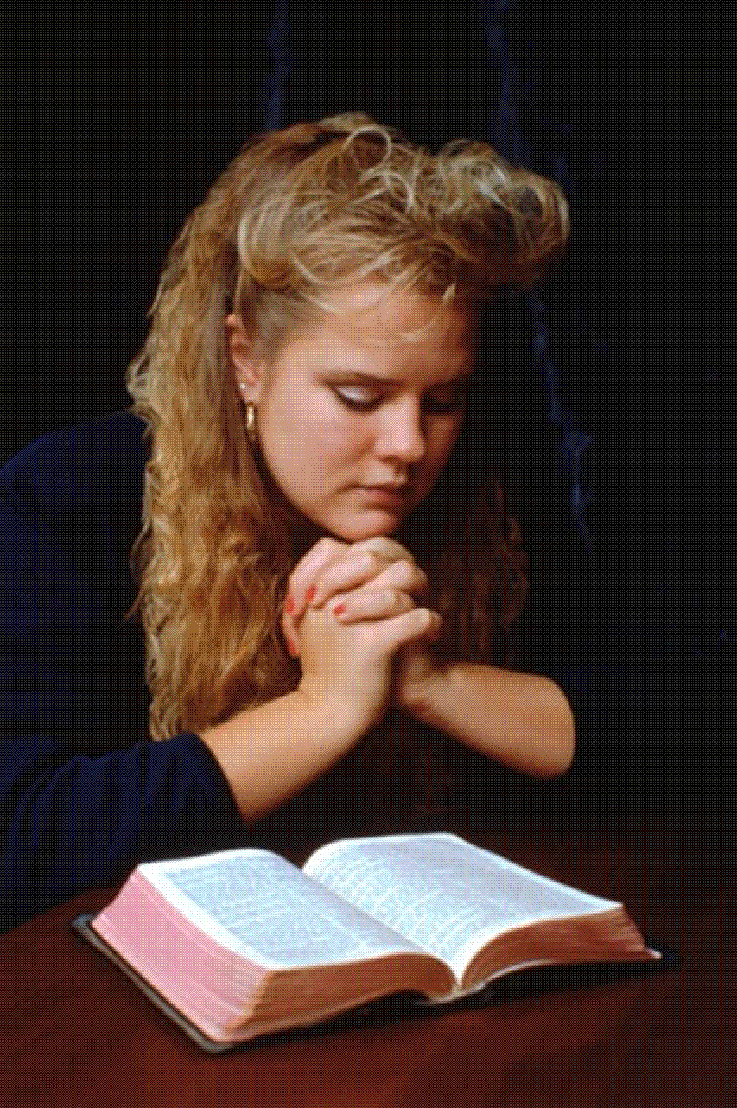
CHRISTIANS CARE Because:
We want to be like God
Psalms 23
We want to be like Christ
Romans 5:8
We want to be like 1st century Christians
Acts 4:36-37; Romans 16:1-2
It shows a mark of maturity
1 Corinthians 13:4-7
Richie Thetford www.thetfordcountry.com

Slide 3
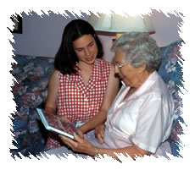
CARING CHRISTIANS
Are helpful
Acts 4:32-37
Help others feel needed and useful
1 Corinthians 12:23-26
Are benevolent
Matthew 25:31-46
Richie Thetford www.thetfordcountry.com

Slide 4
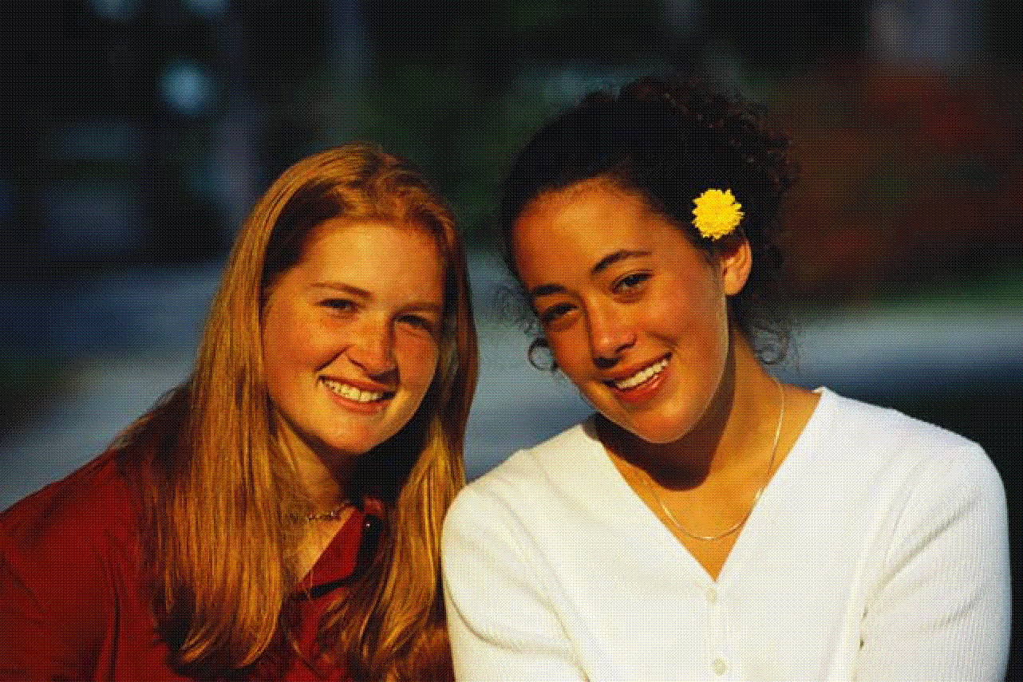
CARING CHRISTIANS
Are friendly
Romans 16:16; 1 Corinthians 16:20
Are concerned about all souls
Psalms 142:4; 1 Timothy 4:16
Richie Thetford www.thetfordcountry.com

Slide 5
A Caring People
Those whom we love and admire the most are caring people
Caring is shown
by way of:
visiting, evangelizing, edifying, benevolence
Richie Thetford www.thetfordcountry.com

