Slide 1
“All That the Lord Has Spoken We Will Do”
Exodus 19:1-8
Richie Thetford www.thetfordcountry.com

Slide 2
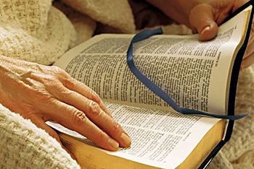
“All That the Lord Has Spoken We Will Do”
Deliverance
John 8:33-34
Romans 11:26
Colossians 1:13-14
1 Peter 1:18-19
Obedience
Romans 6:17-18
Hebrews 5:8-9
Richie Thetford www.thetfordcountry.com

Slide 3
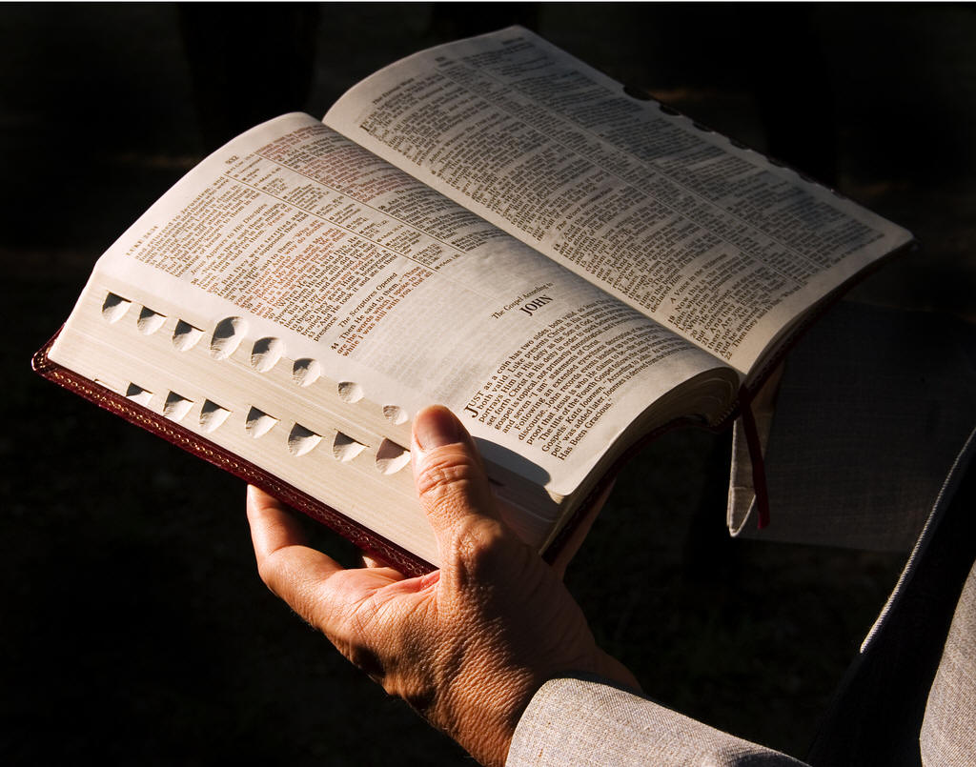
“All That the Lord Has Spoken We Will Do”
Special Treasure
Isaiah 43:1-4
Titus 2:14
1 Peter 2:9-10
Kingdom of Priests
Revelation 1:6
1 Peter 2:9
Richie Thetford www.thetfordcountry.com

Slide 4
“All That the Lord Has Spoken We Will Do”
Holy Nation
Leviticus 19:2
1 Peter 1:15-16
Mediator
1 Timothy 2:5
Hebrews 7:25
Philippians 2:5-11
Richie Thetford www.thetfordcountry.com

Slide 5
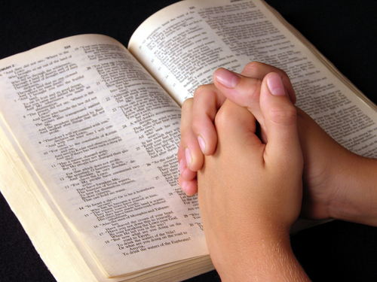
“All That the Lord Has Spoken We Will Do”
Sanctification
John 17:17-19
Awe and Respect
Hebrews 12:18-24, 28
Trumpet Sound
1 Thessalonians 4:13-18
1 Corinthians 15:52
Richie Thetford www.thetfordcountry.com

Slide 6
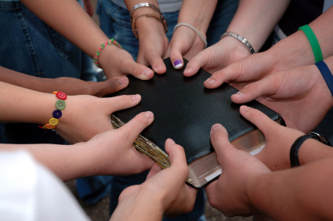
“All That the Lord Has Spoken We Will Do”
Richie Thetford www.thetfordcountry.com

