Slide 1
Answering the call of god
“And I also say to you that you are Peter, and on this rock I will build My church, and the gates of Hades shall not prevail against it.”
Matthew 16:18
Richard Thetford www.thetfordcountry.com

Slide 2
Jesus built His church
One body – the church
Ephesians 4:4
Ephesians 1:22-23
Colossians 1:18, 24
Richard Thetford www.thetfordcountry.com

Slide 3
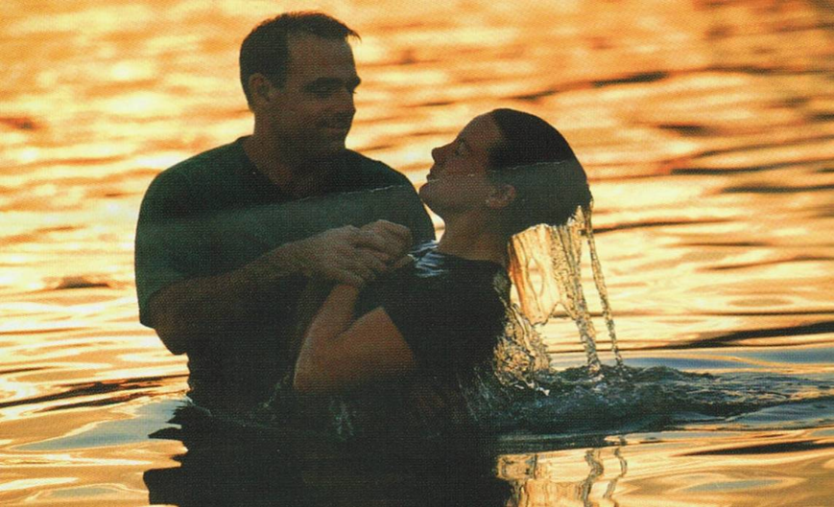
Jesus built His church
The church universal
Added through baptism
1 Corinthians 12:12-13
The church local
Composed of the baptized
Worship faithfully together
Lay by into a common treasury
1 Corinthians 1:2
Richard Thetford www.thetfordcountry.com

Slide 4
Ways in which god calls us
To walk in the steps of Jesus
1 Peter 2:21
By the gospel
2 Thessalonians 2:13-14
1 Peter 1:10-11
1 Corinthians 2:6-8
To the hope of eternal life
1 Timothy 6:12
Richard Thetford www.thetfordcountry.com

Slide 5
Ways in which god calls us
Out of Darkness
1 Peter 2:9
Out of Satan’s domain
Colossians 1:13
Matthew 15:13-14
1 John 4:1
Romans 6:16-18
Richard Thetford www.thetfordcountry.com

Slide 6
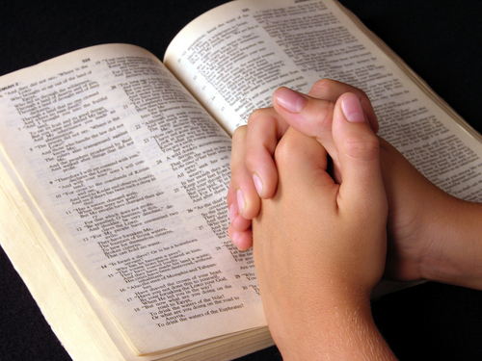
Ways in which god calls us
“called out”
Stresses separation from the world
“in the church” means set apart for God
2 Corinthians 6:17
James 4:4
Richard Thetford www.thetfordcountry.com

Slide 7
Facts concerning the call of god
Everyone is called the same way
By the gospel
2 Thessalonians 2:13-14
God is no respecter of persons
Romans 2:11
Acts 10:34
To reject the gospel is to reject His call
1 Thessalonians 4:7-8
Hebrews 1:1-3
Richard Thetford www.thetfordcountry.com

Slide 8
conclusion
Purpose of our calling is seen in God’s goodness
Philippians 3:14
Make our call and election sure
2 Peter 1:10-11
Those added to the church have answered the “call” of God
Richard Thetford www.thetfordcountry.com

