Slide 1
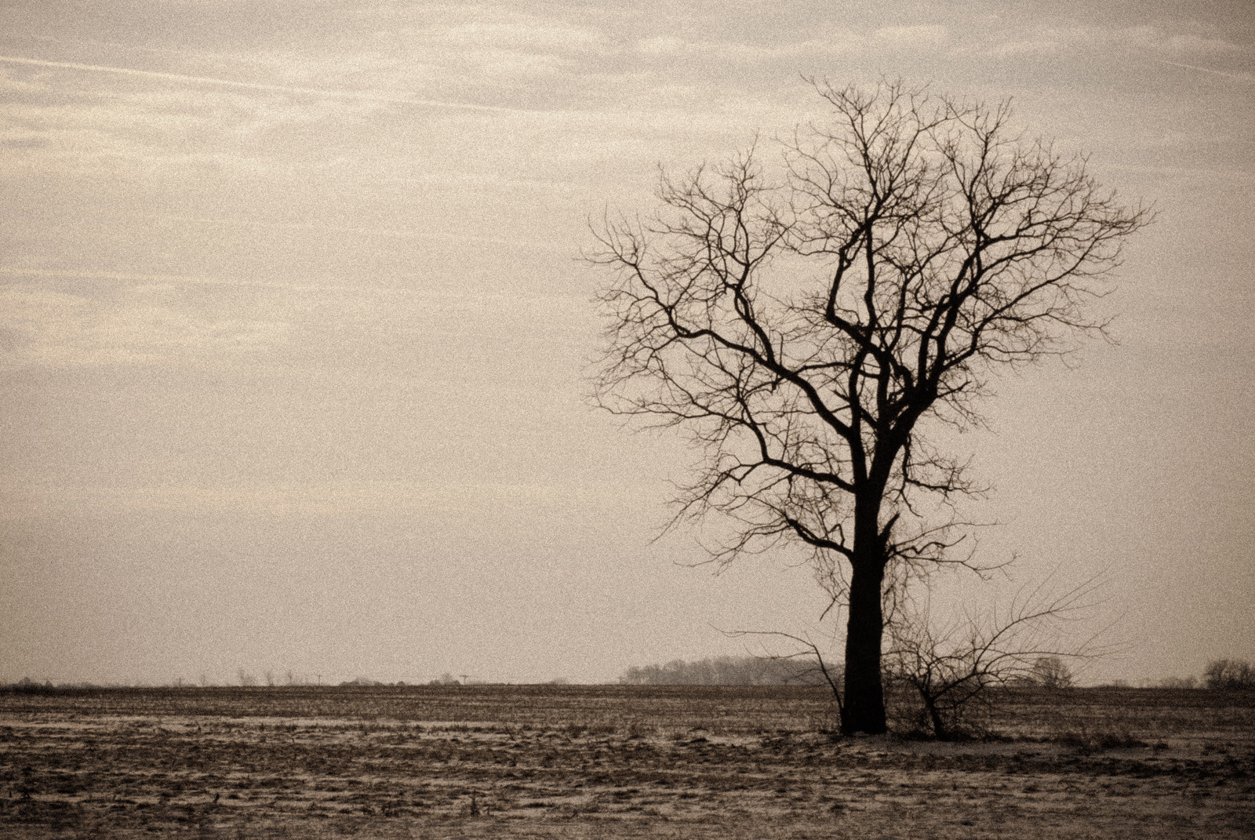
The Barren Fig Tree
Luke 13:6-9
Richie Thetford www.thetfordcountry.com

Slide 2
Lesson of the Parable
Owner of the vineyard comes to check on the progress of the Fig Tree
Tree had not produced properly in the vineyard
The Fig Tree (the Jews), should have the desire and motivation to move the plan of God forward, yet they resisted God’s scheme
The Vinedresser intercedes
Richie Thetford www.thetfordcountry.com

Slide 3
Application Principles Today
God has invested in our salvation
1 Corinthians 6:19-20; 7:23
Romans 8:32
Psalms 92:13-14
Hebrews 5:12-14
Matthew 28:18-20
Galatians 5:22-23
Matthew 25:34-36; 3:10; 13:22
Colossians 1:10
Richie Thetford www.thetfordcountry.com

Slide 4
Application Principles Today
Jesus intercedes for us
Hebrews 7:25
God is longsuffering
2 Peter 3:9
A final day of accounting awaits us
2 Corinthians 5:10
Hebrews 9:27
Richie Thetford www.thetfordcountry.com

Slide 5
Must Abide in the Word of Christ
John 15:1-8
“If you abide in My word,
you are My disciples indeed.”
John 8:31
Richie Thetford www.thetfordcountry.com

