Slide 1
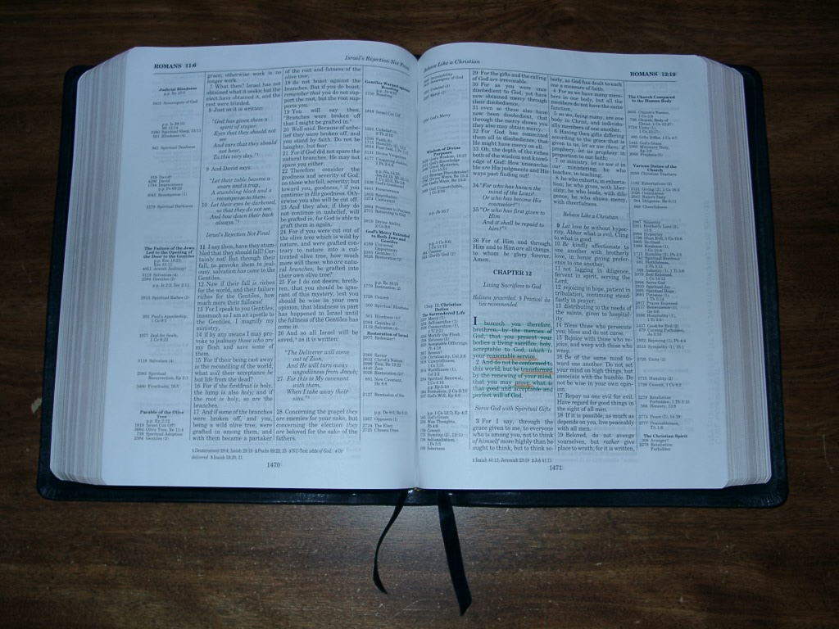
Being devoted to god
Romans 12:1-8
Richard Thetford www.thetfordcountry.com

Slide 2
self sacrifice (v.1)
Contrast between Christian and Gentile
Romans 1:24
1 Corinthians 6:12
1 Corinthians 6:19-20
A complete surrender of SELF
2 Corinthians 8:5
Richard Thetford www.thetfordcountry.com

Slide 3
self alteration (v.2)
Two view points
Negatively
1 John 2:15-17
Positively
To be “transformed”
Richard Thetford www.thetfordcountry.com

Slide 4
self examination (v.3)
Essential to spiritual growth
2 Corinthians 10:12-18
Examine by the right standard
James 1:23-25
Richard Thetford www.thetfordcountry.com

Slide 5
self involvement (v.4-8)
Something for everyone to do
Our “spiritual service”
Richard Thetford www.thetfordcountry.com

Slide 6
conclusion
Must be devoted
Colossians 3:17
Grounded in Scriptures and shining lights!
Matthew 5:16
Richard Thetford www.thetfordcountry.com

