Slide 1
Christian Characteristics
VIRTUE
2 Peter 1:5-10
Moral
Excellence
“Standing up for what is right regardless of what others think or what will happen to us.”
“to do what one has to do as if from inclination – likened to courage which is the quality of being fearless.”
Richie Thetford www.thetfordcountry.com

Slide 2
Ralph Waldo Emerson
“Whatever you do, you need courage. Whatever course you decide upon, there is always someone to tell you that you are wrong. There are always difficulties arising that tempt you to believe your critics are right. To map out a course of action and follow it to an end requires some of the same courage that a soldier needs. Peace has its victories, but it takes brave men and women to win them.”
Richie Thetford www.thetfordcountry.com

Slide 3
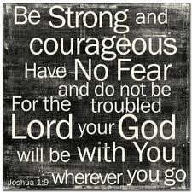
Courage Ordered
Old Testament
Joshua
Joshua 1:6-9
Israel
Joshua 23:1-6
Richie Thetford www.thetfordcountry.com

Slide 4
Courage Ordered
New Testament
Upon the Disciples of Christ
Matthew 10:28
Ordered by Paul
1 Corinthians 16:13
Philippians 1:27-28
“And do not fear those who kill the body but cannot kill the soul. But rather fear Him who is able to destroy both soul and body in hell”.
Richie Thetford www.thetfordcountry.com

Slide 5
Courage Is Needed
Must always do what is right
Majority are sometimes wrong
Matthew 7:13-14
“Enter by the narrow gate; for wide is the gate and broad is the way that leads to destruction, and there are many who go in by it. Because narrow is the gate and difficult is the way which leads to life, and there are few who find it.”
Richie Thetford www.thetfordcountry.com

Slide 6
Courage Is Needed
Must always do what is right
Strength shown with our trust in God
Philippians 4:13
Leviticus 26:8
Bible examples who show us COURAGE even while in the minority
Joshua and Caleb – Numbers 13:30; 14:6f
Gideon – Judges 7:2-12
Daniel – Daniel 6:1-23
Paul – 2 Timothy 4:14-18
Apostles – Acts 4:18-20; 5:28-29
Richie Thetford www.thetfordcountry.com

Slide 7
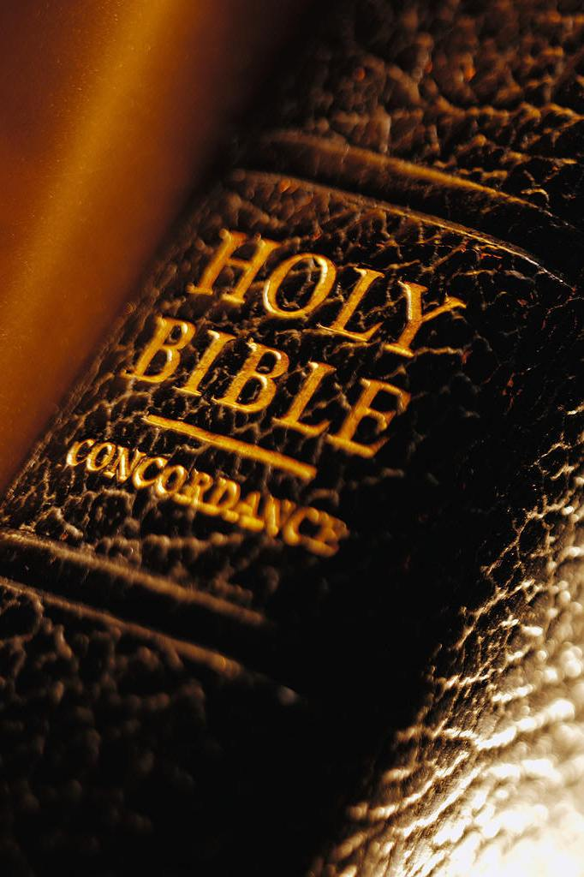
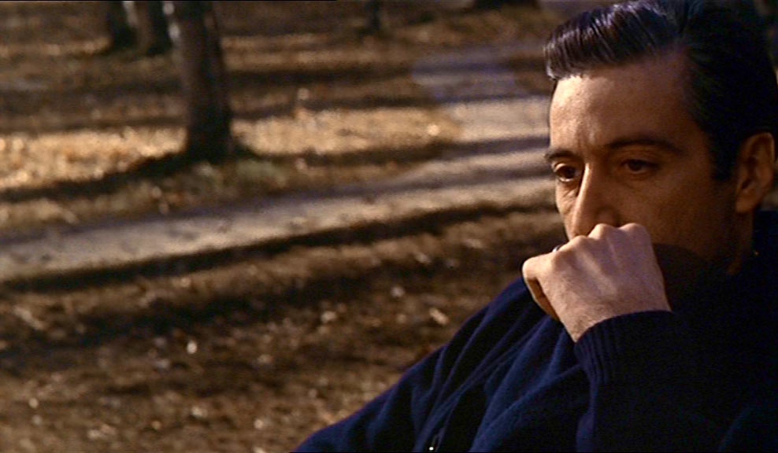
We Are Virtuous When We:
Endure Temptation
Temptation endured is for our own good
James 1:12; 1 Peter 1:6
Richie Thetford www.thetfordcountry.com

Slide 8
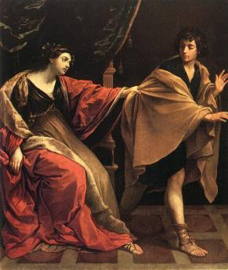
We Are Virtuous When We:
Have courage to say “NO”
Joseph was an example of this
Genesis 39:7-9
Learn to avoid situations that will get us into trouble!
Richie Thetford www.thetfordcountry.com

Slide 9
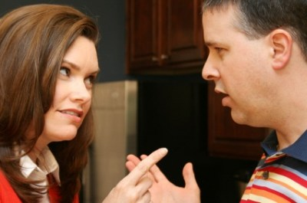
We Are Virtuous When We:
Have courage to reprove those who sin
Takes courage to confront the problem
Titus 1:13
Richie Thetford www.thetfordcountry.com

Slide 10
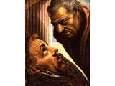
We Are Virtuous When We:
Have courage to reprove those who sin
Examples of courage of this kind:
Nathan Rebuking David
2 Samuel 12:1-7
Peter Rebuking Ananias & Sapphira
Acts 5:1-5
Peter Rebuking Simon
Acts 8:20-23
Richie Thetford www.thetfordcountry.com

Slide 11
We Are Virtuous When We:
Are able to preach and teach the truth
Ready to endure persecution
“be ready to stand for what we believe in at all cost.”
Stephen
Acts 7
Apostle Paul
Acts 20:22-24
Richie Thetford www.thetfordcountry.com

Slide 12
The Results of Virtue
Proves our sincerity to others
Acts 4:13
Will mean everything to us after our life on this earth is over
Revelation 2:10
I would define true courage to be a perfect sensibility of the measure of danger, and a mental willingness to endure it. --- W. T. Sherman
Richie Thetford www.thetfordcountry.com

Slide 13
CONCLUSION
Proper faith in God will give us Virtue
“In the fear of the LORD there is strong confidence, and His children will have a place of refuge.”
Proverbs 14:26
We can do all things through Christ who strengthens us!
Richie Thetford www.thetfordcountry.com

