Slide 1
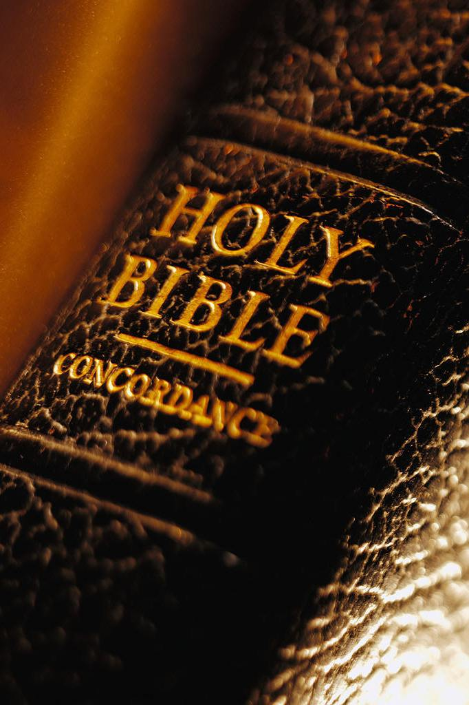
The Christian Winning by Losing
Acts 7:59-60
Ephesians 6:10-12
Richie Thetford www.thetfordcountry.com

Slide 2
Stephen’s Service Acts 6:1-8
A problem arose in the church at Jerusalem
Acts 2:44-45
Acts 4:32-37
Apostles offered a solution to the problem
Acts 6:2-4
1 Timothy 3:8-13
Stephen was one of seven selected
Richie Thetford www.thetfordcountry.com

Slide 3
Stephen’s Sermon Acts 6:9-7:53
Stephen’s controversy with the Jews
Acts 6:9-15
Speech before the Sanhedrin
Acts 7:1-53
Point of Stephen’s speech
John 4:21-24
Stephen’s charge
Richie Thetford www.thetfordcountry.com

Slide 4
Stephen’s Sacrifice Acts 7:54-8:2
Response to Stephen’s speech
Acts 7:54-56
Stoning of Stephen
Acts 7:57-8:2
Result of this mob lynching
Acts 11:19-21
Richie Thetford www.thetfordcountry.com

Slide 5
Conclusion
Saul and Stephen
Christians are promised a “victory” in Christ!
Matthew 10:39
Revelation 2:10
Romans 8:35-39
2 Corinthians 6:4-10
May we learn to distinguish between true success and failure
Richie Thetford www.thetfordcountry.com

