Slide 1
The Deity of Christ (2)
Matthew 1:23
John 1:1
John 1:14
Deuteronomy 29:29

Slide 2
The Deity of Christ
How could Deity put on flesh and remain Deity?
Did the human part of Jesus have a fleshly spirit separate from the divine spirit?
Was Jesus omnipotent, omniscient, and omnipresent while in the flesh?
How was He tempted?
How did He remain sinless?
Can we live sinless lives?
Did Jesus use divine power to resist temptation?
Either He was and is God or He isn’t. It can’t be both ways.

Slide 3
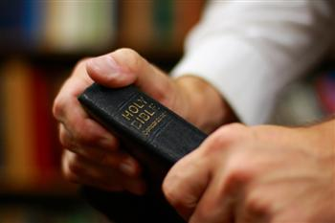
Jesus Is Jehovah
He was “God in the flesh”
1 Timothy 3:16
John the Baptist prepared the way
Isaiah 40:3
Exodus 3:14 (“I Am”)

Slide 4
Jesus Is Jehovah
Jesus claimed to be the existing one
John 8:24, 58
Isaiah 43:10-11
Matthew 26:62-66
John 10:30-33

Slide 5
Jesus Was Deity on Earth
Attributes of His Deity was manifested while on earth
John 14:9
John 10:30
Colossians 2:9
John 5:36
Acts 1:16
John 14:6

Slide 6
Jesus Was Deity on Earth
He was omniscient on earth
Matthew 12:25
Luke 6:8
John 6:64
John 13:1, 11
John 4:39
John 2:24-25
John 17:5

Slide 7
Jesus Was Deity on Earth
He was omnipotent on earth
Matthew 12:22
John 11:43
Matthew 14:25
He allowed Himself to be worshiped
Those not God refused worship
Revelation 22:8-9
Acts 10:25-26; 14:13-15

Slide 8
Jesus Was Deity on Earth
He allowed Himself to be worshiped
He knew that He was deity
John 9:35-38
Matthew 2:11
Matthew 8:2
Matthew 9:18
Other Scriptures
Matthew 14:33 Those in the boat
Matthew 15:25 A woman
Matthew 28:9 Disciples
Luke 24:52 Disciples

Slide 9
Conclusion
Jesus did not lose His godhood
1 John 4:15
Calvinism seeks to elevate the superiority of God at the expense of man’s free will
The suggestion that Christ could divest His nature (the characteristics that make Him who He is) is anti-scriptural

