Slide 1
The Deity of Christ (3)
False teachers are promoting that Jesus was just a man so they can put man on the same level and say that man “can go without ever sinning, as Jesus did.” We know that can’t happen (Romans 3:23)

Slide 2
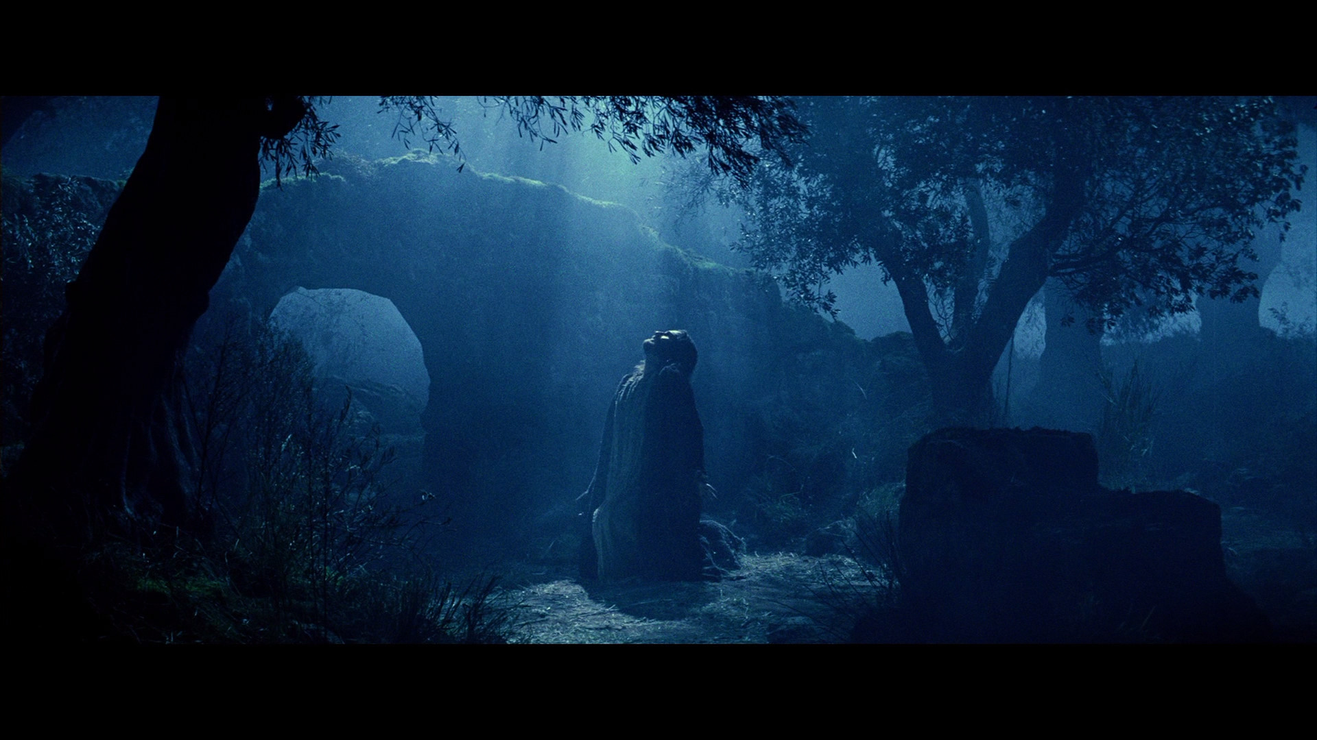
The Deity of Christ
We will discredit any claim that Jesus was “just an ordinary man”

Slide 3
Just an Ordinary Man
Quote from an article put in the form of a booklet concerning what they are advocating:
"Jesus, prior to His birth could adequately be described as equal with God. He divested Himself of the glory, honor, divinity, godhood and became subject to the Father as a man. Whatever qualities and characteristics had been his as divine were foregone. Whatever privileges and powers there might have been were stripped from Him. He was a man."

Slide 4
The Attribute – “Power”
“and when they saw him, they worshiped him: but some doubted. And Jesus came and spake unto them, saying, ALL POWER is given unto me in heaven and in earth.” Matthew 28:17-18
THOUGHT
If Jesus did not have “all power” was He then a liar? If Jesus was a liar, then He sinned. We know that Jesus did not sin, therefore, He did not lie!
Kenotic comes from the Greek for “kenos” --- meaning: “empty” or “empty handed.” Found in Philippians 2:5-8
Kenotic Theory

Slide 5
“God” of the Kenotic Theory
If God does not know everything – not omniscient.
Only the Father knows the time of Jesus’ return
Therefore, Jesus is not omniscient…neither is Holy Spirit
Omniscient
Omnipotent
Omnipresent
Unchangeable
Holy, etc.
Omniscient
Omnipotent
Omnipresent
Unchangeable
Holy, etc.
HOLY SPIRIT
FATHER
Omniscient
Omnipotent
Omnipresent
Unchangeable
Holy, etc.
Three personalities in three states of being … how many deities?
SON

Slide 6
Philippians 2:5-8
Kenotics believe that He gave up everything that made Him God
Privileges, prerogatives, power, etc.
The Bible teaches: That He “humbled” Himself of the spiritual form of Deity and took upon Himself the form of a servant and fashion of a man. He was still the same person!
Matthew 1:23; John 9:38; John 2:25
He did not empty Himself of Deity – He emptied Himself of the display of His Deity for personal gain

Slide 7
Hebrews 4:15
Kenotics conclude that Jesus had to think, feel, and experience everything just like us
Had to get a “human spirit” to be like us
The Bible teaches:
By what He did, He proved to us that He understands and cares about what we go through

Slide 8
The Temptation of Jesus
Kenotics teach that “God cannot be tempted”
James 1:13
Since Jesus was tempted – he was not God
Hebrews 4:15
Should say:
God in the flesh can be tempted

Slide 9
The Temptation of Jesus
Temptation of Matthew 4:1-11
Asked Jesus to do something that no man could ever do!
“for in Him dwells all the fullness of the Godhead bodily”
Colossians 2:9

Slide 10
The Temptation of Jesus
“Jesus possessed Deity, and at any time He desired He could have called upon the power He possessed to overcome the weaknesses of the physical body. Herein were the temptations. Would Christ go about His mission in such a way as to nullify His reasons for coming in the flesh? He was determined to be a servant, to live here like a man among men, so that He could save them. Really, this makes His temptations even more profound because He refused to call upon the power He possessed. He came to do the will of the Father, not of Himself (Hebrews 10:5-9; John 5:30). He was denying Himself and going about His mission in the way He knew would save us.” --- T. Doy Moyer

Slide 11
Conclusion
Jesus was not “just an ordinary guy”
Some will not confess the fullness of Jesus Christ
1 John 4:3
Will be heresies in the church
1 Corinthians 11:19
We must simply have faith in Him
Hebrews 11:1

