Slide 1
Discouragement
The greatest of saints can get discouraged
Richie Thetford www.thetfordcountry.com

Slide 2
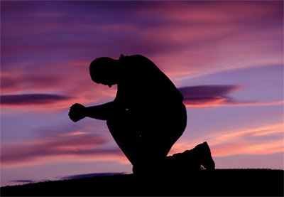
God’s Mighty Warriors
David
1 Samuel 30:6
Psalms 42:11
Jeremiah
Lamentations 3:1-8
Lamentations 3:21-31
John the Baptist
Matthew 11:2-6
Matthew 14:4
Richie Thetford www.thetfordcountry.com

Slide 3
Overcoming Discouragement
Give up the right to understand
Isaiah 55:8-9
Measure success by obedience
1 Samuel 15:22
2 Corinthians 10:12
Read God’s Word and Pray
Hebrews 4:12
Richie Thetford www.thetfordcountry.com

Slide 4
Overcoming Discouragement
Choose to be faithful
Matthew 25:23
Habitually giving thanks
1 Thessalonians 5:16-18
Resist discouragement
1 Peter 5:8-9
Richie Thetford www.thetfordcountry.com

Slide 5
Conclusion
God is with us
We are deeply valued
Resist the Devil
Position our hearts in faithful service to God
Believe and trust
Be obedient
Read the Bible and pray
Be faithful in all things
Give thanks constantly
Resist discouragement
Richie Thetford www.thetfordcountry.com

