Slide 1
Drawing Near to God
“let us draw near with a true heart in full assurance of faith, having our hearts sprinkled from an evil conscience and our bodies washed with pure water.”
Hebrews 10:22
Richie Thetford www.thetfordcountry.com

Slide 2

A True Heart
Is necessary
  Matthew 5:8
  Psalms 24:3-5
  James 4:8; 4:4
  1 Chronicles 12:33
  James 1:21
  Luke 8:15
  Matthew 23:25-28
Richie Thetford www.thetfordcountry.com

Slide 3
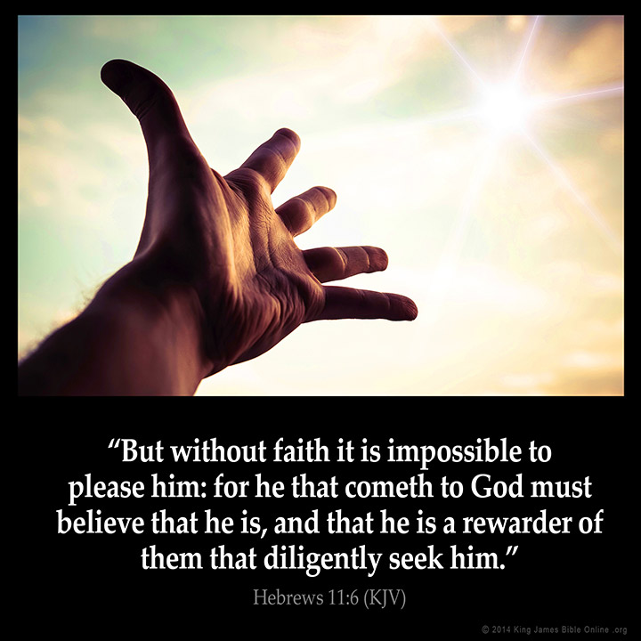
An Assured Faith
Is necessary
  Hebrews 11:6
  Psalms 40:4
  Proverbs 3:5-6; 30:5
  James 2:14-17
  Hebrews 5:9
Richie Thetford www.thetfordcountry.com

Slide 4

Clean Conscience
Is necessary
  Leviticus 1:1-9
  Exodus 24:8; 29:21
  Hebrews 9:11-14
  Isaiah 59:1-2
  Ephesians 2:13
  1 Peter 3:21
  Ephesians 5:26
  Romans 6:3-4
Richie Thetford www.thetfordcountry.com

Slide 5
A true heart, an assurance of faith, and a clean conscience
Hebrews 10:19-22
Richie Thetford www.thetfordcountry.com

