Slide 1
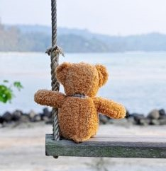
Feeling Alone?
Richie Thetford www.thetfordcountry.com

Slide 2
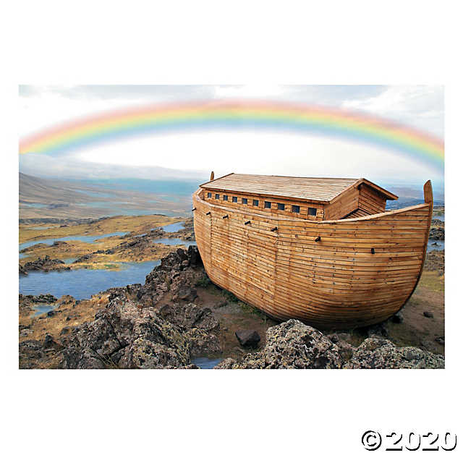
Only EIGHT people got on the Ark
Genesis 6:17-7:1
Richie Thetford www.thetfordcountry.com
Notes:
gettyimages-1061332616-2048x2048

Slide 3
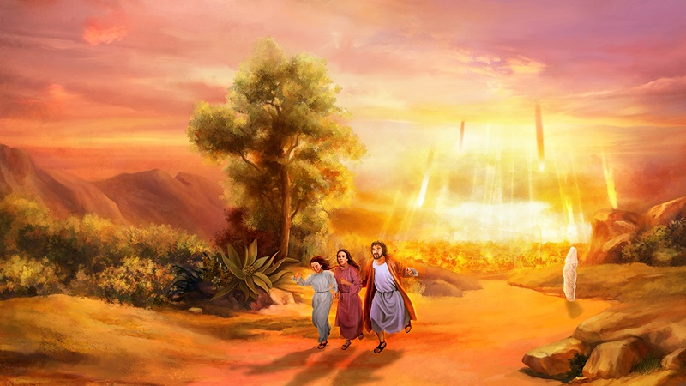
Only FOUR people escaped from Sodom and Gomorrah
Genesis 19:13-26
Luke 9:62
Richie Thetford www.thetfordcountry.com
Notes:
gettyimages-1061332616-2048x2048

Slide 4
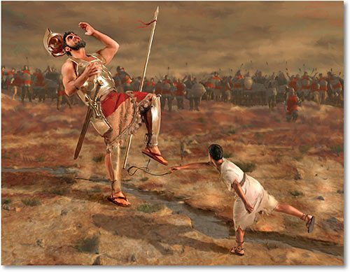
Only DAVID stood against Goliath
1 Samuel 17:25-27
1 Samuel 17:32-51
Richie Thetford www.thetfordcountry.com
Notes:
gettyimages-1061332616-2048x2048

Slide 5
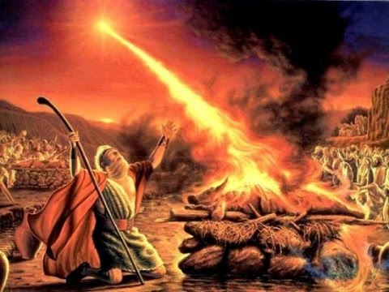
Only ELIJAH stood against the prophets of Baal
1 Kings 18:17-40
Richie Thetford www.thetfordcountry.com
Notes:
gettyimages-1061332616-2048x2048

Slide 6
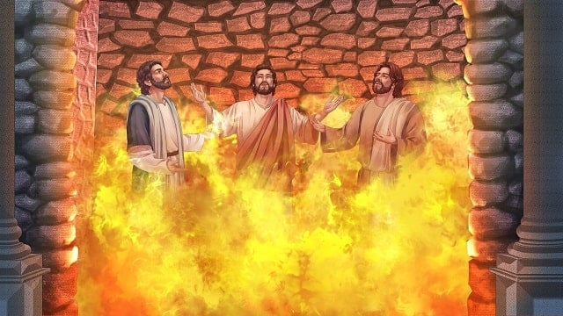
Only THREE refused to bow to the King’s idol
Daniel 3:12-30
Richie Thetford www.thetfordcountry.com
Notes:
gettyimages-1061332616-2048x2048

Slide 7
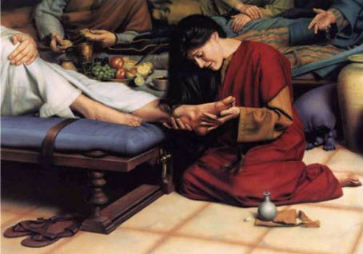
Only ONE woman anointed Jesus’ feet
John 12:1-8
Richie Thetford www.thetfordcountry.com
Notes:
gettyimages-1061332616-2048x2048

Slide 8
Being a true Christian can get lonely, but being a part of the heavenly minority is worth it all in the end!
1 Corinthians 15:58
Richie Thetford www.thetfordcountry.com

