Slide 1
From Earth to Heaven
“Therefore, since all these things will be dissolved, what manner of persons ought you to be in holy conduct and godliness”
2 Peter 3:11

Slide 2
Live a Christ-Like Life
Christ is our example
1 Peter 2:21
Philippians 2:3-5
Acts 10:38
Jesus’ life and teaching
Cared enough to die for us
Loved unconditionally
Did His Father’s will

Slide 3
Strive to Save Our Family
Noah – A preacher of righteousness
2 Peter 2:5
1 Peter 3:20
Joshua
Joshua 24:15
The world and the church
Genesis 18:19
Ephesians 6:4

Slide 4
Be Committed to the church of Christ
Never be ashamed of it
Acts 20:28
1 Corinthians 15:25
When Christ returns:
The church of Christ, the church belonging to Christ, His church, will be delivered to His Father
1 Corinthians 15:24

Slide 5
Strive for Unity
Make it our aim to have unity
Ephesians 4:1-6
Church must function in unity
Acts 5:29

Slide 6
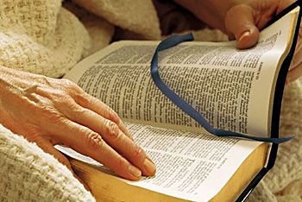
Must Be in the Book of Life
Our journey is being recorded
Exodus 32:32
Philippians 4:3
Only the redeemed are included
Revelation 20:11-15:
The way we live our life from this day forward will determine where we will spend our eternity!
Revelation 2:10

