Slide 1
Growing Older
Growing old in Christ

Slide 2
Age Required in Some Instances
Aged women to teach the younger
Titus 2:3-5
Aged men should become a stabilizing element
Titus 2:2

Slide 3
Age Is Helpful
In overcoming the world
1 John 2:13-14
The Process of Maturing
2 Peter 1:5-11

Slide 4
Age Is Helpful
In overcoming temptations
James 1:13-15
The longer one resists,
The stronger one becomes

Slide 5
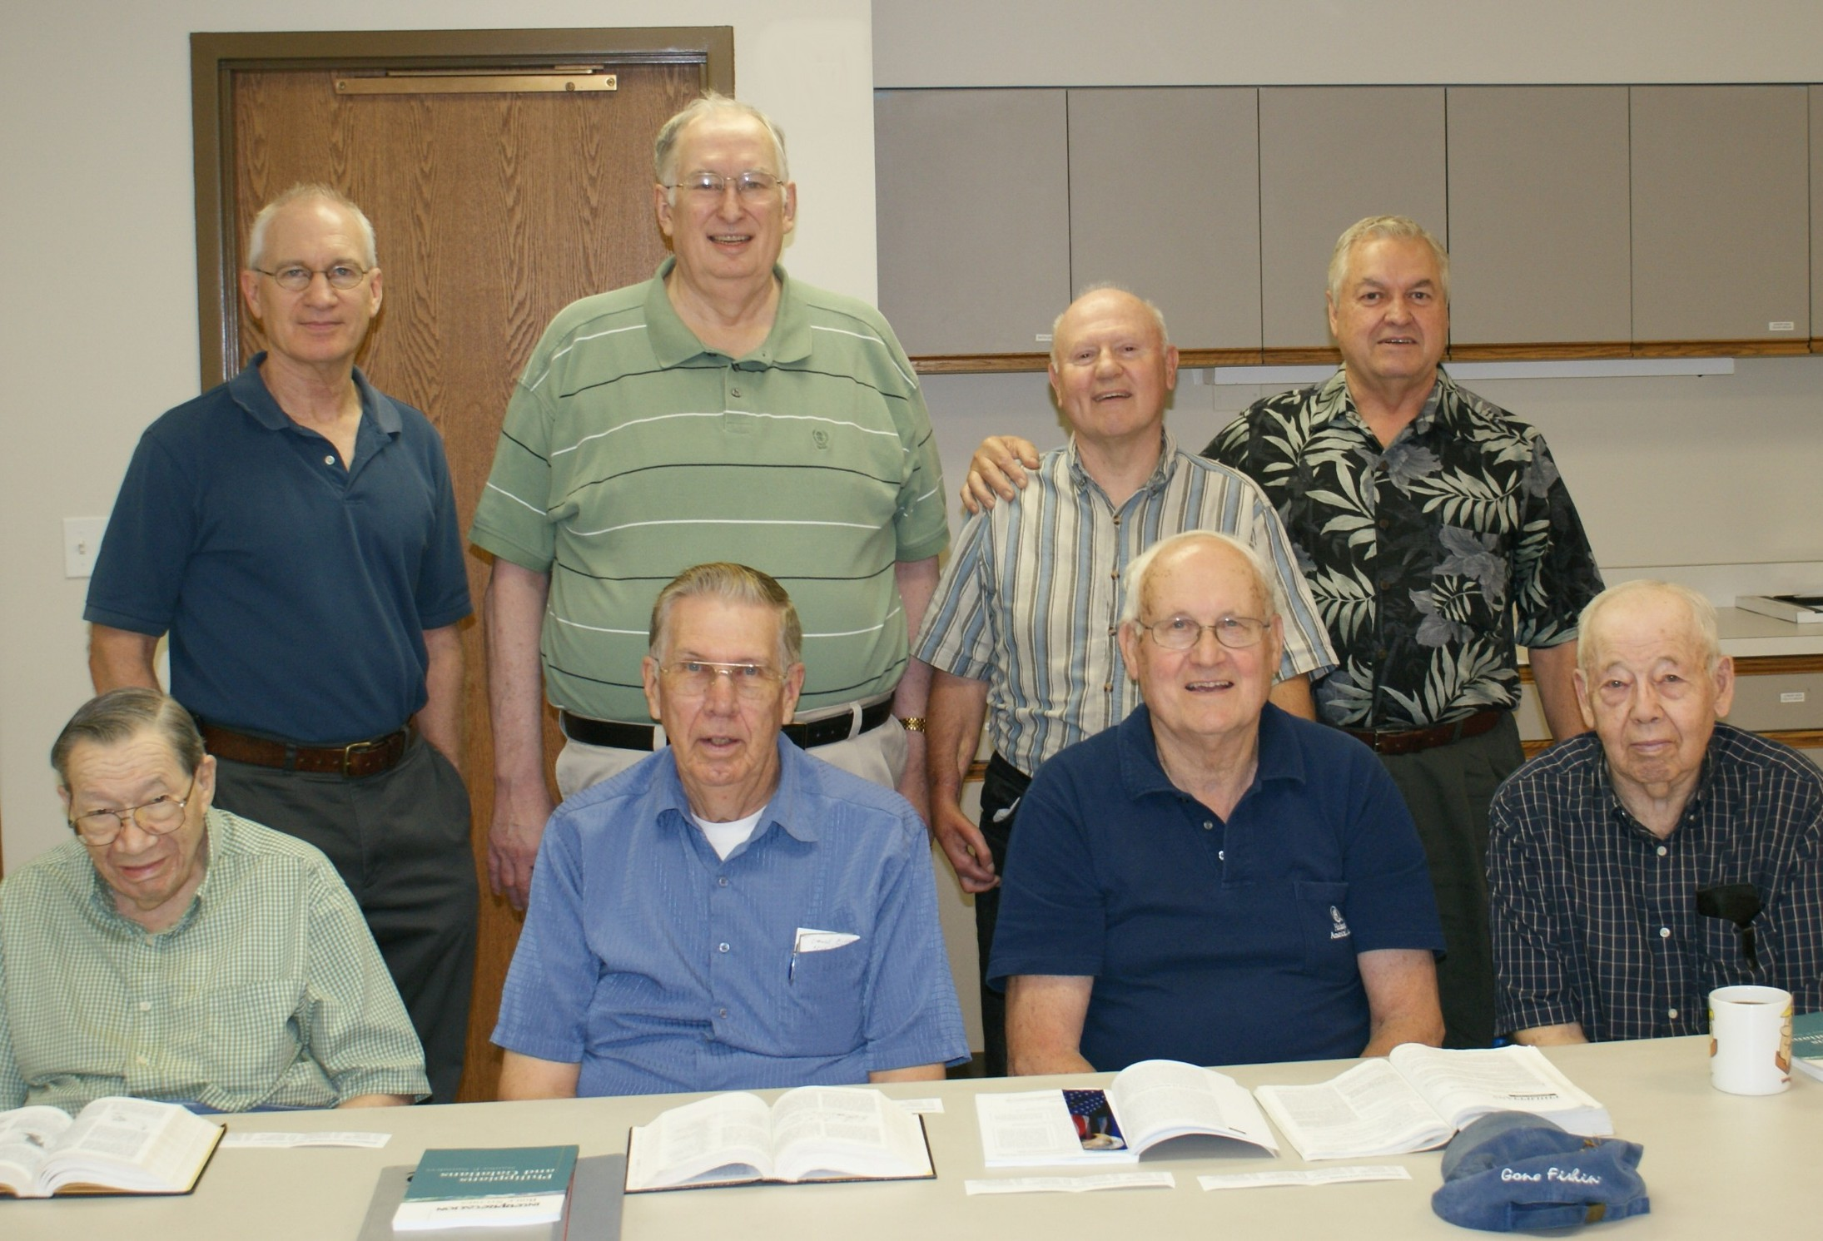
Age Is Helpful
In learning how to live closer to God
Hebrews 5:12-14
Colossians 3:16
Let God’s Word abide in our heart

Slide 6
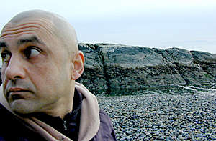
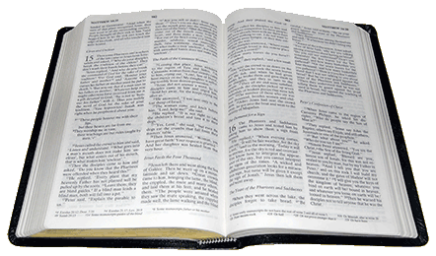
Things to Avoid
Departing from the Lord
Hebrews 3:12
Luke 9:62

Slide 7
Things to Avoid
Faith that grows static and cold
PETER
Luke 22:32 (young man)
Matthew 26:34-35, 74 (denied Jesus)
Acts 4:13 (mature man)
1 Peter 4:11 (inspired to write)

Slide 8
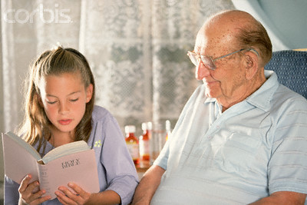
Things to Avoid
Growing old in heart
2 Corinthians 4:16-5:4

Slide 9
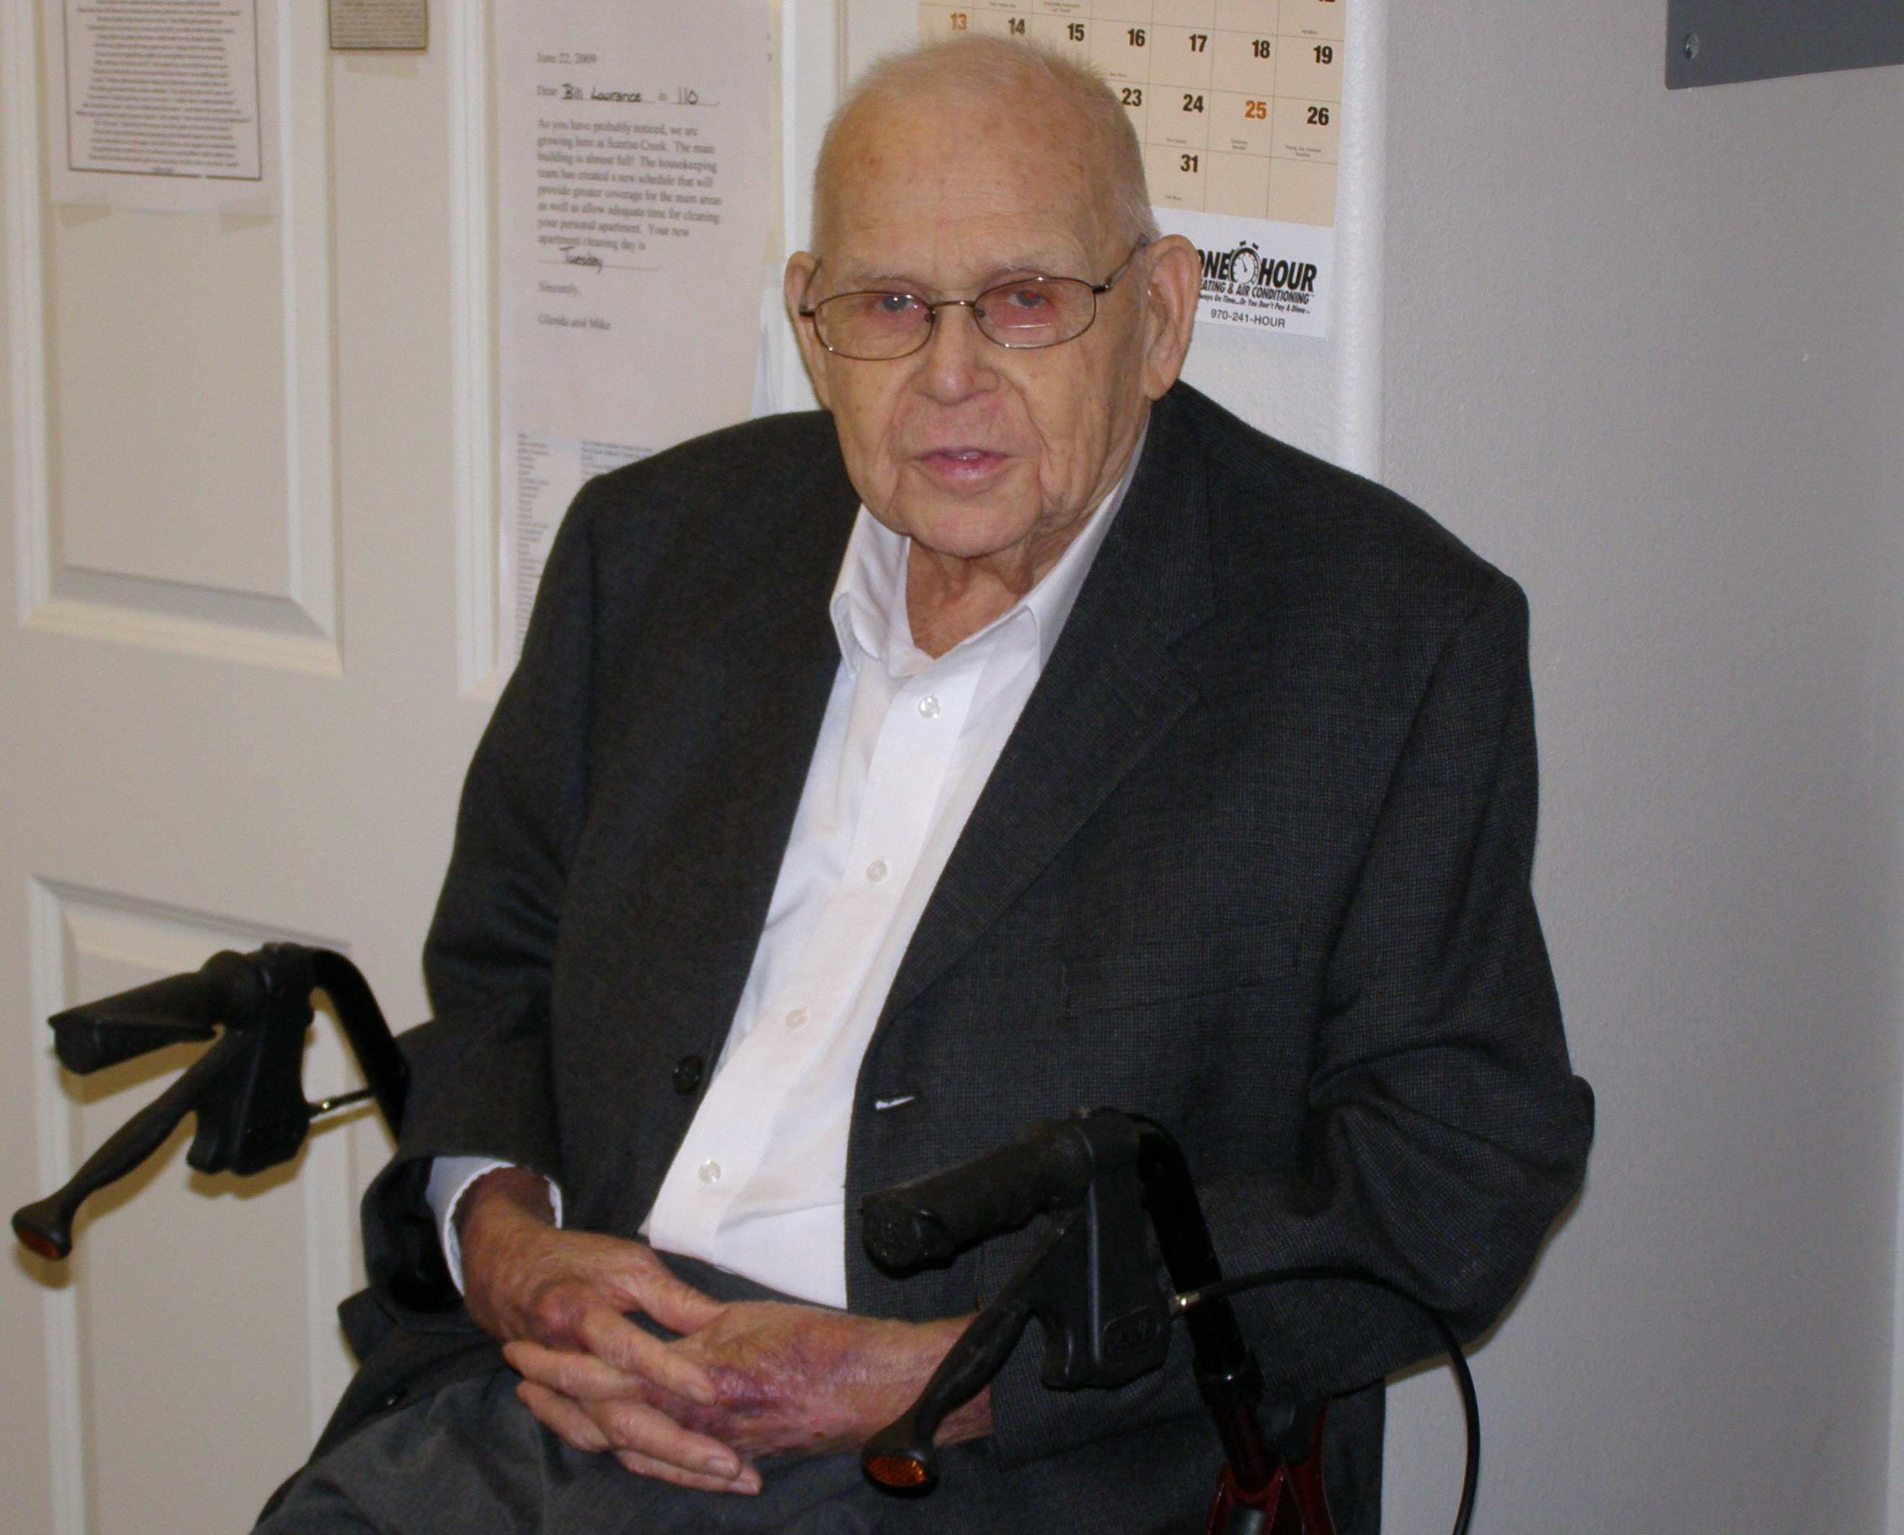
Things to Avoid
Allowing physical disorders to discourage us
“Sweeter as the years go by.”

Slide 10
Conclusion
Different Definition to Youth and Old Age
“YOUTH”

Slide 11
Conclusion
May God help us all to live our days in the service and praise of the Master – NEVER looking back!

