Slide 1
The Hall of Faith
Hebrews 11

Slide 2
What is Faith?

Slide 3
What is Faith?
By faith we believe God created all
Hebrews 11:2-3

Slide 4
God’s Hall of Faith
Abel
Hebrews 11:4
Enoch
Hebrews 11:5
Noah
Hebrews 11:7
Abraham
Hebrews 11:8-10, 17-19

Slide 5
God’s Hall of Faith
Sarah
Hebrews 11:11
Isaac
Hebrews 11:20
Jacob
Hebrews 11:21
Joseph
Hebrews 11:22

Slide 6
God’s Hall of Faith
Moses
Hebrews 11:23-29
Joshua
Hebrews 11:30
Rahab
Hebrews 11:31
Gideon, Barak, Samson, Others
Hebrews 11:32-38

Slide 7
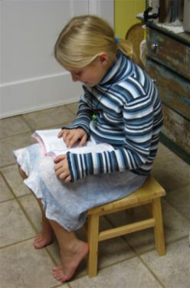
Jesus, the Perfecter of Faith
Did not receive what was promised
Acts 1:4; 2:39
Galatians 3:14
Hebrews 11:13-16, 39-40
Jesus is our great example
Hebrews 12:2-3
Revelation 1:8
Our complete model of faith

Slide 8
Must Have Faith in God’s Word
This is necessary
1 John 5:1-5
Must obey His commands
Romans 4:16-21
John 12:48
Acts 17:30
Acts 2:38
Hebrews 10:25
Philippians 2:12

Slide 9
Must Have Faith in God’s Word
To have faith in His promises
Sins forgiven
Acts 2:38
Work not in vain
1 Corinthians 15:58
Needs will be supplied
Matthew 6:33
Of the resurrection when Jesus returns
John 5:28-29

Slide 10
Conclusion
Must use our faith to keep it alive!
Romans 15:4
No greater reward can be received than to have their name written in the book of life!

