Slide 1
The Joy That Awaits Us!
“Therefore we also, since we are surrounded by so great a cloud of witnesses, let us lay aside every weight, and the sin which so easily ensnares us, and let us run with endurance the race that is set before us, looking unto Jesus, the author and finisher of our faith, who for the joy that was set before Him endured the cross, despising the shame, and has sat down at the right hand of the throne of God.” Hebrews 12:1-2

Slide 2
“By faith Moses, when he became of age, refused to be called the son of Pharaoh's daughter, choosing rather to suffer affliction with the people of God than to enjoy the passing pleasures of sin, esteeming the reproach of Christ greater riches than the treasures in Egypt; for he looked to the reward.”
Hebrews 11:24-26

Slide 3
Our Joy May Be Brought Low
We have not come to terms with ourselves
We have not learned to live with people
Be patient, tolerant and develop an understanding heart
We must leave peculiarities of people alone
Trying to reform others to fit into our opinion
We have not learned that we have a life to share with others

Slide 4
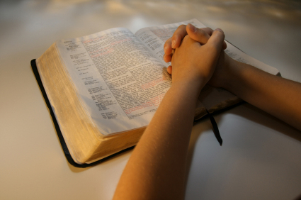
The Joy of Living Within God’s Law
Being resolved to do God’s prescribed law
Be determined to follow His teaching
Love your enemy
Love your neighbors
Love the brethren

Slide 5
Five Joyous Testimonies
Moses looked to the future rewards
Hebrews 11:24-26
A doorkeeper in the house of God
Psalms 84:9-11
The righteous shall flourish
Psalms 92:12-14
Delighting in the law of the Lord
Psalms 1:1-6

Slide 6
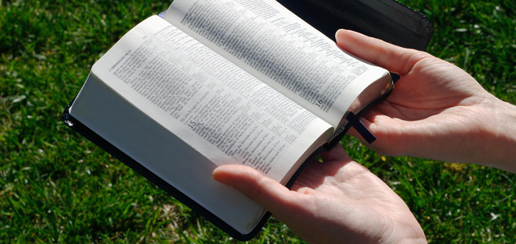
Five Joyous Testimonies
Paul suffered the loss of all things in order to win Christ
Philippians 3:8
Won all by serving God
Waiting for the eternal joy of victory!
2 Timothy 4:6-8
Paul left us an example in order to be victorious in Christ!

Slide 7
Conclusion
The Christian life is not burdensome
The joys are set before us:
Forgiveness of sins!
Deliverance from bondage!
An eternal home with God!
The burden is trying to carry the cross of Christ and the weight of the world also

