Slide 1
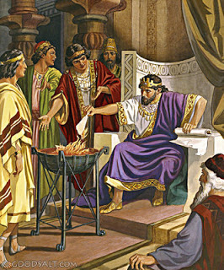
King Jehoiakim
2 Kings 23:36-37
Richard Thetford www.thetfordcountry.com

Slide 2
Characteristics of Jehoiakim’s Reign
Extortion, oppression, dishonesty, injustice
Jeremiah 22:13-17
Our responsibility
James 1:27
Richard Thetford www.thetfordcountry.com

Slide 3
Characteristics of Jehoiakim’s Reign
Threatening and killing prophets
Jeremiah 26:2-5, 12-15
Our responsibility
Galatians 4:16
Richard Thetford www.thetfordcountry.com

Slide 4
Characteristics of Jehoiakim’s Reign
Disregard for God’s Word
Jeremiah 36:2-6, 21-23, 27-32
Our responsibility
John 17:17; Revelation 22:18-19
Isaiah 40:8; Hebrews 4:12
Richard Thetford www.thetfordcountry.com

Slide 5
Jehoiakim’s End Was Tragic
Jeremiah 22:18-19
Let us NOT suffer the same fate!
2 Thessalonians 1:6-10
Richard Thetford www.thetfordcountry.com

