Slide 1
Learning From the Ephesians
Their Conversion to Christ Ephesians 1:7-14
Richie Thetford www.thetfordcountry.com

Slide 2
What the Ephesians Were Before Their Conversion
Disciples of John, Exorcists, Magicians
Acts 19:1-7, 11-19
Ephesians 2:1-3
Were “dead in trespasses and sins”
“Walked according to the course of the world”
“Conducted themselves in the lusts of the flesh”
“Fulfilling the desires of the flesh and of mind”
“Were by nature children of wrath”
Richie Thetford www.thetfordcountry.com

Slide 3
What the Ephesians Were Before Their Conversion
Ephesians 2:11-12
“Were without Christ”
“Aliens from the commonwealth of Israel”
“Strangers of the covenants of promise”
“Having no hope and without God in the world”
Ephesians 2:13
“Were once far off”
Richie Thetford www.thetfordcountry.com

Slide 4
What the Ephesians Were Before Their Conversion
Ephesians 4:14
“Carried about with every wind of doctrine;” “trickery of men”
Ephesians 4:17-20
“Futility of mind;” “Understanding darkened;” “ignorant;” “Works of the flesh”
Richie Thetford www.thetfordcountry.com

Slide 5
What the Ephesians Did to Become Christians
Heard the Word of Truth
Ephesians 1:13
Acts 19:5, 10; 20:26-27
Believed the message of God
Ephesians 1:13
Acts 20:21
Ephesians 2:8
Richie Thetford www.thetfordcountry.com

Slide 6
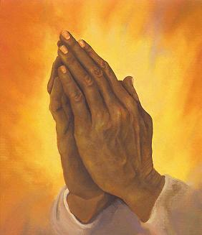
What the Ephesians Did to Become Christians
They Repented
Acts 20:21
Acts 19:18-19
They Confessed Christ
Acts 19:7
Richie Thetford www.thetfordcountry.com

Slide 7
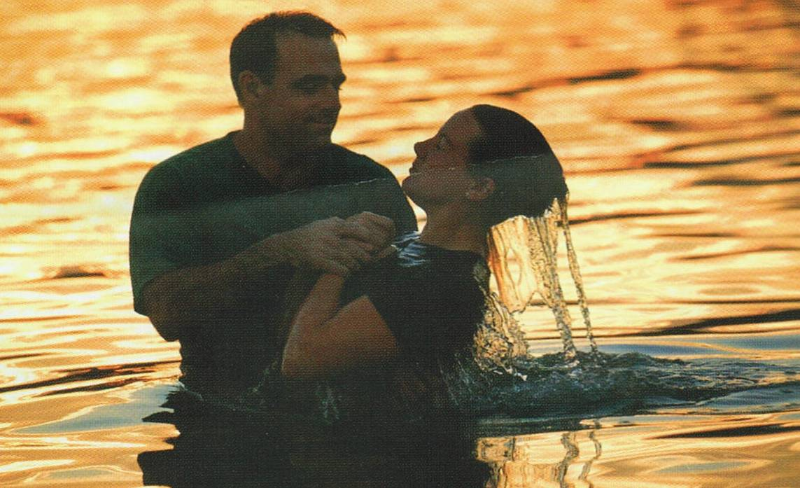
What the Ephesians Did to Become Christians
They were Baptized in the name of Christ
Acts 19:5
Ephesians 4:4-6
Ephesians 5:26
Do as the Ephesians did and become a Christian
Richie Thetford www.thetfordcountry.com

