Slide 1
The Lord’s Church is Right

Slide 2
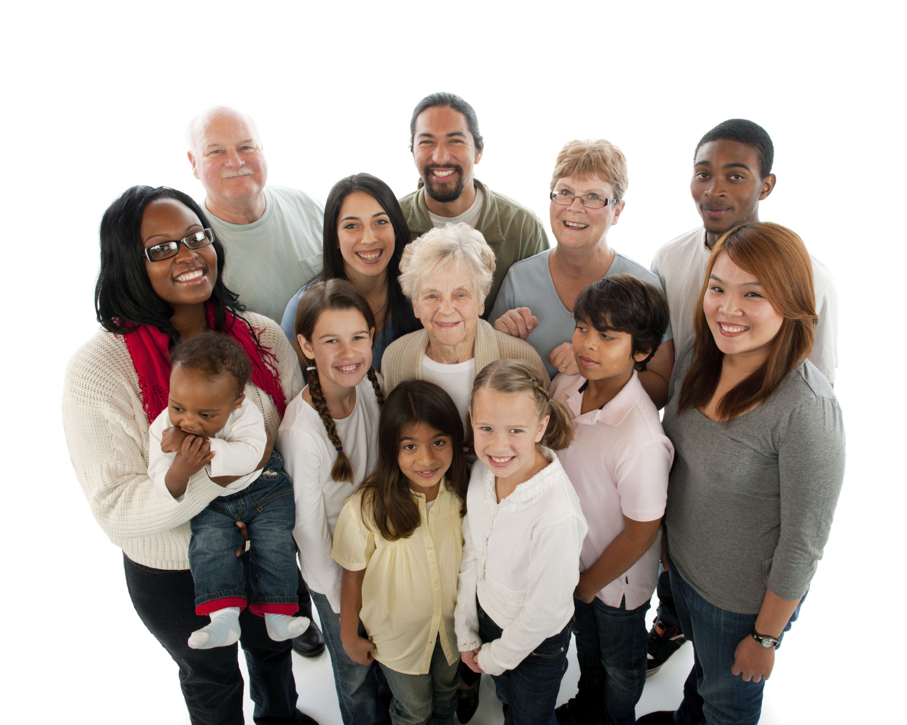
Introduction
The church is the body of Christ
Ephesians 1:21-23
Made up of baptized believers
“church” – Greek word ekklesia
an assembly; called-out
“church” is the people
– not a building

Slide 3
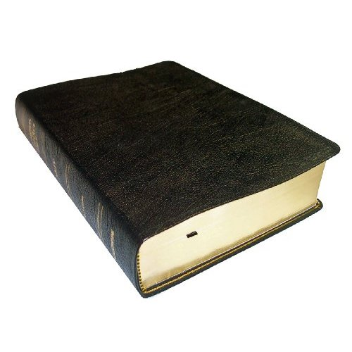
The Foundation is Right
Church built on the foundation of faith
Matthew 16:13-19
Jesus is that foundation
1 Corinthians 3:11
Ephesians 2:20-21
Solid – like a rock
Matthew 7:24-27

Slide 4
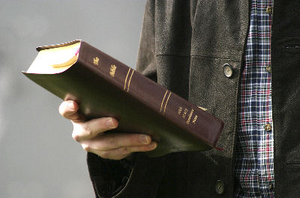
The Faith is Right
The Doctrine of Christ
“Doctrine” is that which we teach
The “truth” is what we contend for
Jude 3
Church has the right doctrine because Jesus IS that doctrine
Acts 8:35

Slide 5
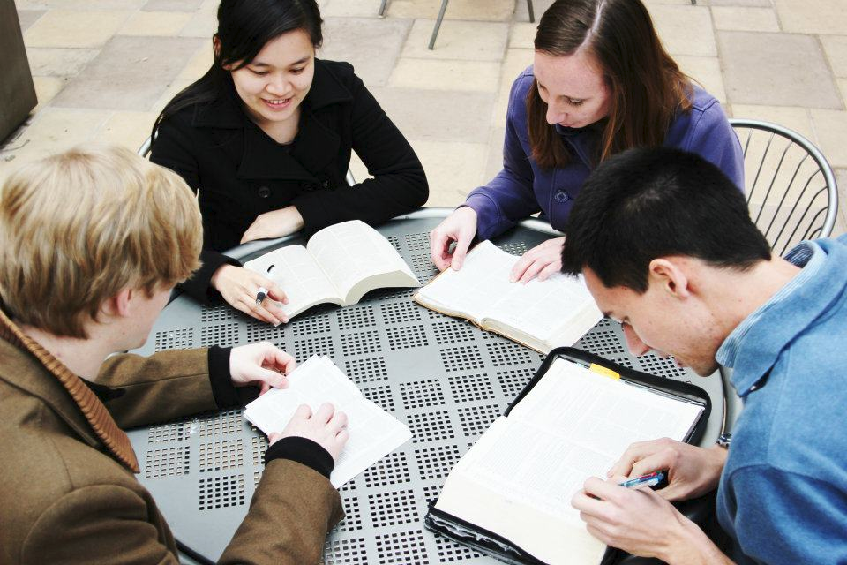
The Fellowship is Right
Fellowship is the life blood of the church
Philippians 1:3-6
Acts 2:42
Early church examples:
Suffer and rejoice
1 Corinthians 12:26
Carry burdens
Galatians 6:2

Slide 6
The Fellowship is Right
Early church examples:
Restore
Galatians 6:1
Pray
Romans 15:30
Encourage
Romans 1:12
Forgive
Ephesians 4:32

Slide 7
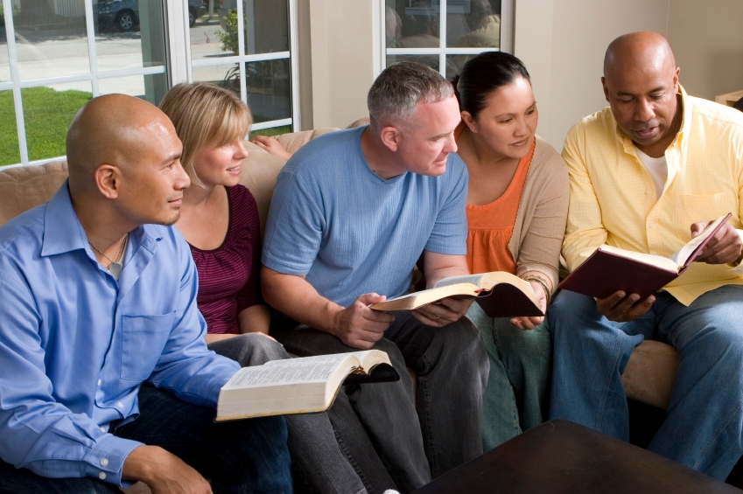
The Fellowship is Right
Early church examples:
Confess
James 5:16
Be truthful
Ephesians 4:25
Spur each other on
Hebrews 10:24
Give
Philippians 4:14-15

Slide 8
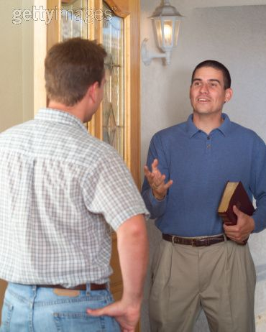
The Focus is Right
Fixated on souls
Mark 16:15
Jesus had compassion on lost souls
Matthew 9:35-36
Motivated Him to do two things:
Pray for laborers
Matthew 9:37-38
Send out teachers
Matthew 10:1, 5-7

Slide 9
The Future is Right
Jesus coming for His church
1 Corinthians 15:24
The words of Paul:
For the Lord Himself will descend from heaven with a shout, with the voice of an archangel, and with the trumpet of God. And the dead in Christ will rise first. Then we who are alive and remain shall be caught up together with them in the clouds to meet the Lord in the air. And thus we shall always be with the Lord. 1 Thessalonians 4:16-17
Each day we should live for the one who died for us!

Slide 10
Conclusion
The Church is Right!
Beauty of the church is the glory of Christ!
Jesus always shines!
Colossians 3:17
1 John 3:2-3

