Slide 1
“Make Yourselves Clean”
Isaiah 1:1-20
1 Timothy 5:22
2 Corinthians 7:1
Revelation 3:4-5

Slide 2
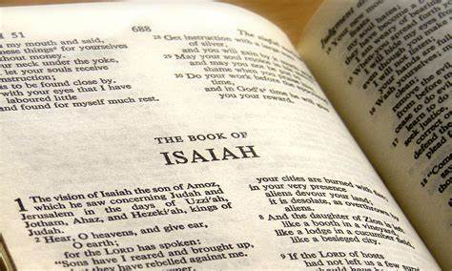
Wash Yourselves Clean by the Word of God
“Hear the Word of the Lord…”
John 15:3
John 17:17
Reveals to us Jesus
Matthew 6:17
Galatians 1:10-12
1 Corinthians 2:11-16
Proverbs 14:12
Basis for knowledgeable saving faith
Romans 10:17
Richie Thetford www.thetfordcountry.com

Slide 3
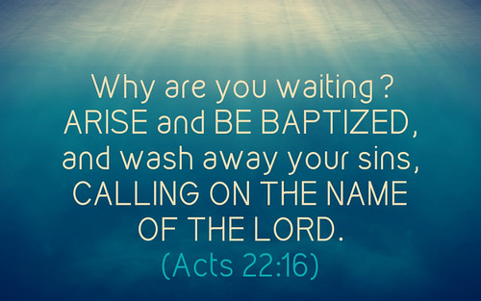
Wash Yourselves Clean by Obedience
“If you are willing and obedient…”
Acts 22:16
1 Corinthians 6:11
Ephesians 5:25-27
Titus 3:3-5
Richie Thetford www.thetfordcountry.com

Slide 4
Wash Yourselves Clean by Walking in the Light
“Come, let us walk in the light of the LORD”
1 John 1:5-7
This involves:
Putting away evil – 1 Thessalonians 5:21-22
Ceasing to do evil – Ephesians 2:1-2
Learning to do good – 2 Timothy 2:15
Standing up for Jesus in your everyday life – Matthew 10:32-39
“Come now, and let us reason together,” Says the LORD, “Though your sins are like scarlet, They shall be as white as snow; Though they are red like crimson, They shall be as wool. If you are willing and obedient, You shall eat the good of the land; But if you refuse and rebel, You shall be devoured by the sword”; For the mouth of the LORD has spoken. Isaiah 1:18-20
Richie Thetford www.thetfordcountry.com

