Slide 1
The Meaning of the Lord’s Supper
Matthew 26:26-29
Richie Thetford www.thetfordcountry.com

Slide 2
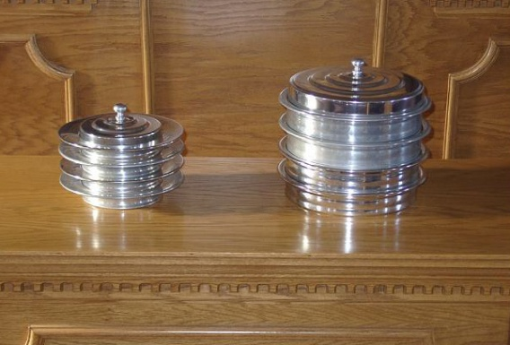
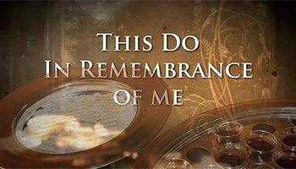
The Institution of the
Lord’s Supper
Observed weekly
  Acts 20:7
Significance is important
  1 Corinthians 11:27
Richie Thetford www.thetfordcountry.com

Slide 3

The Lord’s Supper
Is a Commemoration
Observed in Memory of Christ
  Luke 22:19; 1 Corinthians 15:1-4
Man Can Be Forgetful
  Jeremiah 2:32
  Ecclesiastes 12:1
  2 Peter 3:1
Constant Reminder of the Death of Jesus
Richie Thetford www.thetfordcountry.com

Slide 4
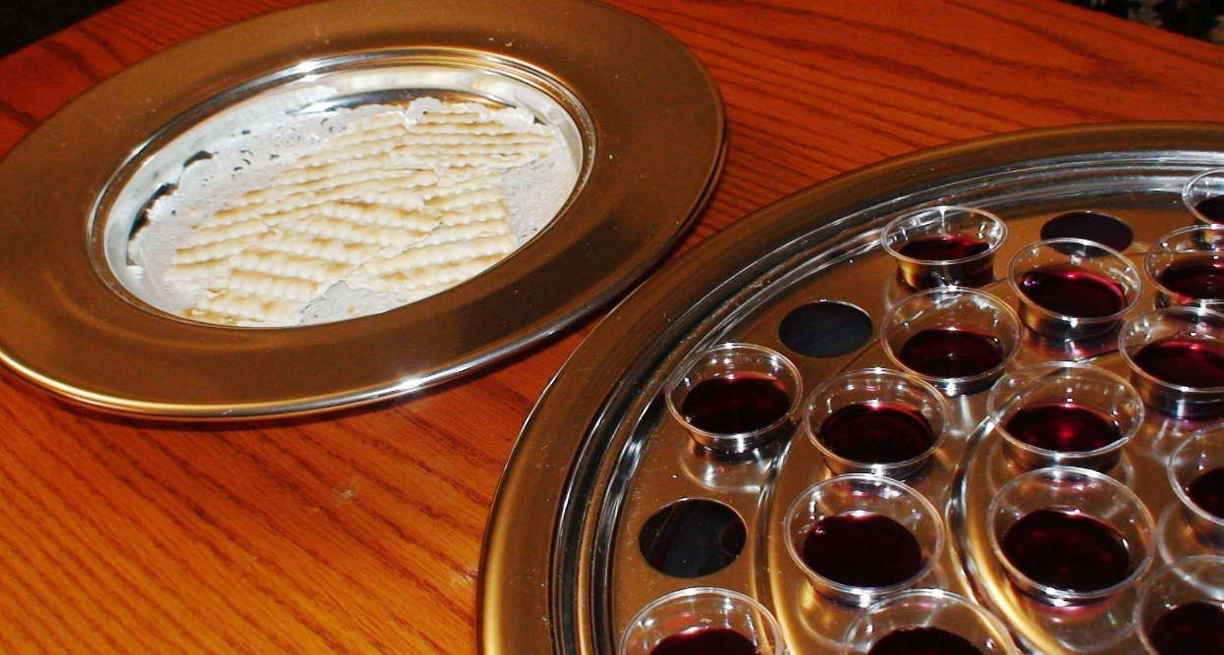
The Lord’s Supper
Is a Communion
Cup and Bread – Communion of Christ
  1 Corinthians 10:16
  Proved to be of benefit for Christians only
    Matthew 26:29
Richie Thetford www.thetfordcountry.com

Slide 5

The Lord’s Supper
Is a Communion
A twofold communion:
  With Christ
    1 Corinthians 10:16
  With one another
    1 Corinthians 10:17
Richie Thetford www.thetfordcountry.com

Slide 6

The Lord’s Supper
Is a Proclamation
Announcement or Declaration
  1 Corinthians 11:26; 2:1
  Mark 16:16
  Hebrews 10:25
God’s love and
salvation
Richie Thetford www.thetfordcountry.com

Slide 7
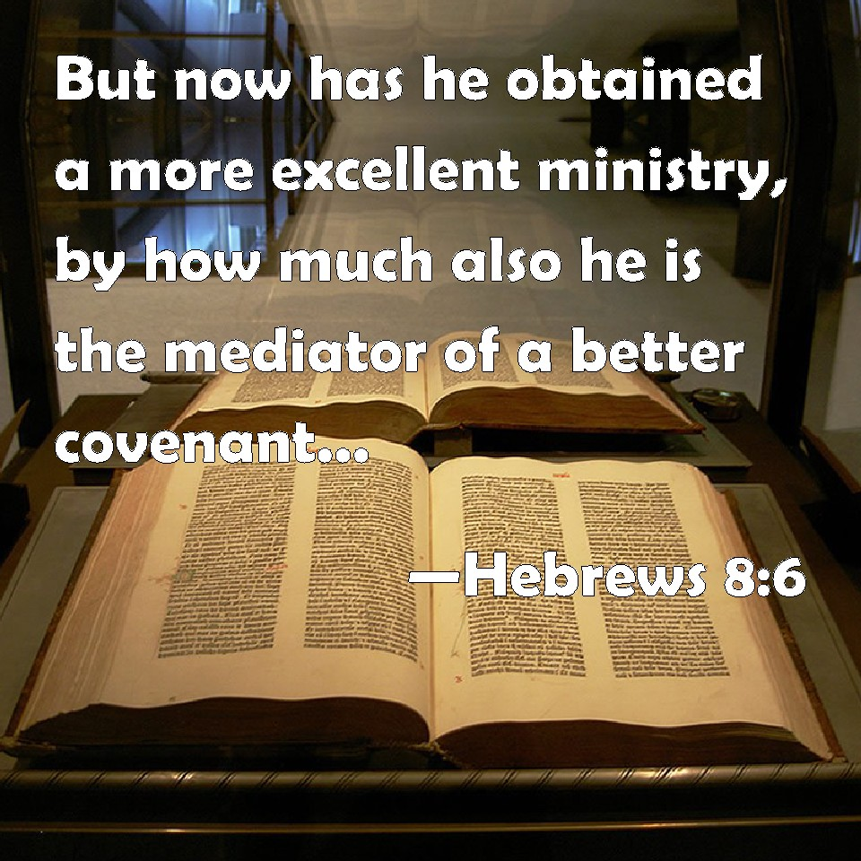
The Lord’s Supper Is a Dedication of a New Covenant
New Covenant “in my blood”
  1 Corinthians 11:25
  Exodus 24:5-8
Blood-Ratified
Covenant
  Hebrews 8:6-8, 12
  Ephesians 1:3
Richie Thetford www.thetfordcountry.com

Slide 8
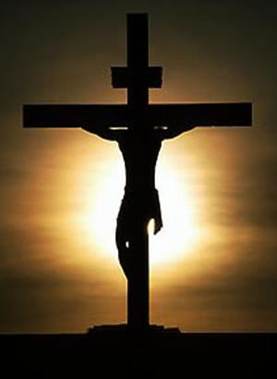
The Lord’s Supper
Is An Anticipation
Given to Christians “until He comes”
  1 Corinthians 11:26; Acts 1:11
We should have this hope rekindled within us every week as we observe the feast divine!
Richie Thetford www.thetfordcountry.com

Slide 9


“We love Him because He first loved us.”
1 John 4:19
“For God so loved the world that He gave His only begotten Son, that whoever believes in Him should not perish but have everlasting life.” (John 3:16)
Richie Thetford www.thetfordcountry.com

