Slide 1
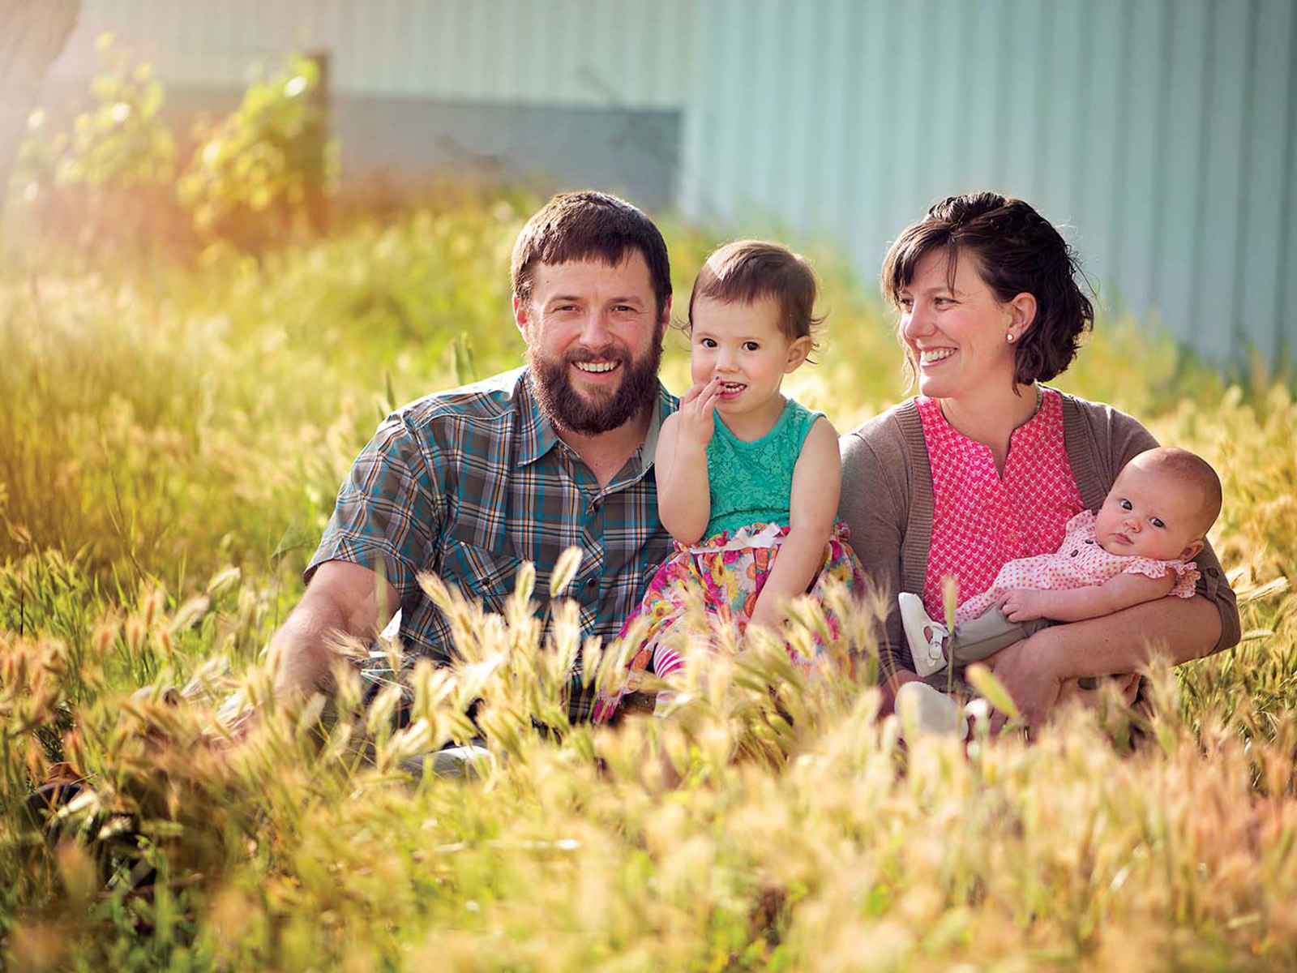
Mothers
The Heart of the Family
Richie Thetford www.thetfordcountry.com

Slide 2
Managers of the Home
God’s order
1 Timothy 5:14-15
Keeping the home
Domestic manager
Proverbs 31:21
Proverbs 31:15-16
Proverbs 31:18, 24
Proverbs 31:23, 25
Richie Thetford www.thetfordcountry.com

Slide 3
Models of Obedience
Examples of submissiveness
James 4:7
Galatians 2:20
1 Peter 3:1, 5
Titus 2:4-5
Seen in Mary
Luke 1:38
Richie Thetford www.thetfordcountry.com

Slide 4
Teachers of Good Things
Reflects God’s plan
Proverbs 1:8, 6:20, 31:1
Matthew 7:5
Timothy’s mother and grandmother
2 Timothy 1:5
2 Timothy 3:15
Richie Thetford www.thetfordcountry.com

Slide 5
Helpers of the Helpless
Agents of grace and mercy
Proverbs 15:20
Proverbs 10:1
Mothers care for us
Richie Thetford www.thetfordcountry.com

Slide 6
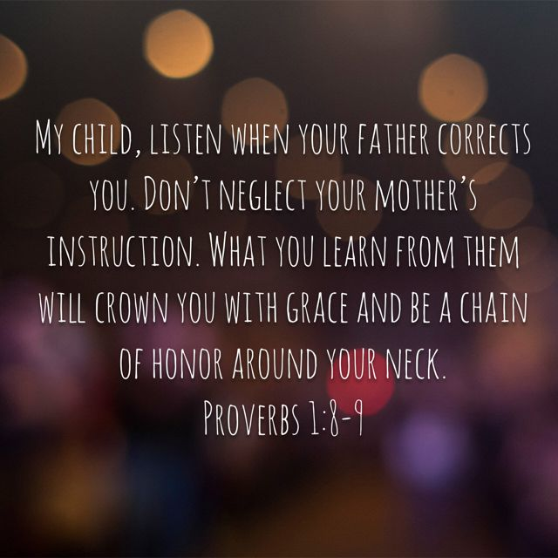
Encouragers of the Fainthearted
The law of mother
Proverbs 1:8-9
Proverbs 14:1
“Builds” her house
A source of encouragement
The example of Hannah
1 Samuel 1:2-10
Richie Thetford www.thetfordcountry.com

Slide 7
Respected and Honored
Rooted in the Old Testament Sprouts in the New Testament
Leviticus 19:3
Proverbs 23:25
Ephesians 6:2
The disrespectful child
Proverbs 19:26; 20:20
2 Timothy 3:2
Richie Thetford www.thetfordcountry.com

Slide 8
Respected and Honored
Be thankful for our mother
Proverbs 31:28
Expressed in deeds
1 John 3:18
Richie Thetford www.thetfordcountry.com

Slide 9
Mothers
Ezekiel 16:44
The Heart of the Family
Richie Thetford www.thetfordcountry.com

