Slide 1
Mothers Pleasing to God
Reflecting on the importance of mothers

Slide 2
Honor Father and Mother
Honor – to obey them while we are young and to provide for them when they’re old
Honor our mothers every day of the year!

Slide 3
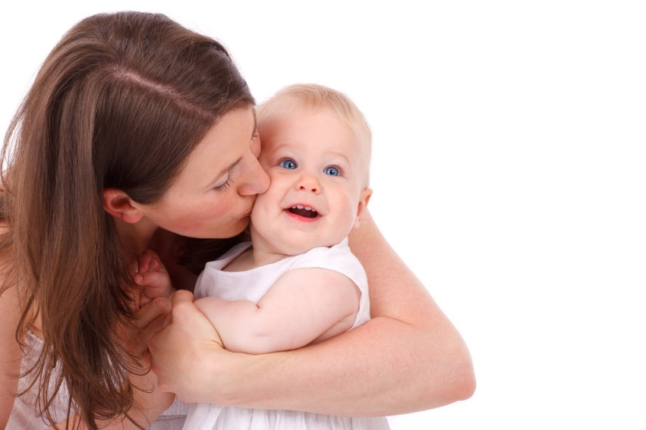
Reflecting on Mothers Celebrating Life
Life began with God
Genesis 2:7
Man was made in the image of God
Genesis 1:26-27
Life is a gift from God

Slide 4
Reflecting on Mothers Celebrating Life
Process of procreation
Genesis 3:20
1 Timothy 2:15
We celebrate life through our mothers
John 10:10
John 3:16

Slide 5
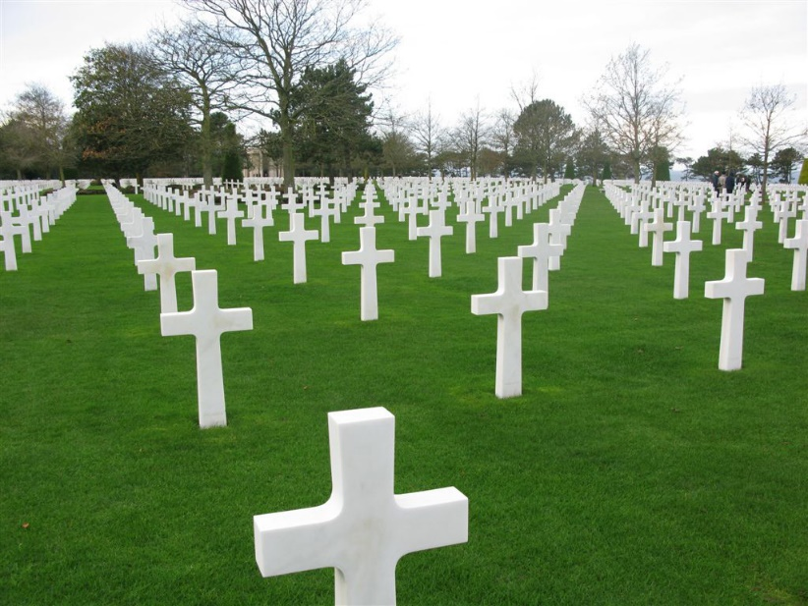
Reflecting on Mothers Remembering Death
All are appointed to die
Hebrews 9:27
God told Adam:
Genesis 3:19
Godly mothers raised us with the end in sight
Psalms 90:10,12; Ecclesiastes 7:2-4

Slide 6
Reflecting on Mothers Reinforcing Holiness
Examples of good mothers
Sarah (Genesis 17:15-16)
Hannah (1 Samuel 1-2)
Elizabeth (Luke 1:6)
Mary
Good mothers are desperately needed

Slide 7
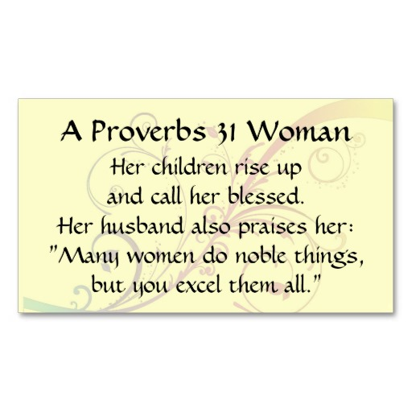
Reflecting on Mothers Reinforcing Holiness
Godly mother described for us in scripture
Proverbs 31:10-31
Is industrious
Is charitable
Takes care of her husband and children
Paul instructs: (Titus 2:4-5)

Slide 8
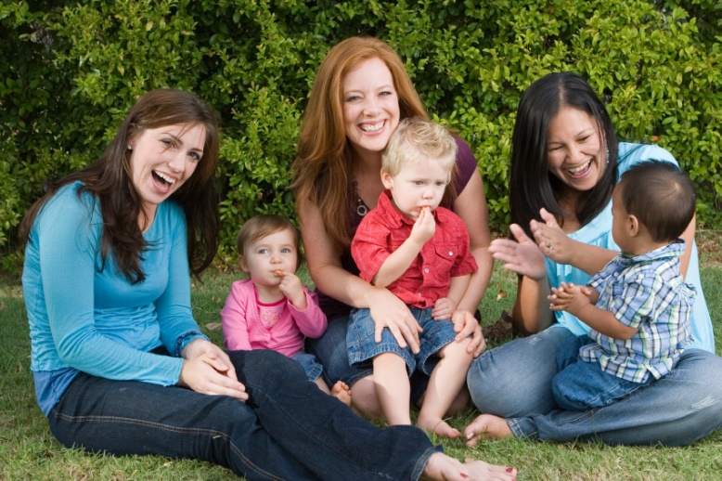
Conclusion
We need mothers to help us:
Celebrate life
Remember death
Reinforce holiness
Let us honor our mothers and live with these principles in mind

