Slide 1
My Mother Loved Me
Recall your mother’s love for you and also God’s love for you
Richard Thetford www.thetfordcountry.com

Slide 2
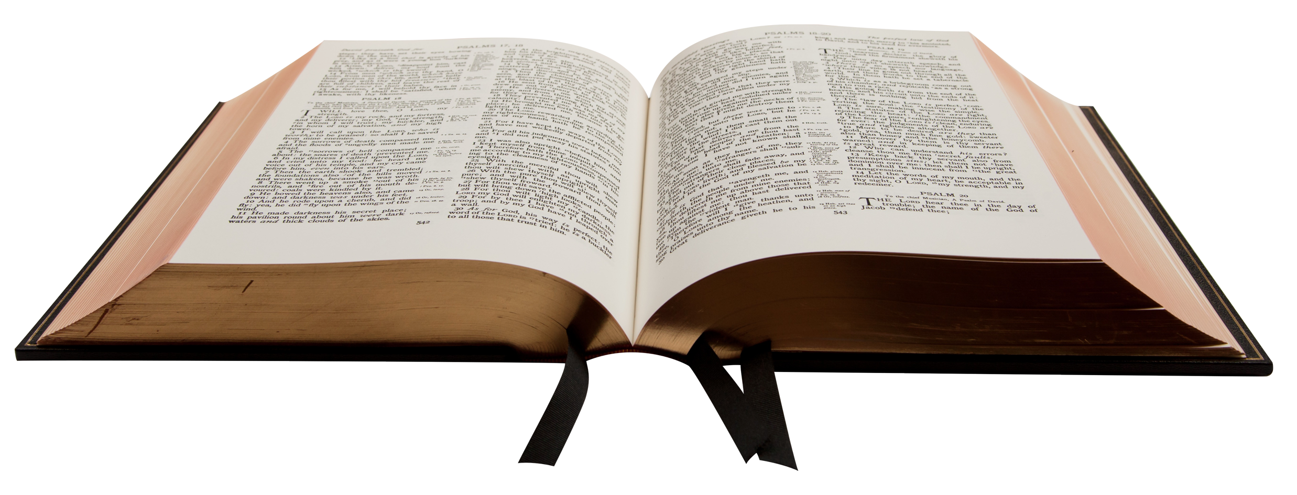
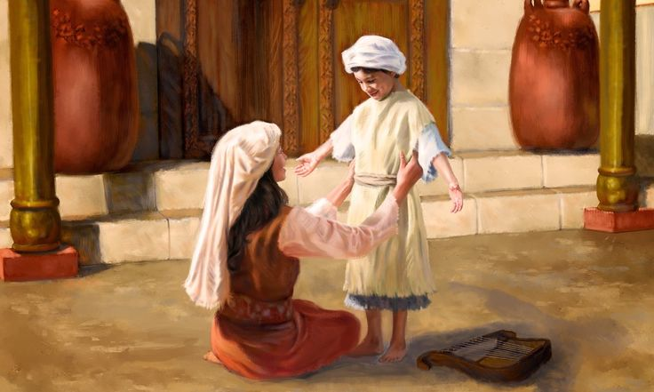
The Example of Hannah
A great example of a good mother
1 Samuel 2:19
Hannah loved Samuel

Slide 3
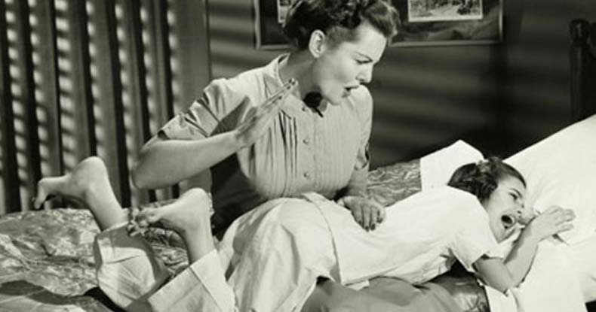
Disciplined Me
Disciplined me when I did wrong
Proverbs 13:24
Proverbs 29:15

Slide 4
Cared for Me
Knew exactly what to do
Psalms 35:13-14
Matthew 4:24

Slide 5
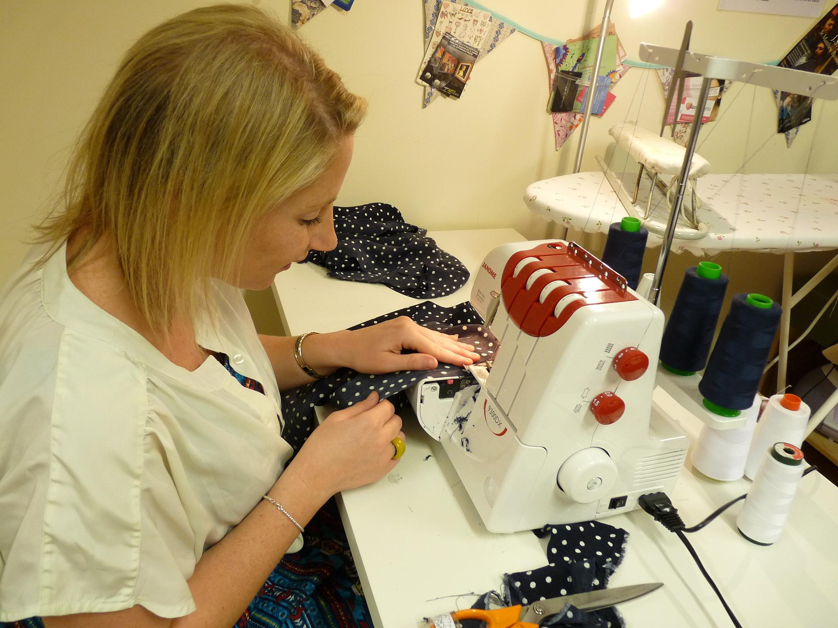
Fed and Clothed Me
Always made sure I had what I needed
Matthew 5:44-48
Romans 5:7-8

Slide 6
Taught Me God’s Word
Godliness and righteousness was a priority
Psalms 22:10
2 Timothy 1:3-5

Slide 7
Conclusion
I know my mother loved me because…..
She disciplined me when I was wrong
She cared for me when I was sick
She fed me and clothed me even when I rebelled
She taught me about God’s word
Her love was demonstrated through action based on God’s teaching

