Slide 1
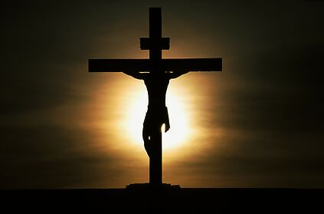
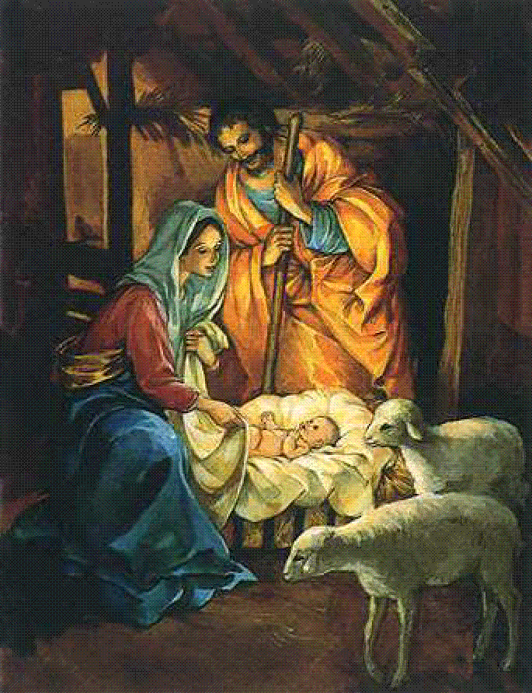
Not the Manger
But the Cross
Our emphasis should not be on the
manger of Jesus, but the cross of Jesus
Then Jesus cried out and said, “He who believes in Me, believes not in Me but in Him who sent Me.”
John 12:44

Slide 2
Not the Manger
But the Cross
Errors of Christmas Traditions
House – Not Stable (Matthew 2:11)
“3” Wise men, Gifts ($$, Shirt, Tie)
Time – Shepherds (Luke 2:8, Nov 1st)
Celebration of Birth (Matthew 28:20; 15:8-9; Colossians 3:17; Galatians 1:8-9; 4:9-10; 2 John 9)

Slide 3
Not the Manger
But the Cross
We Are Not
meaning Jesus’ birth Luke 2:10-20
nying the virgin birth Matthew 1:18-25; Luke 1:34
stroying prophecy Micah 5:2; Isaiah 9:6
moting Mary Luke 1:26-31, 41-49
fending “our” views Isaiah 8:20; 1 Cor. 4:6
DE

Slide 4
Not the Manger
But the Cross
Jesus Emphasized
“Sign” Matthew 12:38-40
“Things of God” Matthew 16:21-23
Purpose of His Coming John 12:27, 32-33
Prophecy is fulfilled Luke 22:37; 24:25-27, 44-46

Slide 5
Not the Manger
But the Cross
Apostles Emphasized
Peter Acts 2:22-36; 3:13-15; 4:2
Where’s the emphasis – Jesus’ birth or death?
Paul Acts 13:26-39; 17:2-3; 18:4-6
Where’s the emphasis – Jesus’ birth or death?
The Epistles 1 Peter 1:3, 18-19; 2:24; 1 Corinthians 15:1-4
Where’s the emphasis – Jesus’ birth or death?

Slide 6
Not the Manger
But the Cross
What the Cross Shows Us
Enormity, Awfulness of Sin!
The Love of God John 3:16; 1 John 4:9-10
Grace of God in Christ 2 Corinthians 8:9
That Jesus was Born Galatians 4:4; Hebrews 2:9
We believe He was born!
Emphasis is on His death, burial, and resurrection!

Slide 7
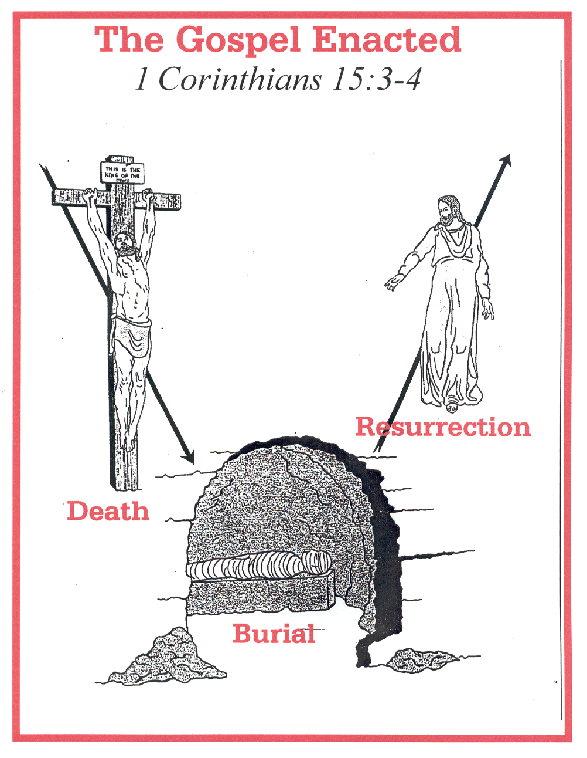
1 Cor. 15:3-4
How do we come to
the Cross

Slide 8
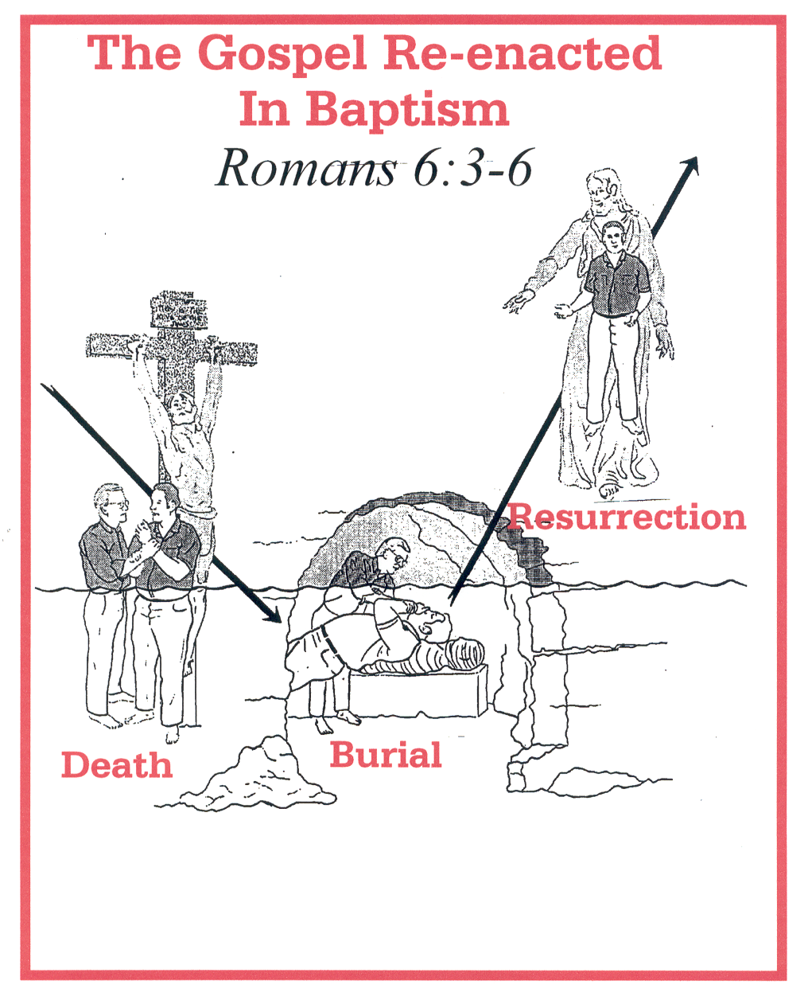
Romans 6:3-17
How do we come to
the Cross

