Slide 1
and Done!
1
There are some things in life that we only get the opportunity to do once
Richie Thetford www.thetfordcountry.com

Slide 2
We Will Only Live Once
James 4:14
whereas you do not know what will happen tomorrow. For what is your life? It is even a vapor that appears for
a little time and then vanishes away
2 Peter 3:9-13
Richie Thetford www.thetfordcountry.com

Slide 3
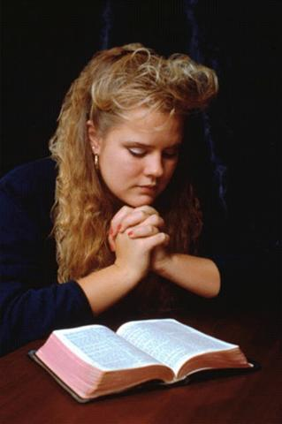
We Will Only Live Once
Must live righteously
By the Word of God
Matthew 4:4
By Faith
2 Corinthians 5:7
Striving to elevate our lives above sin
Romans 6:1-2
Richie Thetford www.thetfordcountry.com

Slide 4
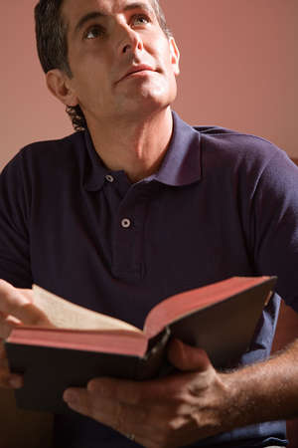
We Will Only Live Once
Must live righteously
By being led by the Spirit
Romans 8:12
Live for Christ in all that we do
2 Corinthians 5:15
Titus 2:11-12
Richie Thetford www.thetfordcountry.com

Slide 5
We Will Only Die Once
How can we be prepared?
By being obedient to the teaching of God
Matthew 7:21
Hebrews 5:8-9
John 14:15
Ecclesiastes 12:13
Richie Thetford www.thetfordcountry.com

Slide 6
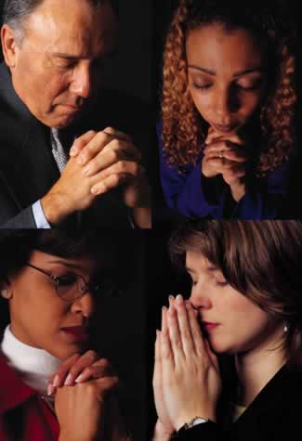
We Will Only Die Once
How can we be prepared?
By living faithfully
Matthew 10:22
Revelation 2:10
Making sure that we die in the Lord
Revelation 14:13
Richie Thetford www.thetfordcountry.com

Slide 7
We Raise Our Children Once
Psalms 127:3-5
Behold, children are a heritage from the Lord, The fruit of the womb is a reward. Like arrows in the hand of a warrior, So are the children of one's youth. Happy is the man who has his quiver full of them; They shall not be ashamed, But shall speak with their enemies in the gate
Proverbs 22:6
Train up a child in the way he should go, And when he is old he will not depart from it
Richie Thetford www.thetfordcountry.com

Slide 8
We Raise Our Children Once
How are we supposed to raise our children?
In the nurture and admonition of the Lord
Ephesians 6:1-4
Teach them properly
Luke 2:52
Richie Thetford www.thetfordcountry.com

Slide 9
We Raise Our Children Once
How are we supposed to raise our children?
To live an exemplary life
Deuteronomy 6:6-9
Discipline them
Hebrews 12:4-11
Proverbs 19:18
Proverbs 22:15
Establish a standard
Enforce the standard
Punish every deviation
Richie Thetford www.thetfordcountry.com

Slide 10
We Will Only Be Judged Once
Be prepared for the judgment
There WILL be a judgment day!
Acts 17:30-31
Matthew 25:33-34, 41
Romans 2:16
All will be judged
2 Corinthians 5:10
Revelation 20:12-15
Richie Thetford www.thetfordcountry.com

Slide 11
We Will Only Be Judged Once
Be prepared for the judgment
Will be according to the Word of God
John 12:47-48
Romans 2:6:-11
“WELL DONE” or “DEPART”
All will receive an eternal sentence
“HEAVEN” or “HELL”
Richie Thetford www.thetfordcountry.com

Slide 12
CONCLUSION
Hebrews 2:1-4
Therefore we must give the more earnest heed to the things we have heard, lest we drift away. For if the word spoken through angels proved steadfast, and every transgression and disobedience received a just reward, how shall we escape if we neglect so great a salvation, which at the first began to be spoken by the Lord, and was confirmed to us by those who heard Him, God also bearing witness both with signs and wonders, with various miracles, and gifts of the Holy Spirit, according to His own will?
Richie Thetford www.thetfordcountry.com

Slide 13
CONCLUSION
2 Peter 1:12-15
For this reason I will not be negligent to remind you always of these things, though you know and are established in the present truth. Yes, I think it is right, as long as I am in this tent, to stir you up by reminding you, knowing that shortly I must put off my tent, just as our Lord Jesus Christ showed me. Moreover I will be careful to ensure that you always have a reminder of these things after my decease.
Richie Thetford www.thetfordcountry.com

Slide 14
CONCLUSION
1
Life on earth
Physical Death
Parental Chance
Judgment
Are we ready for death and the judgment?
Richie Thetford www.thetfordcountry.com

