Slide 1

Our Life in Christ
1 Peter 3:17-18
1 Peter 2:21
1 Peter 3:18-4:6
Richie Thetford www.thetfordcountry.com

Slide 2
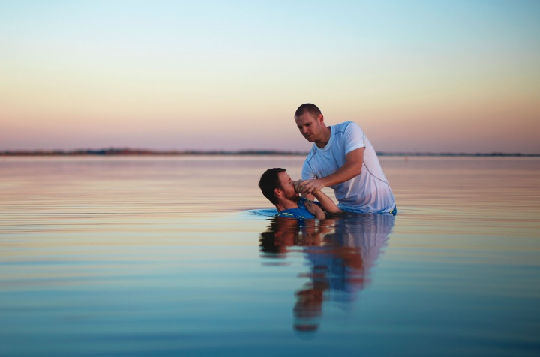
We Have Entered a New World
After baptism
  1 Peter 3:20-21
  New birth
    John 3:3-5
  New creature
    2 Corinthians 5:17
  Salvation (if faithful)
    Ephesians 2:1
Richie Thetford www.thetfordcountry.com

Slide 3
We Have Entered a New World
After baptism
  1 Peter 3:20-21
  New Relationship
    Galatians 3:27
    Romans 6:4-7, 21-23
  No longer live in sin
    Ephesians 4:17-20
Richie Thetford www.thetfordcountry.com

Slide 4
We Have a New Mind
Christ had a mind to suffer
  1 Peter 4:1
  1 Peter 2:21-24
Must have the same mind
    1 Peter 3:14
    Matthew 5:10-12
    Ephesians 4:21-24
Richie Thetford www.thetfordcountry.com

Slide 5
We Have a New Mind
Have ceased from sin
  Romans 6:1-2, 11, 14
Must have the mind of Christ
Richie Thetford www.thetfordcountry.com

Slide 6
We Have a New Way of Life
No longer live for the lusts of men
  1 Peter 4:2-4
  1 John 2:15-17
  Galatians 2:20
Now live for the
will of God
  1 Peter 4:2
Will suffer for what is right
  1 Peter 3:17; 1 Peter 4:4
Richie Thetford www.thetfordcountry.com

Slide 7
Our Life in Christ
Never forget:
Entered a new world
Have a new mind
Have a new way of life
Richie Thetford www.thetfordcountry.com

